Slide 1
Course: Inclusive Green Economy (IGE) modelling
Module 1 – Different pathways towards inclusive green economies
Date / Place / Name

Slide 2
OVERVIEW
1 Rationale for advancing inclusive green economies
2 Policy instruments
3 Simulation models and how they support decision making
4 Group exercise

Slide 3
1
Rationale for advancing inclusive green economies
@shutterstock

Slide 4
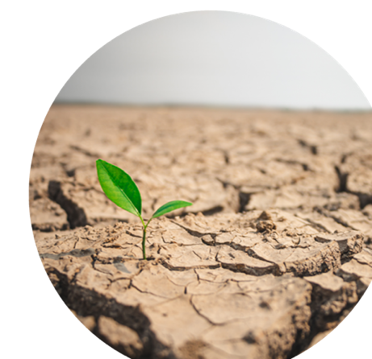
THE NEED FOR A NEW ECONOMIC MODEL
The scale of the challenges over the coming decades is clear:
Population keeps growing, and so do ecological scarcity and environmental degradation.
An inclusive green economy is an alternative to today's dominant economic model, which led to:
Inequalities, waste creation and resource scarcities, and generates widespread threats to the environment and human health.
@shutterstock
Notes:
The scale of the challenges over the coming decades is clear.
1) We will need to meet the needs of a growing population of between nine and 10 billion people by 2050 while keeping resource consumption and environmental impacts within the Earth’s natural limits, also called “carrying capacity”.
2) An example of the above: food demand is expected to grow by 50 per cent by 2030, energy consumption will increase by 45 per cent and the need for water by 30 per cent, all the while supply is being increasingly limited by environmental boundaries (Global Sustainability Panel, 2012).
3) The solution is an inclusive green economy, an alternative to today's dominant economic model, which exacerbates inequalities, encourages waste, triggers resource scarcities, and generates widespread threats to the environment and human health. Over the past decade, the concept of the green economy has emerged as a strategic priority for many governments.

Slide 5
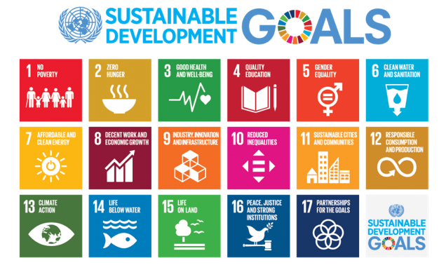
WHAT IS THE OBJECTIVE? THE SDGS
“
We, the Heads of State and Government and High Representatives, meeting at the United Nations Headquarters in New York from 25-27 September 2015 as the Organization celebrates its seventieth anniversary, have decided today on new global Sustainable Development Goals.
“
17 objectives, 169 targets to be achieved by 2030.
Notes:
The Sustainable Development Goals (SDGs) help define what sustainable development is and how it can be measured. There are 17 SDGs, emphasizing the social, economic and environmental dimensions of development. With 17 goals and 169 targets, the SDGs highlight the need for customization/personalization of sustainable development, such as through the use of selected indicators and targets. Of critical importance for development, and for the use of the SDGs, is the understanding of how these 17 SDGs are interrelated and interconnected with one another (i.e. none of the goals can be considered and used in isolation).
The IGE is not seen as an objective, rather as a vehicle. The IGE approach focuses on sound economic policymaking that promotes economic growth through investments in environmental protection and social inclusion.

Slide 6
POLL
You have all heard about climate change. By how many degrees do you think global mean surface temperature has risen since the industrial revolution (1880)?
0.2°C
0.8°C
2.5°C
Notes:
The correct answer is B.
According to an ongoing temperature analysis conducted by scientists at NASA's Goddard Institute for Space Studies (GISS), the average global temperature on Earth has increased by about 0.8° Celsius (1.4° Fahrenheit) since 1880.
https://earthobservatory.nasa.gov/world-of-change/DecadalTemp

Slide 7
POLL
And what are the projections for 2100 under a business as usual scenario?
4.1 - 4.8 °C
2.8 - 3.2°C
1.3 - 1.4°C
Notes:
The correct answer is A.
https://climateactiontracker.org/global/temperatures/

Slide 8
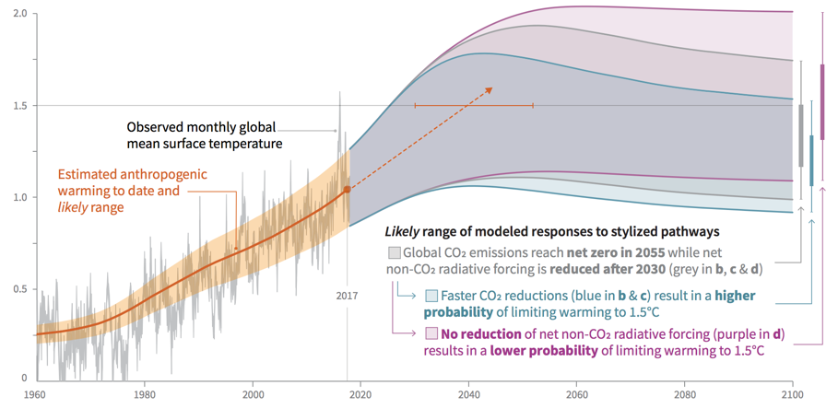
WHAT ARE WE UP AGAINST? GLOBAL WARMING
Global Warming relative to 1850 -1900 (^{º}C)
Source: IPCC, 2018
Notes:
Climate change poses critical challenges. It highlights planetary boundaries. Global warming is on the rise and all forecasts show further temperature increases in the medium-term. Only decisive action to keep warming at 1.5°C will stabilize the trend.
Source: IPCC, 2018: Summary for Policymakers. Global warming of 1.5°C. An IPCC Special Report on the impacts of global warming of 1.5°C above pre-industrial levels and related global greenhouse gas emission pathways, in the context of strengthening the global response to the threat of climate change, sustainable development, and efforts to eradicate poverty. V. Masson-Delmotte, P. Zhai, H. O. Pörtner, D. Roberts, J. Skea, P. R. Shukla, A. Pirani, W. Moufouma-Okia, C. Péan, R. Pidcock, S. Connors, J. B. R. Matthews, Y. Chen, X. Zhou, M. I. Gomis, E. Lonnoy, T. Maycock, M. Tignor, T. Waterfield (eds.). World Meteorological Organization, Geneva, Switzerland, 32 pp.

Slide 9
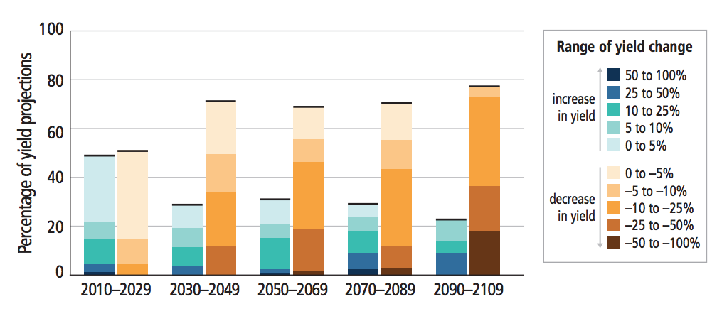
WHAT ARE WE UP AGAINST? LAND YIELD IS GENERALLY EXPECTED TO DECLINE
Summary of projected changes in crop yields due to climate change over the 21st century.
Source: IPCC, 2014
Notes:
Changes in crops yields are relative to the late 20th century. Data for each time frame adds up to 100%. The figure clearly shows that the projection of yield decline becomes larger as years pass by.
Source: Intergovernmental Panel on Climate Change (IPCC), 2014: Fifth Assessment Report.

Slide 10
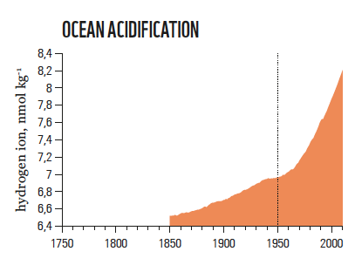
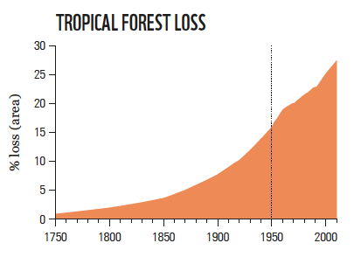
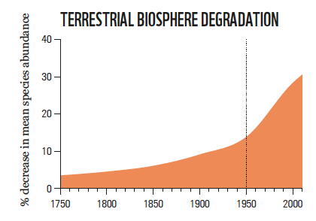
SEVERAL ADDITIONAL UNDESIRABLE TRENDS ARE ON THE RISE
Earth System Trends
Source: WWF, 2018
Notes:
All the trends we are observing are exponential, both consumption and pollution. There is little or no decoupling in sight, indicating that the problem will grow bigger. As a result, more fundamental solutions are required rather than small incremental improvements.
Source: WWF, 2018: Living Planet Report - 2018: Aiming Higher. Grooten, M. and Almond, R.E.A.(Eds). WWF, Gland, Switzerland.

Slide 11
HOW TO TURN CHALLENGES INTO OPPORTUNITIES?
A three-capital model of wealth creation
Responding to these challenges requires:
A fundamental economic redesign
Reorientation of financial flows
All with greater emphasis on addressing environmental and societal costs
Welfare/Utility
Consumption/
Investment
Direct Benefits
Production
Capital feedback effects
Natural Capital
Produced Capital
Human Capital
Productive Base
Source: UNEP, 2018
Notes:
Responding to the challenges we are facing in relation to sustainable development requires a fundamental economic redesign and reorientation of financial flows towards a model that places greater emphasis on addressing environmental and societal costs, focusing on investments in natural capital, clean technologies, and the creation of green jobs. The figure shows that our understanding of production has to shift, and should include explicitly natural capital, along with produced and human capital.
Source: UNEP, 2018: Inclusive Wealth Report 2018.

Slide 12
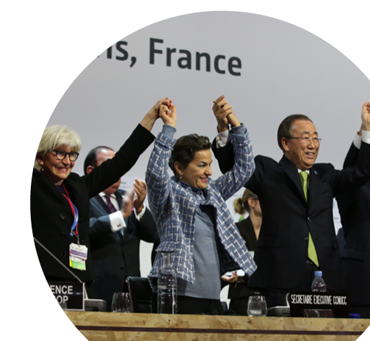
SUCCESS STORIES FOR THE IGE – THE PARIS AGREEMENT
The Paris Agreement aims to strengthen the global response to climate change by keeping a global temperature rise this century to well below 2 degrees Celsius.
Earth Negotiations Bulletin
Notes:
The Paris Agreement brings all nations into a common cause to undertake ambitious efforts to combat climate change and adapt to its effects. It requires all Parties to put forward their best efforts through nationally determined contributions (NDCs).
The Paris Agreement entered into force on 4 November 2016.
Source: https://unfccc.int/process-and-meetings/the-paris-agreement/the-paris-agreement
Image source: https://enb.iisd.org/climate/cop21/enb/images/12dec/3K1A5493.jpg

Slide 13
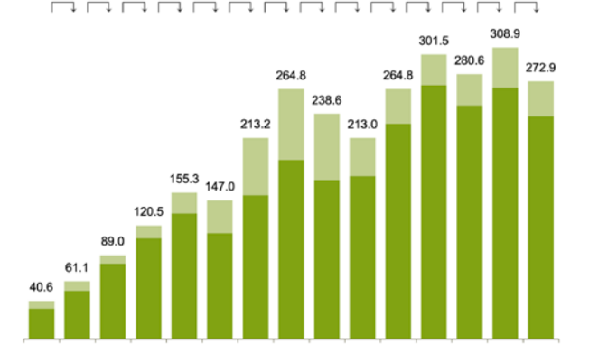
SUCCESS STORIES FOR THE IGE – GREEN ENERGY INVESTMENTS
Global Renewable Energy Capacity Investment, 2004 to 2018, $bn
51% 46% 35% 29% -5% 45% 24% -10% -11% 24% 14% -7% 10% -12%
301.5
308.9
280.6
272.9
264.8
264.8
238.6
213.2
213.0
155.3
147.0
120.5
89.0
61.1
40.6
Source: Frankfurt School-UNEP Centre/BNEF, 2019
2004 2005 2006 2007 2008 2009 2010 2011 2012 2013 2014 2015 2016 2017 2018
Asset finance
Small distributed capacity
Notes:
The IGE is a reality. Green Energy investments have been on the rise since 2004 and continue to grow, especially in developing countries.
Source: Frankfurt School-UNEP Centre/BNEF, 2019: Global Trends in Renewable Energy Investment 2019.

Slide 14
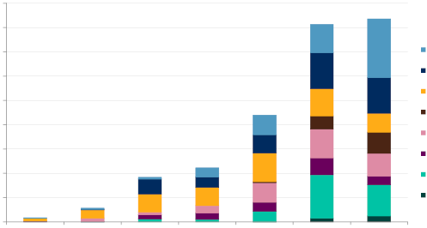
SUCCESS STORIES FOR THE IGE – GREEN BONDS
Annual green-labelled issuance by issuer type ($bn)
180
160
140
120
100
80
60
40
20
0
Bank
Corporate
Development bank
Sovereign
Government agency
Local government
Asset-backed security
Other debt instruments
2012 2013 2014 2015 2016 2017 2018
Source: S&P Global Ratings, 2019
Notes:
Green bonds, a more recent development, are also rapidly on the rise. This indicates that more and more IGE projects are being implemented.
Source: S&P Global Ratings, 2019: https://www.spglobal.com/marketintelligence/en/news-insights/trending/P9Lq4MCmw-HL6iMRUKgEHg2

Slide 15
REFLECTION POINT
What opportunities do you see in your country for moving towards an inclusive green economy?
Module 1, Section 1: Rationale for Advancing IGE

Slide 16
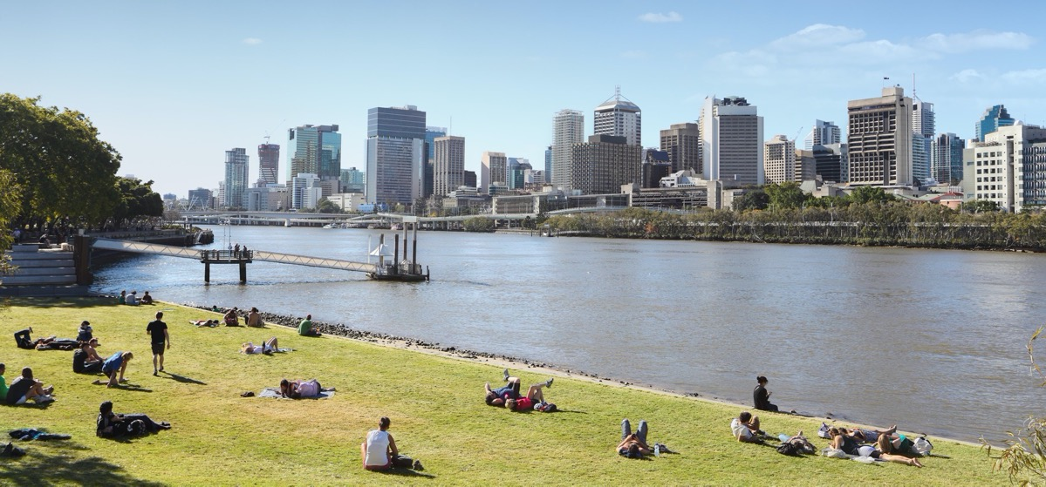
“At a visionary level, a Green Economy is one that results in increased human well-being and social equity, while significantly reducing environmental risks and ecological scarcities”
(UNEP, 2011)
@shutterstock
Module 1, Section 1: Rationale for Advancing IGE
Notes:
Definition from UNEP’s Green Economy Report. This is an early definition, representing the starting point for the field, which has been further customized and improved.
For example, PAGE (2017) says: ”An Inclusive Green Economy is a pathway for delivering sustainable development and a response to three sets of global challenges, namely: (a) persistent poverty; (b) overstepped planetary boundaries; and (c) inequitable sharing of growing prosperity.
Source: PAGE, 2017: The Green Economy Progress Measurement Framework – Methodology.

Slide 17
THE IGE: WHAT TYPE OF ECONOMY?
Sets of challenges that an Inclusive Green Economy aims to answer
IGE as an economy that is:
Low carbon.
Efficient and clean in production.
Inclusive in consumption and outcomes.
Based on sharing, circularity, collaboration, solidarity, resilience, opportunity and interdependence.
Eradicating Poverty
Within planetary boundaries
Sharing Prosperity
Economic Transformation
Natural capital
Physical capital
Consumption
Investments
Human capital
Social capital
Public spending
Trade
Module 1, Section 1: Rationale for Advancing IGE
Source: UNEP, 2017
17
Notes:
The IGE is an economy that “is low carbon, efficient and clean in production, but also inclusive in consumption and outcomes, based on sharing, circularity, collaboration, solidarity, resilience, opportunity and interdependence.
It is focused on expanding options and choices for national economies, using targeted and appropriate fiscal and social protection policies, and backed up by strong institutions that are specifically geared to safeguarding social and ecological floors” (UN Environment, 2015).
Source: PAGE, 2017: The Green Economy Progress Measurement Framework – Methodology.

Slide 18
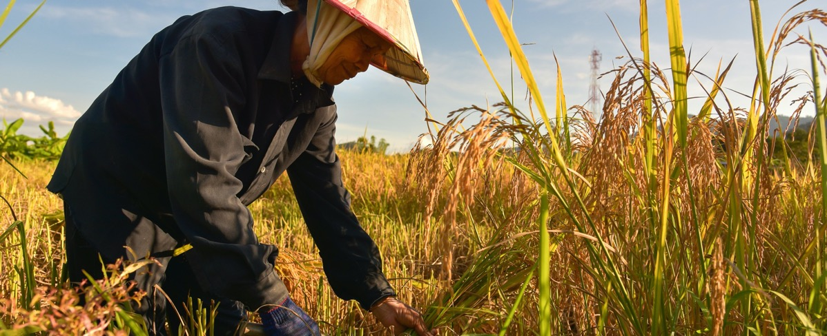
HOW IS THE IGE INCLUSIVE?
@shutterstock
Module 1, Section 1: Rationale for Advancing IGE
18
Notes:
A green economy must be inclusive and pro-poor.
It focuses on resource use, such as supporting water efficiency and sustainable agriculture practices, to increase production as well as food security and, simultaneously, improve access to water for all.
Ensures a fair distribution of costs and benefits, such as by calling for the use of incentive measures for farmers and poor communities, to stimulate entrepreneurship.

Slide 19
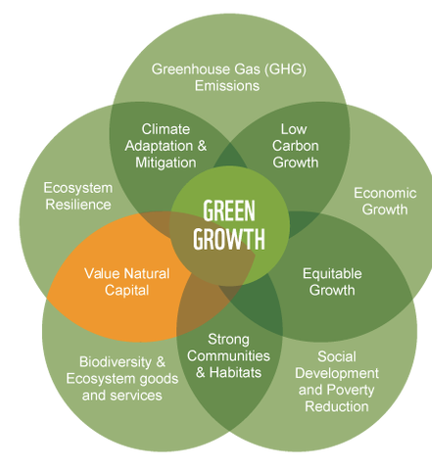
IGE and Green Growth
Green Growth
“
Economic progress that fosters environmentally sustainable, low-carbon and socially inclusive development
“
UN-ESCAP et al., 2010
“
Green growth means fostering economic growth and development, while ensuring that natural assets continue to provide the resources and environmental services on which our well-being relies
“
OECD, 2011
Source: GGGI
Module 1, Section 1: Rationale for Advancing IGE
Notes:
There are many definitions similar to the IGE. This and the next slides provide a few examples. The underlying concept is very similar to the one of the IGE (see text in quotes), but different terms are used by different organizations. This is to create ownership and to stress specific aspects of the IGE, those aspects that are key to the mission of each organization that works on sustainable development, such as environment, economic growth, industrial development and jobs.
“Economic progress that fosters environmentally sustainable, low-carbon and socially inclusive development” (UN-ESCAP et al., 2010).
“Green growth means fostering economic growth and development, while ensuring that natural assets continue to provide the resources and environmental services on which our well-being relies” (OECD, 2011).

Slide 20
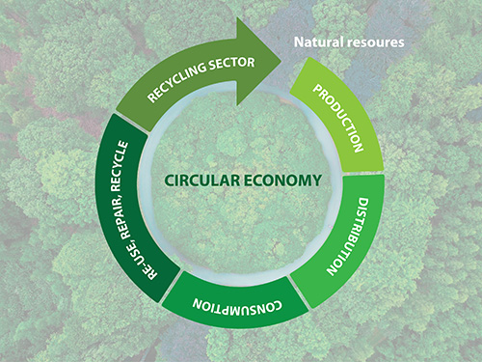
IGE AND CIRCULAR ECONOMY
Circular Economy
An economy that:
reduces the consumption of resources and the generation of waste, and reuses and recycles waste throughout the production, distribution and consumption processes.
Source: UN Environment, 2018
Module 1, Section 1: Rationale for Advancing IGE
Notes:
The CE is also very similar to the IGE. The CE is an economy that reduces the consumption of resources and the generation of waste, and reuses and recycles waste throughout the production, distribution and consumption processes. As a result, it could be said that the CE is a strategy that is a subset of the broader concept of IGE that is consistent but narrower in scope.
Source: UN Environment, 2018: https://www.unenvironment.org/events/workshop/strengthening-leadership-circular-economy

Slide 21
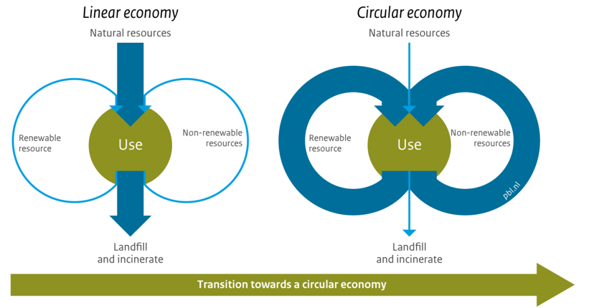
IGE AND CIRCULAR ECONOMY
From a linear to a circular economy
Module 1, Section 1: Rationale for Advancing IGE
Source: PBL, 2016
Notes:
The figure shows how the CE is characterized by circular (or feedback) dynamics. A conventional approach is instead linear, leading to waste generation with minimal reuse.
Source: PBL, 2016: Why a circular economy? PBL Netherlands Environmental Assessment Agency, The Hague.

Slide 22
IGE AND GREEN JOBS
Greener Business Approach
Green jobs are jobs that are (ILO, 2019):
Resource efficiency and greener operations
Quality products and services
Good for the environment
Good for the economy
Good for people
Worker – employer cooperation
Improved working conditions
More productive workplaces
Source: ILO, 2016
Module 1, Section 1: Rationale for Advancing IGE
Notes:
ILO defines green jobs as good for the environment, good for the economy and good for people.
Source: ILO, 2019: Green Jobs: The key to sustainable development:
https://www.ilo.org/global/about-the-ilo/multimedia/video/institutional-videos/WCMS_660556/lang--en/index.htm
Suggest playing short video: https://youtu.be/cSIg0hSm6OM
Source: ILO, 2016: Greening Economies, Enterprises and Jobs - The role of employers' organizations in the promotion of environmentally sustainable economies and enterprises. International Training Centre of the International Labour Organization, 2016.

Slide 23
REFLECTION POINT
What differences do you find when comparing these definitions?
Module 1, Section 1: Rationale for Advancing IGE
Notes:
As indicated above, there are only small differences across definitions, such as different terms but with the same underlying elements: emphasis on the economy and growth, mention of inclusiveness and recognition of the importance of the environment. The differences are often only driven by the mandate and focus of the organisation that coined and uses the definition. For example, UNEP emphasizes the environment, prioritizing developing countries that still have a considerable amount of natural capital, whereas the OCED emphasizes economic growth, representing developed countries that have already lost most of their biodiversity.

Slide 24
DEFINITIONS OF THE IGE – CONSIDERATIONS
There is no single or universal approach to an IGE.
Common characteristics of IGE definitions (global and national):
In an IGE, change is driven by public and private investments;
An IGE recognizes natural capital as a critical economic asset.
Module 1, Section 1: Rationale for Advancing IGE
Notes:
There is no one approach to an IGE. In an IGE, growth in income and employment are driven by public and private investments that reduce carbon emissions and pollution, enhance resource and energy efficiency, and prevent the loss of biodiversity and ecosystem services. Moreover, these investments need to be catalyzed and supported by targeted public expenditure and policy reforms. An IGE recognizes natural capital as a critical economic asset.

Slide 25
DEFINITIONS OF THE IGE – CONSIDERATIONS
A green economy must be aligned with national priorities and development targets:
Developing specific national strategies and action plans;
Engaging a broad variety of national stakeholders;
Creating knowledge and national expertise to support the shift to new production and consumption patterns.
Module 1, Section 1: Rationale for Advancing IGE
Notes:
It is crucial that the IGE is aligned with national development plans. An IGE is likely to be unsuccessful if it creates a parallel planning process at the country level. It is instead more likely to be successful if the concepts of the IGE are embedded in existing/ongoing planning exercises at the sectoral and national levels.

Slide 26
Policy instruments
2
@shutterstock

Slide 27
THE CENTRAL ROLE OF INVESTMENT
At the operational level, a Green Economy is seen as one where growth in income and employment is driven by investments that (EMG, 2011):
Reduce carbon emissions and pollution;
Enhance energy and resource efficiency;
Prevent the loss of biodiversity and ecosystem services.
Module 1, Section 2: Policy Instruments
Notes:
At the operational level, a Green Economy is seen as one where growth in income and employment is driven by investments that (EMG, 2011):
1) Reduce carbon emissions and pollution;
2) Enhance energy and resource efficiency;
3) Prevent the loss of biodiversity and ecosystem services
This can reduce emissions, minimize waste (and related negative externalities) and avoid the loss of biodiversity, hence supporting maintaining critical ecosystem services.

Slide 28
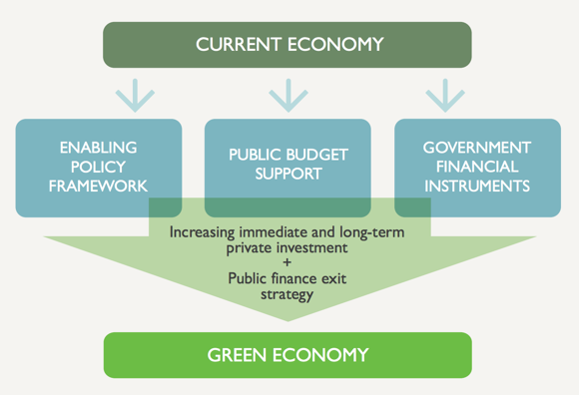
INVESTMENT AND ITS ENABLING CONDITIONS
Role of public policy and finance in unlocking private investment in green growth
How to achieve those goals?
Trigger investments, with three main enabling policies:
Incentives and disincentives
Public targets mandated by law
Social interventions
Module 1, Section 2: Policy Instruments
Source: GGBP, 2014
Notes:
There are several ways to realize an IGE. Investments are critical, and there are three ways to generate investments: public incentives and disincentives, public targets and mandates, and social interventions, such as awareness raising and capacity building.
Source: GGBP, 2014: Green Growth in Practice - Lessons from Country Experience. Green Growth Best Practice.

Slide 29
INVESTMENT
Public investment, from budgetary allocation, for public infrastructure and related services.
Private investment, for purchasing assets, such as solar panels, energy efficient LED lights and electric vehicles.
Goal: ensure adoption, lead by example.
Module 1, Section 2: Policy Instruments
Notes:
Examples of investments are:
- Direct public intervention, originating from budgetary allocation, aimed at creating new or improved green infrastructure, or restructuring existing public services.
- Private investment in infrastructure or more generally in assets, such as solar panels, energy efficient LED lights and electric vehicles.

Slide 30
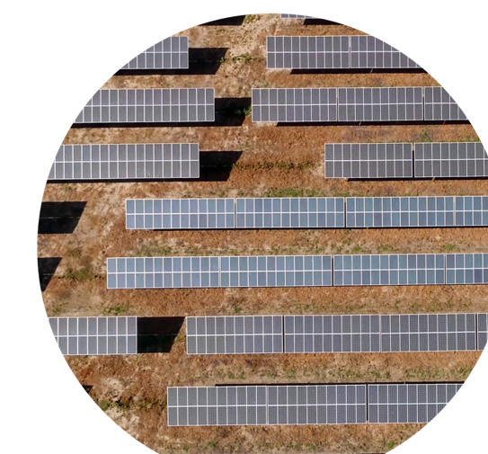
EXAMPLES
Morocco
direct public investments in clean energy (Plan Solaire, with $ 9bn committed), has created a market for renewable energy and delivered socio-economic benefits at the same time.
Source: World Bank, 2012; Invest in Morocco, 2016; UNEP, 2018
@shutterstock
Module 1, Section 2: Policy Instruments
Notes:
Sources:
World Bank, 2012: Inclusive green growth: The pathway to sustainable development. Washington.
Invest in Morocco, 2016: Investment opportunities in solar energy. Retrieved from www.invest.gov.ma/?Id=24&lang=en&RefCat=2&Ref=145
UNEP, 2018: Green Industrial Policy - Concept, Policies, Country Experiences.

Slide 31
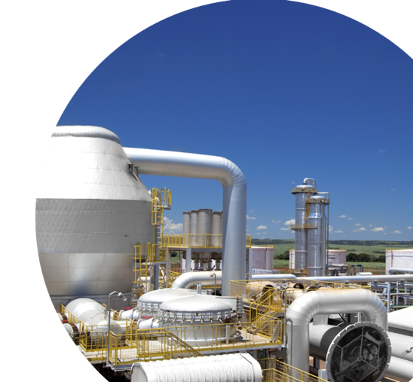
EXAMPLES
Brazil
the ‘PAISS Industry’ programme combined credit, equity and non-reimbursable support for projects aimed at improving ethanol supply chain productivity and reducing CO2 emissions.
Source: Nyko et al., 2010; Milanez et al., 2015; CGEE, 2016
@shutterstock
Module 1, Section 2: Policy Instruments
Notes:
Sources:
Nyko, D., Garcia, J. L. F., Milanez, A. Y., & Dunham, F. B., 2010: A corrida tecnológica pelos biocombustíveis de segunda geração: uma perspectiva comparada. BNDES Setorial, Rio de Janeiro, (32), 5–48.
Milanez, A.Y., Nyko, D., Valente, M.S., Sousa, L.C. de, Bonomi, A., Jesus, C.D.F. de, Chagas, M.F., Watanabe, M. D. B., Rezende, M. C. A. F., Cavalett, O., Junqueira, T. L., & Gouveia, V.L.R de, 2015: De promessa a realidade: como o etanol celulósico pode revolucionar a indústria da cana-de-açúcar – uma avaliação do potencial competitivo e sugestões de política pública. BNDES Setorial 41, Rio de Janeiro, (41).
CGEE, 2016: Second Generation Sugarcane Bioenergy & Biochemicals: Advanced Low-Carbon Fuels for Transport and Industry. Final Version. Brasília: Center for Strategic Studies and Management (CGEE).

Slide 32
POLICY INSTRUMENTS – INCENTIVES/DISINCENTIVES
Introduction of fiscal measures.
Goal: stimulate or dissuade private investments.
These instruments guide the market through price signals, towards more sustainable production and consumption.
Module 1, Section 2: Policy Instruments
Notes:
Incentives and disincentives aim at changing investment behavior. They make certain investments more or less attractive. In the case of incentives, used as an example, a cost-sharing mechanism is introduced. The full cost is split between those that provide the incentive and those that invest, with a lower cost to sustain. Examples include feed-in tariffs for renewable energy and the removal of fossil fuel subsidies.

Slide 33
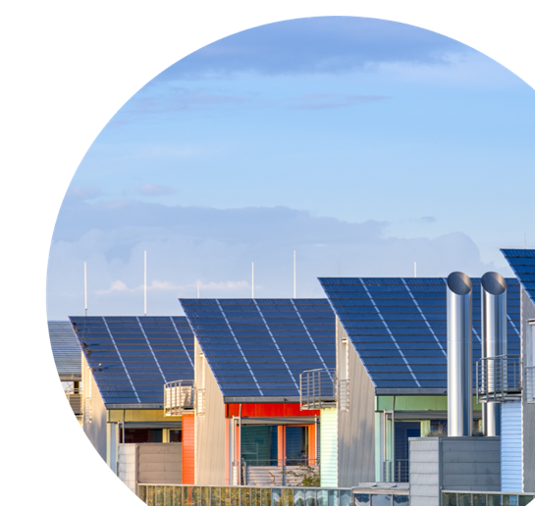
EXAMPLES
Germany
under the Energiewende programme, Germany introduced feed-in tariffs complemented by low-cost loans for renewable energy.
Source: Lütkenhorst & Pegels, 2014
@shutterstock
Module 1, Section 2: Policy Instruments
Notes:
Source: Lütkenhorst, W., & Pegels, A., 2014: Stable policies - turbulent markets: Germany’s green industrial policy: the costs and benefits of promoting solar PV and wind energy. Research report. Winnipeg, Manitoba, Geneva, Switzerland, Beaconsfield, Quebec. International Institute for Sustainable Development; Global Subsidies Initiative; Canadian Electronic Library.

Slide 34
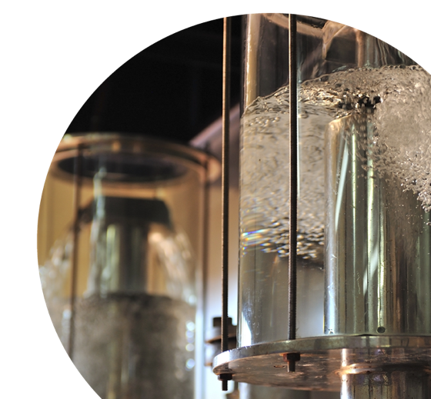
EXAMPLES
Brazil
Incentives, such as sales tax reductions, for ethanol-powered vehicles and a price cap on ethanol significantly contributed to Brazil’s success in establishing bio-fuels in the late 1980s and early 1990s.
Source: BNDES & CGEE, 2008; Meyer et al., 2012
@shutterstock
Module 1, Section 2: Policy Instruments
Notes:
Sources:
BNDES & CGEE, 2008: Sugarcane-based bioethanol: energy for sustainable development. Rio de Janeiro, BNDES.
Meyer, D, Mytelka, L., Press, R., Dall’Oglio, E.L., de Souza Jr., P.T., & Grubler, A., 2012: Brazilian Ethanol: unpacking a success story of energy technology innovation. Grubler A., Aguayo, F., Gallagher, K.S., Hekkert, M., Jiang, K., Mytelka, L., Neij, L., Nemet, G., & Wilson, C. Historical case studies of energy technology innovation, chapter 24, Cambridge University Press.

Slide 35
POLICY INSTRUMENTS – PUBLIC TARGETS MANDATED BY LAW
Establishment of laws, regulations and standards as the formal enactment of targets.
Goal: to ensure enforcement and compliance.
Module 1, Section 2: Policy Instruments
Notes:
Targets and mandates require that the full investment is sustained by citizens and businesses. These are often implemented when there is a positive return on investment, and it makes economic sense to invest.
Examples include Renewable Energy Standards (RES), Fuel efficiency standards in the EU, the establishment of protected areas and environmental remediation.

Slide 36
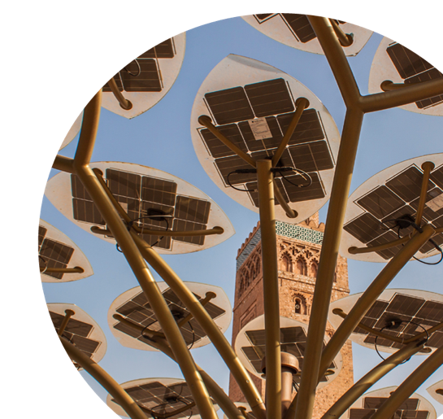
EXAMPLES
Morocco
a favorable legal framework, such as Law 13-09, providing access to the grid, was critical for establishing a market for renewable energy.
Source: Daouda, 2016
@shutterstock
Module 1, Section 2: Policy Instruments
Notes:
Source: Daouda, T., 2016, January 4: Morocco amends renewable energy law. SeeNews. Retrieved from https://renewablesnow.com/news/morocco-amends-renewable-energy-law-507698/

Slide 37
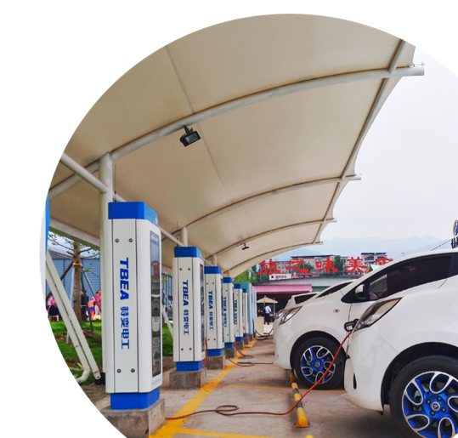
EXAMPLES
China:
in 2017, China imposed an electric vehicle quota on carmakers, mandating 8% of new cars to have an electric engine in 2018 and 12% by 2020.
Source: The Guardian, 2017; UNEP, 2018
@shutterstock
Module 1, Section 2: Policy Instruments
Notes:
Sources:
The Guardian, 2017, September 11: China to ban production of petrol and diesel cars ‘in the near future’. The Guardian. Retrieved from https://www.theguardian.com/world/2017/sep/11/china-to-ban-production-of-petrol-and-diesel-cars-in-the-near-future
UNEP, 2018: Green Industrial Policy - Concept, Policies, Country Experiences.

Slide 38
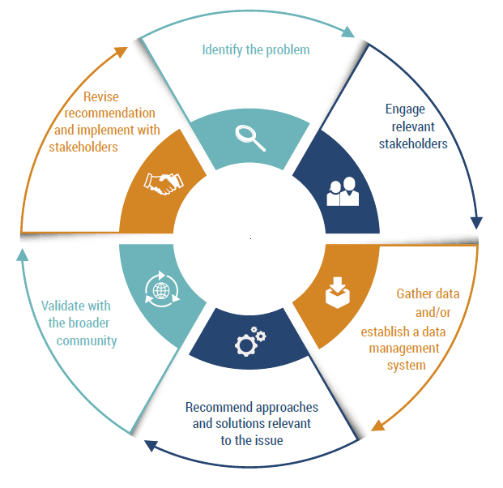
POLICY INSTRUMENTS – SOCIAL INTERVENTIONS
GI-REC pilot process
Aimed at informing the public
Goal: stimulate voluntary changes in behavior
Interventions: capacity building (personal and institutional) and awareness raising
No reliance on economic incentives
Module 1, Section 2: Policy Instruments
Source: UNEP, 2019
38
Notes:
Social interventions aim at informing the public, often for interventions that require little or no investment, such as behavior change only, or offer a positive return on investment. Examples include training farmers on the use of organic agricultural inputs.
Source: UNEP, 2019: Growing in circles - Climate-ready, resilient, resource-efficient, and equitable cities.

Slide 39
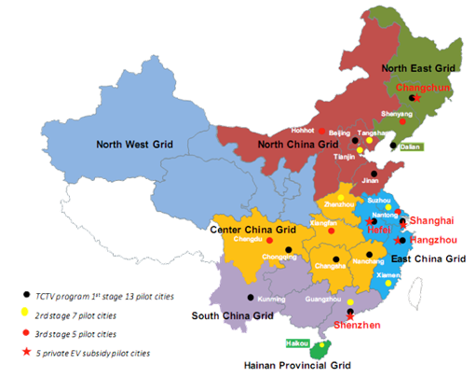
EXAMPLE
China
in 2009, the ‘Ten Cities, Thousand Vehicles‘ programme launched electric vehicle demonstration projects in 13 Chinese cities and added 12 more later on. (ADB, 2009)
Source: Asian Development Bank (ADB), 2009
Module 1, Section 2: Policy Instruments
Notes:
Source: Asian Development Bank (ADB), 2009: Electric Bikes in the People’s Republic of China: Impact on the Environment and Prospects for Growth (ADB economics working paper series). Manila, Philippines.

Slide 40
REFLECTION POINT
What IGE policy instruments have been implemented in your country/region?
Module 1, Section 2: Policy Instruments
Notes:
Describe the type of IGE policies you are aware of at sectoral or country level. It is important to highlight that most of the interventions we consider to be IGE ones have been known (and have been used) for a long time.

Slide 41
3
Simulation models and how they support decision making
@shutterstock

Slide 42
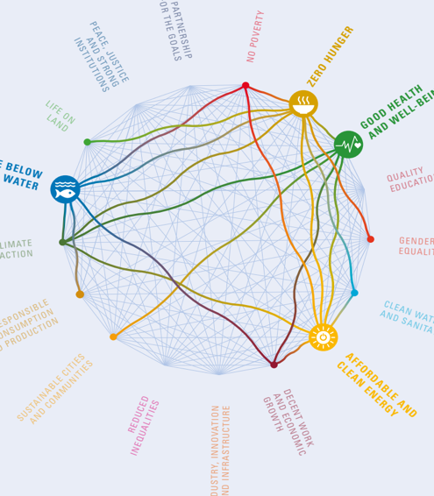
WHY USE SIMULATION MODELS?
Society, the economy and the environment are more and more interconnected.
Simulation models can help us anticipate change and tackle complexity.
Module 1, Section 3: Simulation Models and How They Support Decision Making
Source: ICSU, 2017
Notes:
Reality is complex: society, the economy and the environment are heavily interconnected and we need simulation models to simplify such complexity. They help to avoid side effects and maximize value for money for our investments.
Source: International Council for Science (ICSU), 2017: A Guide to SDG Interactions: from Science to Implementation [D.J. Griggs, M. Nilsson, A. Stevance, D. Mc Collum (eds)]. International Council for Science. Paris.

Slide 43
POLICY QUESTIONS THAT MODELLING SHOULD HELP TO ANSWER
How can the impact of investments and policies be assessed?
Are the impacts likely to be long or short-term?
What benefits might investments and policies generate across sectors in terms of economic opportunities, inclusiveness and environmental sustainability?
Which labour interventions deliver more and better green jobs? Which approaches create better access for the unemployed and underemployed?
JOBS
Module 1, Section 3: Simulation Models and How They Support Decision Making

Slide 44
POLICY QUESTIONS THAT MODELLING SHOULD HELP TO ANSWER
How will green subsidy reforms likely impact productivity in GE sectors?
How will green tax reforms and removing fossil fuel subsidies mobilize domestic revenues for green investment? What will be the implications of such reforms on environmental, economic/fiscal and social fronts?
How do trade policies and regulations enhance investments in GE sectors?
What types of industrial policy measures are in place to support the transition towards a green economy?
Module 1, Section 3: Simulation Models and How They Support Decision Making

Slide 45
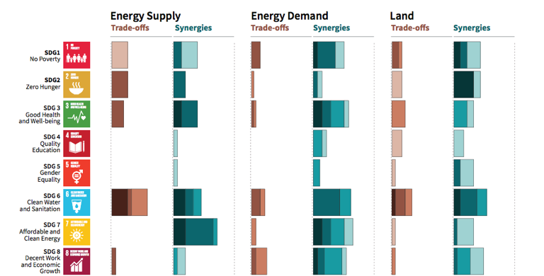


A SYSTEMIC APPROACH IS REQUIRED
Potential synergies and trade-offs between the sectoral portfolio of climate change mitigation options and the Sustainable Development Goals (SDGs).
Source: IPCC, 2018
Module 1, Section 3: Simulation Models and How They Support Decision Making
Notes:
None of our interventions (policies or investments) can be assessed in isolation. Previously we saw a graph that shows the trends in investments in renewable energy. This graph shows the relevance of energy supply for all SDGs. It illustrates that interventions (and investments) in the energy sector have far-reaching outcomes. In fact, both energy demand and supply (figure on the right) affect all SDGs. It is not enough to focus on stimulating investments, we need models that help to break down complexity and forecast outcomes of investments for a variety of indicators, possibly for all SDGs.
Sources:
Frankfurt School-UNEP Centre/BNEF, 2019: Global Trends in Renewable Energy Investment 2019.
IPCC, 2018: Summary for Policymakers. World Meteorological Organization, Geneva, Switzerland, 32 pp.

Slide 46
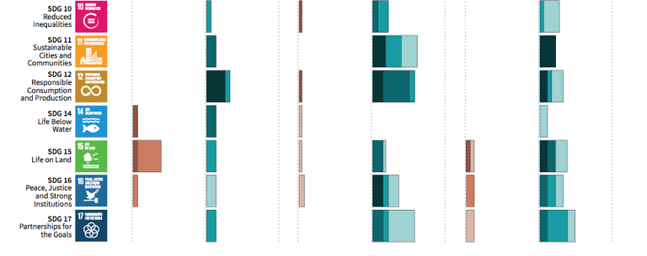
A SYSTEMIC APPROACH IS REQUIRED
Potential synergies and trade-offs between the sectoral portfolio of climate change mitigation options and the Sustainable Development Goals (SDGs).
Source: IPCC, 2018
Module 1, Section 3: Simulation Models and How They Support Decision Making
Notes:
None of our interventions (policies or investments) can be assessed in isolation. Previously we saw a graph that shows the trends in investments in renewable energy. This graph shows the relevance of energy supply for all SDGs. It illustrates that interventions (and investments) in the energy sector have far-reaching outcomes. In fact, both energy demand and supply (figure on the right) affect all SDGs. It is not enough to focus on stimulating investments, we need models that help to break down complexity and forecast outcomes of investments for a variety of indicators, possibly for all SDGs.
Sources:
Frankfurt School-UNEP Centre/BNEF, 2019: Global Trends in Renewable Energy Investment 2019.
IPCC, 2018: Summary for Policymakers. World Meteorological Organization, Geneva, Switzerland, 32 pp.

Slide 47
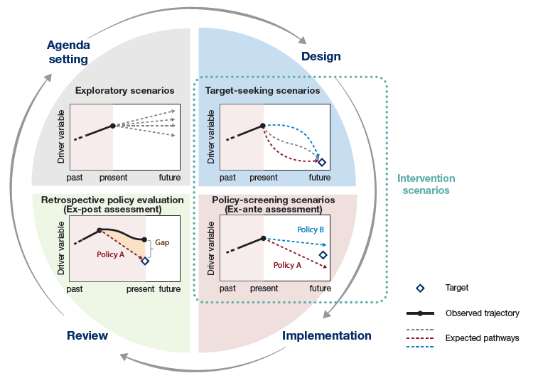
SIMULATION MODELS AND HOW THEY SUPPORT DECISION MAKING
Simulation model
Simulation models can support various steps of the policymaking cycle.
What models are needed?
What specific policymaking steps can each model support?
Module 1, Section 3: Simulation Models and How They Support Decision Making
Source: IPBES, 2016
Notes:
Simulation models can support various steps of the policymaking cycle.
The image is taken from IPBES (https://ipbes.net/scenarios) and presents what type of scenario exercises are available to inform decision making: exploratory for agenda setting, target seeking for design, policy screening for implementation and retrospective for review of policy outcomes.
Source: IPBES, 2016: Summary for policymakers of the assessment report of the methodological assessment of scenarios and models of biodiversity and ecosystem services by the Intergovernmental Science-Policy Platform on Biodiversity and Ecosystem Services.

Slide 48
REFLECTION POINT
Are you aware of any simulation models used for sectoral/national analysis?
Module 1, Section 3: Simulation Models and How They Support Decision Making
Notes:
This question is to test the awareness of students of the existence of models across a variety of sectors/fields. It should become explicit that there are many models for each sector and even more if we consider all the sectors that are relevant for an IGE.

Slide 49
WHAT MODEL FEATURES ARE REQUIRED FOR AN IGE?
The green economy is defined by UNEP as
“
“
An economy that results in improved human well-being and social equity, while significantly reducing environmental risks and ecological scarcities.
The misallocation of capital in the last two decades has been identified as one of the main causes contributing to the manifestation of several concurrent crises.
To curb negative trends and trigger the transition, investments are needed. These would target behavioral change, through the implementation of targeted public expenditure, policy reforms and regulation changes.
Module 1, Section 3: Simulation Models and How They Support Decision Making
Notes:
This slide should be used in conjunction with the following slide. We have here the definition of IGE. The next slide highlights, in red font, important keywords for models. This shows how we can “extract” from the definition of IGE what the key features of an IGE model should be.

Slide 50
WHAT ASSESSMENTS CAN BE CREATED WITH SIMULATION MODELS?
Economic assessment
Social assessment
Environmental assessment
Governance assessment
Integrated assessment
Five main types of assessments can be found to inform policy formulation and assessment.
Each of these assessments makes use of tools.
Module 1, Section 3: Simulation Models and How They Support Decision Making
Notes:
Simulation models can be used to create various types of assessments. This slides provides a brief overview. More details and examples are to follow.
It is important to note that these assessments may or may not use simulation models, but the use of models supports (with quantified estimates) the conclusions of the assessments.

Slide 51
REFLECTION POINT
Have you come across any of these assessments in your studies? Could you provide examples?
Module 1, Section 3: Simulation Models and How They Support Decision Making
Notes:
This question is to determine whether the students are aware of a specific connection between simulation models and their results being featured/used in any specific type of assessment or in more than one.

Slide 52
WHAT MODEL FEATURES ARE REQUIRED FOR AN IGE?
The green economy is defined by UNEP as
“
“
An economy that results in improved human well-being and social equity, while significantly reducing environmental risks and ecological scarcities.
The misallocation of capital in the last two decades has been identified as one of the main causes contributing to the manifestation of several concurrent crises.
To curb negative trends and trigger the transition, investments are needed. These would target behavioural change, through the implementation of targeted public expenditure, policy reforms and regulation changes.
Module 1, Section 3: Simulation Models and How They Support Decision Making

Slide 53
SIMULATION MODELS AND HOW THEY SUPPORT DECISION MAKING
Issues and related policy goals can be of a general nature, or they can be social, economic and environmental (with the latter being more relevant for UNEP).
Issue identification and agenda setting
Polity formulation analysis focuses on issues and opportunities and on the broader advantages and disavantages and disavantages of policy implementation.
Policy formulation - Assessment
Policy evaluation makes use of the indicators identified in the first two steps, to evaluate the effectiveness of the intervention and the emergence of unexpected impacts and trends.
Policy monitoring and evaluation
Decision-making is based on the results of the policy formulation stage, and should account for the forecasted impacts of policy implementation on the environment, the economy and overall well-being of the population.
Decision-making
Policy implementation
Source: UNEP, 2014
Module 1, Section 3: Simulation Models and How They Support Decision Making
Notes:
Agenda setting, policy formulation, decision-making and policy evaluation are all steps of the policymaking process that can be supported by simulation models. Each step has a different goal and provides a different input to the decision-making process. As a result, different models are needed to support different steps.
Issue identification and agenda setting, supported by the use of scenario creation tools.
Policy formulation and assessment: supported by simulation models, sectoral and integrated.
All models can be useful for monitoring and evaluation.
This figure provides the example of UNEP, how have they used simulation models in the early years of the Green Economy Advisory Services.
Source: UNEP, 2014: Using models for Green Economy policymaking.

Slide 54
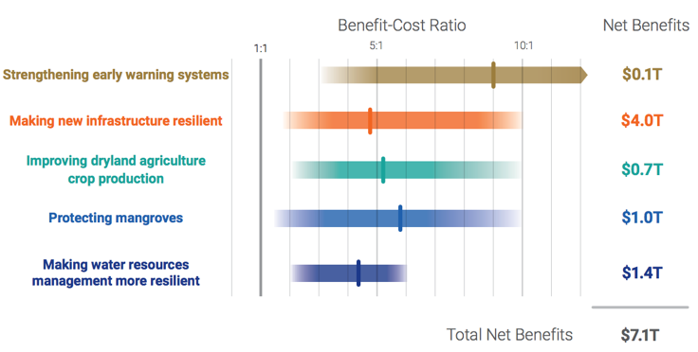
ECONOMIC ASSESSMENTS
Benefits and Costs of Illustrative Investments in Adaptation
Designed to support the analysis of policies, projects and investments.
Focuses on expected economic outcomes.
Example: project feasibility studies
Source: GCA, 2019
Module 1, Section 3: Simulation Models and How They Support Decision Making
Notes:
Economic assessments provide information on whether a policy or investment is economically viable/attractive.
Source: GCA, 2019: Adapt now: A global call for leadership on climate resilience. Global Center on Adaptation & World Resources Institute.

Slide 55
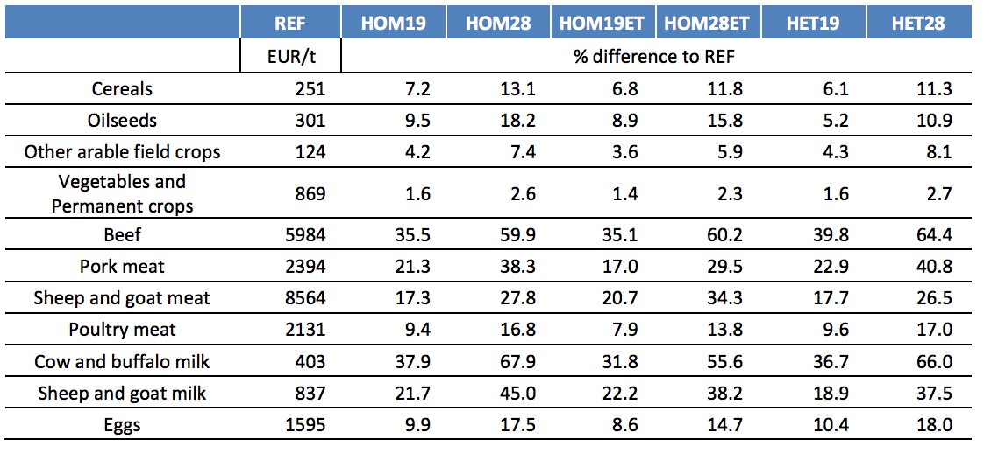
EXAMPLE: AN ECONOMIC ASSESSMENT OF GHG MITIGATION POLICY OPTIONS FOR EU AGRICULTURE (EcAMPA)
Projected changes in consumer prices for selected products (in % compared to the reference [REF] scenario).
Source: JRC, 2015
Module 1, Section 3: Simulation Models and How They Support Decision Making
Notes:
GHG emissions were projected using the CAPRI model, an economic-comparative static agriculture sector model.
All scenarios are simulated until 2030.
Scenario assumptions or changes:
1) Homogenous distribution of emission caps, without emission trade permits (HOM19 & HOM28) and with emission trade permits (HOM19ET & HOM28ET)
2) Heterogenous distribution of emission caps (HET19 & HET28)
Source: JRC, 2015: An economic assessment of GHG mitigation policy options for EU agriculture –EcAMPA. Contributing authors: Von Doorslaer, B.; Witzke, P.; Huck, I.; Weiss, F.; Fellmann, T.; Salputra, G.; Jansson, T.; Drabik, D.; Leip, A.. Luxembourg: Publications Office of the European Union, 2015.

Slide 56
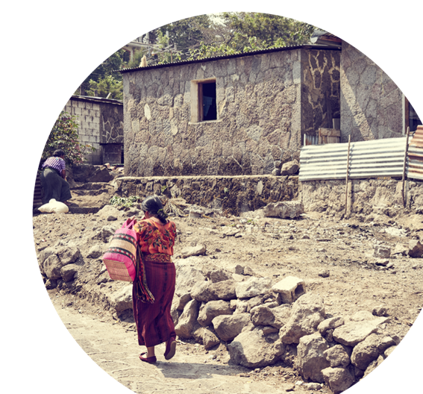
SOCIAL ASSESSMENTS
Provide guidance on policy impacts for different social groups (i.e., inclusiveness).
Support the review and monitoring of key governance indicators.
Example: Poverty and Social Impact Analysis (PSIA), which facilitates the assessment of policy inclusiveness and pro-poor orientation.
@shutterstock
Module 1, Section 3: Simulation Models and How They Support Decision Making
Notes:
Social assessments provide guidance on policy impacts for different social groups, supporting inclusiveness assessments. Social assessments are completed for a variety of topics/sectors, such as fossil fuel subsidies and deforestation.

Slide 57
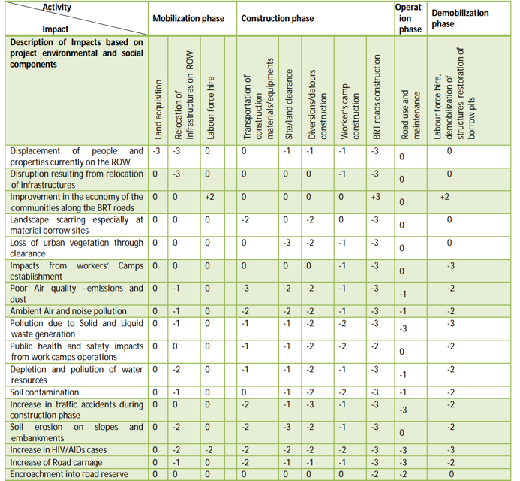
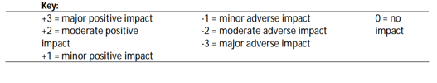
EXAMPLE: DAR RAPID TRANSIT AGENCY (DART)
Impact Assessment Matrix
Source: DART, 2015
Module 1, Section 3: Simulation Models and How They Support Decision Making
Notes:
Using an impact assessment matrix allows for illustrating the magnitude of respective impacts on the population and/or the environment.
The social impact assessment of the Bus Rapid Transit (BRT) in Dar es Salaam (Tanzania) provides information about the impacts of the BRT.
Source: DART, 2015: 3.1 Environmental and Social Impact Assessment Report - Consulting Services for Design of 42.9kms of Bus Rapid Transit System
Phase 2 and 3 in Dar es Salaam City. Dar Rapid Transit Agency (DART), The United Republic of Tanzania. Second Central Transport Corridor Project (CTCP2). Accessed December 12th 2019: https://www.afdb.org/fileadmin/uploads/afdb/Documents/Environmental-and-Social-Assessments/Tanzania_-_Dar_es_Salaam_BRT_Project_ESIA_Phase_2_3_Report_-_04_2015.pdf

Slide 58
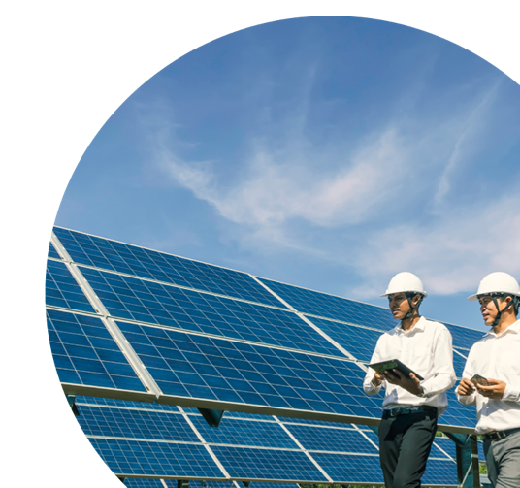
ENVIRONMENTAL ASSESSMENTS
Provide the evaluation of the environmental impacts of development strategies, policies, projects and investments.
Examples: Strategic Environmental Assessment (SEA) and Environmental Impact Assessments (EIA)
@shutterstock
Module 1, Section 3: Simulation Models and How They Support Decision Making
Notes:
Environmental assessments include methodological frameworks that combine tools for the evaluation of the environmental impacts of development strategies, policies, projects and investments. They include: (1) Strategic Environmental Assessment (SEA), for policies; and (2) Environmental Impact Assessments (EIA), for projects.

Slide 59
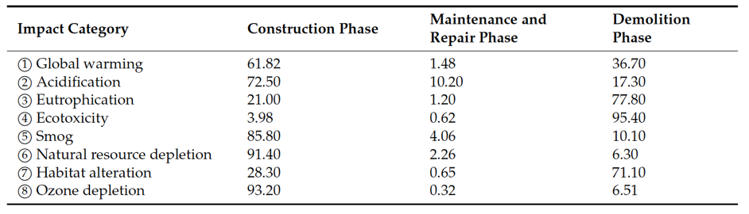
EXAMPLE: EIA OF A FAST TRACK TRANSPORTATION PROJECT IN CHINA
An EIA focuses on the impacts of project-related processes on environmental assets, such as air, water, land, flora and fauna.
Contribution of environmental emissions to each lifecycle stage, in % by impact category.
Source: Li et al., 2019
Module 1, Section 3: Simulation Models and How They Support Decision Making
Notes:
Inputs used in this case study are steel, concrete, quicklime, cement mortar, gravel, pitch, sand, fly ash, clay brick, clay and electricity.
Source: Li et al., 2019: Environmental Impact Assessment of Transportation Infrastructure in the Life Cycle: Case Study of a Fast Track Transportation Project in China. Contributing authors: Li, H.; Deng, Q.; Zhang, J.; Olubunmi Olanipekun, A.; Lyu, S.. Energies 2019, 12, 1015; doi:10.3390/en12061015
Download link: https://www.mdpi.com/1996-1073/12/6/1015/pdf

Slide 60
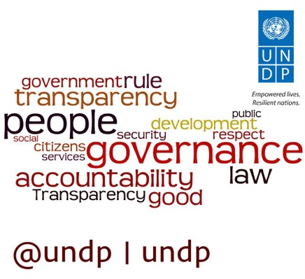
GOVERNANCE ASSESSMENTS
Support the analysis of the efficiency and transparency of institutional frameworks and processes at both the national and local levels.
Example: UNDP’s governance assessment.
Source: UNDP
Module 1, Section 3: Simulation Models and How They Support Decision Making
Notes:
The formulation, implementation, monitoring and evaluation of integrated IGE policies requires efficient and transparent institutional frameworks and processes at both the national and local levels. In order to conduct governance assessments, decision makers can adopt specific methodological frameworks, such as UNDP’s governance assessment.

Slide 61

INTEGRATED ASSESSMENTS
Integrate multiple data and tools in a unique assessment framework.
Estimate policy and investment outcomes across sectors, economic actors, dimensions of development and over time.
Example: Decision Support Systems (DSS).
@shutterstock
Module 1, Section 3: Simulation Models and How They Support Decision Making
Notes:
Approaches exist to conduct a more comprehensive (or integrated) IGE assessment. As an example, by integrating multiple data and tools in a unique assessment framework, Decision Support Systems (DSS) provide valuable guidance to decision makers for the integrated evaluation of IGE policies.

Slide 62
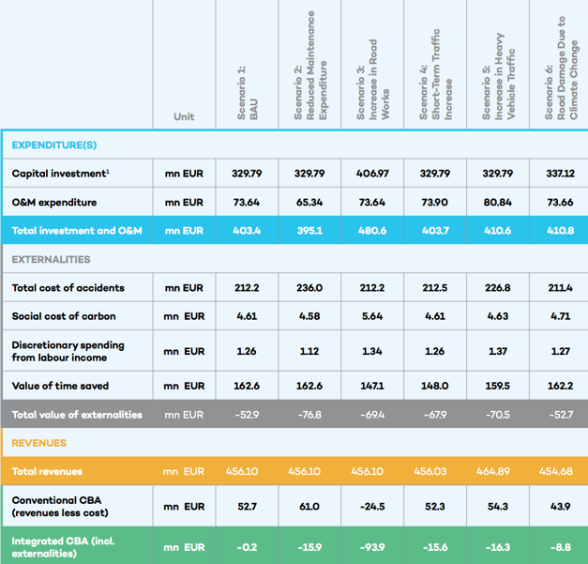
EXAMPLE: SUSTAINABLE ASSET VALUATION (SAVi) OF THE CONTOURNEMENT DE RABAT, MOROCCO
SAVi’s Integrated Cost Benefit Analysis (in EUR millions)
Source: IISD, 2019
Module 1, Section 3: Simulation Models and How They Support Decision Making
Notes:
An assessment of the economic, social and environmental outcomes of various road management strategies.
The assessment focused on road infrastructcure. The analysis covers multiple dimensions (i.e. actors and sectors) over time:
Financial impact of management decisions.
Environmental impacts in terms of material use and emissions.
Social impacts in terms of income generation, travel time and accidents.
Source: IISD, 2019: Sustainable Asset Valuation (SAVi) of the Contournement de Rabat, Morocco: A focus on road infrastructure. Bassi, A.M.; Casier, L.; Perera, O.; Pallaske, G. & Uzsoki, D. Geneva: International Institute for Sustainable Development (IISD).
https://www.iisd.org/sites/default/files/publications/savi-contournement-morocco-en.pdf

Slide 63
SIMULATION MODELS AND HOW THEY SUPPORT DECISION MAKING
Four main groups of tools:
Policy/project assessments tools
Indicators and
measurements frameworks
Scenario forecasting tools (quantitative)
Scenario creation tools (qualitative)
Notes:
There are four main groups of tools, which are complementary to one another. The diagram shows that indicators can be used in all assessments and are an integral part of simulation models. Furthermore, scenario creation tools can support the creation of scenario forecasting tools. For example, a qualitative model and causal-descriptive can be used as a blueprint for the creation of quantitative models. Policy and project assessment tools do not necessarily need forecasts and can make use of indicators.

Slide 64
4
Group exercise
@shutterstock

Slide 65
GROUP EXERCISE
Goal: Development of a qualitative system map.
This could be a Causal Loop Diagram or a tree diagram.
Scope: select a sector, for a specific geography.
E.g. country, city or landscape.
Emphasis on the identification of:
Main drivers of change (internal and external), including problems that could emerge for social, economic and environmental indicators.
Formulation of solutions (i.e. policy interventions).

Slide 66
GROUP EXERCISE – STEPS TO FOLLOW
Identify a problem or opportunity and describe it with one sentence.
Open Vensim (www.vensim.com), or draw the diagram in PowerPoint or manually on a flipchart.
Identify the key indicator representing the problem or opportunity and add it to your diagram, which is blank at this stage.

Slide 67
GROUP EXERCISE – STEPS TO FOLLOW
Add the causes of the problem, one by one, linking them to the first variable considered, and determine the polarity of the causal relation.
Continue identifying and adding the cause of the cause, and so forth.

Slide 68
GROUP EXERCISE – CAUSALITY
A causal link from variable A to variable B is positive if a change in A produces a change in B in the same direction.
A causal link from variable A to variable B is negative if a change in A produces a change in B in the opposite direction.

Slide 69
GROUP EXERCISE – EXAMPLE
Forest area vulnerable to illegal activities
+
+
Total forest
-
B1
Dynamics influencing the expansion of oil palm production
+
< Intensification of oil palm plantations >
Illegal forest encroachment
+
Desired income from illegal activities
+
Illegal oil palm plantations
+
Intensification of oil palm plantations
+
B2
Area in use for oil palm plantations
Income gap
-
-
+
+
Employment
+
Total income
+
Oil palm yield
+
+
Desired income
B3
Oil palm production rate
R1
+
+
+
Migration
Population
+
Notes:
The causal loop diagram shows that if there is an income gap at the local level, there will be an incentive to engage with illegal activities. This will lead to the encroachment of forests, the growth of oil palm plantations, employment creation and growing economic activity. This leads to income creation, which reduces the income gap – creating a Balancing loop (B2) through employment and (B3) through oil palm production.
On the other hand, when new plantations are established, migration to the area may increase, leading to more population and more desired income, which increases the income gap and further leads to illegal activities and forest encroachment – creating a Reinforcing loop (R1).
Finally, any activity that increases the forest area, such as intensification of oil palm plantations, in the absence of monitoring and enforcement, is likely to be ineffective in the long term (B1) and lead to more deforestation.
It is important therefore to understand the underlying drivers of change of the system, and to be able to identify desirable and undesirable developments originating from policy implementation.

Slide 70
End of Module 1. Thank you for your attention!

