Slide 1
Module 2 – Identifying indicators for IGE modelling
Course: Inclusive Green Economy (IGE) modelling
Date / Place / Name

Slide 2
OVERVIEW
1 Introduction to IGE indicators
2 Issue identification
3 Policy formulation
4 Policy assessment
5 Policy monitoring and evaluation
6 The GEP Measurement Framework

Slide 3
1
Introduction to IGE indicators
@shutterstock

Slide 4

Why are indicators important for an inclusive green economy?
@shutterstock
Notes:
Effective policymaking for a green economy requires a robust set of indicators to identify major issues, to formulate appropriate policy responses and assess potential impacts of policy, and then to monitor actual impacts. Indicators used in each of these major policymaking stages capture the nexus of economic performance, environmental status and social dynamics.
In addition to informing various steps in the policymaking process, indicators are a powerful tool for developing consensus among stakeholders on national priorities. Indeed, statistics derived from indicators can sometimes be so illuminating - or so shocking - as to propel public and political support for concerted action. Reaching consensus on priorities can be time-consuming, but the process of reaching agreement focuses action and helps to ensure that all stakeholders contribute to achieving the agreed goals. At a technical level, such agreement also promotes cooperation on data development and sharing.
Source: PAGE, 2019: Indicators for an Inclusive Green Economy – Manual for Introductory Training.

Slide 5
INTRODUCTION
The definition of IGE includes:
Increased human well-being and social equity;
Reduced environmental risks and ecological scarcities.
These factors need to be measured in a comprehensive manner:
The state of a green economy and how it is reached;
The way a green economy is applied in policymaking processes to deliver on this global agenda.
Notes:
Indicators provide information on the historical and current state of a given system, and are particularly useful for highlighting trends that can shed light on causal relations between the elements that the system is composed of. Both quantitative and qualitative information can be used to define an indicator, depending on the issue that needs to be analyzed, as well as on the availability and quality of data. A combination of different indicators might be necessary for describing the IGE, where different concurring causes and effects have to be measured and compared.
Source: PAGE, 2017: The Green Economy Progress Measurement Framework – Methodology.

Slide 6
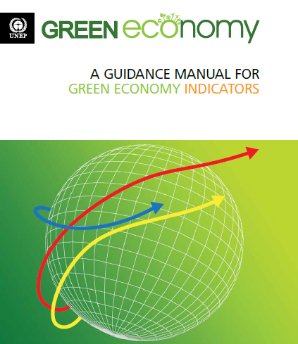
POLICYMAKING AND INDICATORS
Indicators are needed in all phases of the policy cycle, in particular:
Issue Identification
Environmental issues and targets
Policy Formulation
Policy interventions, costs and effectiveness
Policy Assessment
Expected policy impacts across sectors and actors
Policy Monitoring & Evaluation
Actual impacts on well-being and equity
Source: UNEP, 2014
Notes:
The structure of the presentation follows a stylised integrated policymaking (IP) process with the following stages:
1) Issue identification and agenda setting;
2) Policy formulation and assessment;
3) Decision-making;
4) Implementation; and
5) Monitoring and evaluation (M&E).
The emphasis of the presentation is on the use of indicators in stages 1 and 2, and, to some extent, stage 5. The role of indicators in policy implementation, under stage 4, is mainly exercised through monitoring and evaluation (stage 5).
Source: UNEP, 2014: Using models for Green Economy policymaking.

Slide 7
REFLECTION POINT
What type of indicators have you primarily used so far?
Module 2, Section 1: Introduction to IGE Indicators
Notes:
This question is meant to trigger a discussion about indicators. It is expected that many indicators will be mentioned and that it will be difficult to categorise them. This presentation will allow students to group indicators based on the support they can provide to the policymaking process.

Slide 8
POLICYMAKING AND INDICATORS
Overview of the integrated policymaking process
Issues and related policy goals can be of a general nature, or they can be social, economic and environmental (with the latter being more relevant for UNEP).
Issue identification and agenda setting
Polity formulation analysis focuses on issues and opportunities, and on the broader advantages and disavantages of policy implementation.
Policy formulation - assessment
Policy evaluation makes use of the indicators identified in the first two steps, to evaluate the effectiveness of the intervention and the emergence of unexpected impacts and trends.
Policy monitoring and evaluation
Decision-making is based on the results of the policy formulation stage and should account for the forecasted impacts of policy implementation on the environment, the economy and overall well-being of the population.
Decision-making
Policy implementation
Source: UNEP, 2014
Notes:
This image presents in more detail the role of various assessments, including the use of indicators and models to support different stages of the policymaking process. It begins to highlight the synergies between using indicators to bridge past and future (scenario-based) performance. The following sections will present indicators for the different steps in the policymaking cycle: issue identification; policy formulation and assessment; and monitoring and evaluation.
Source: UNEP, 2014: Using models for Green Economy policymaking.

Slide 9
2
Issue Identification
@shutterstock

Slide 10
INDICATORS FOR ISSUE IDENTIFICATION
Issue identification and agenda setting
Policy formulation - assessment
Support decision makers in identifying and prioritising problems.
IGE issues require combining indicators for environmental, social and economic trends.
Policy monitoring and evaluation
Decision-making
Policy implementation
Notes:
Potential issues, present and/or upcoming, may have various causes: environmental, social and economic.
The outcomes of these issues, as well IGE interventions, can also affect environmental, social and economic indicators.

Slide 11
EXAMPLES OF INDICATORS FOR ISSUE IDENTIFICATION
Issues | Examples
Climate Change | Carbon emissions (ton/year) Renewable energy (share of power supply) (%) Energy consumption per capita (Btu/person)
Ecosystem Management | Forestland (ha) Water stress (%) Land and marine conservation area (ha)
Resource Efficiency | Energy productivity (Btu/$) Material productivity (ton/$) Water productivity (m³/$) CO₂ productivity (ton/$)
Chemicals and Waste Management | Waste collection (%) Waste recycling and reuse (%) Waste generation (ton/year) or landfill area (ha)
Notes:
The combination of different indicators for the analysis of simultaneous environmental, social and economic trends is essential for identifying potential issues, present and/or upcoming, and clearly determines their causes and effects within and across sectors.
Question for students: To what extent do the indicators on this slide cover environmental, social and economic factors?

Slide 12
INDICATORS FOR ISSUE IDENTIFICATION - STEPS
1
2
3
4
Identify potentially worrying trends.
Assess the issue and its relation to the natural environment.
Analyze more fully the underlying causes of the issue of concern.
Analyze more fully how the issue impacts society, the economy and the environment.
Notes:
Source: UNEP, 2014: Using models for Green Economy policymaking.

Slide 13

STEP 1
Identify potential worrying trends - Tasks
Identify indicators of sectoral performance related to the problem.
Collect data relevant to the issue under consideration.
Identify national trends and compare them with existing national, regional and global targets.
Compare trends with the performance of comparable countries and/or regions.
@shutterstock
Notes:
An initial step towards determining whether an issue might constitute a threat to sustainable development lies in analysing its historical trend. This can be done by using historical quantitative data or, in case reliable statistics are not available, qualitative information.
Various types of trends and declining trajectories should also be considered, according to the sector and topic analysed, such as the declining trend in forest cover, fish landings or fossil fuel reserves. In other cases, the problem emerges when the trend is on the rise, such as the case of water pollution or energy prices.
Indicators may be interconnected, with varying patterns of interactions. In this phase, the cause-effect relation between indicators needs to be carefully analysed and based on solid evidence, sound theories and empirical studies.

Slide 14
KEY QUESTIONS
Has the trend worsened in recent years?
Is the trend in line with national, regional or global targets?
Is the trend in line with the performance of similar countries?
Notes:
Consider one potential issue and analyze it in more detail. You could use emissions, deforestation and employment (or unemployment,) and ask students to find data and analyze trends.

Slide 15

STEP 2
Assess the issue and its relation to the natural environment - Tasks
Identify indicators of environmental performance related to the problem.
Collect data relevant to the issue under consideration.
Identify national trends and compare them with existing national, regional and global targets.
Compare trends with comparable countries and regions.
@shutterstock
Notes:
Once a trend has been identified and defined as potentially worrisome, indicators need to be selected to further evaluate whether and how the prospective issue of concern is related to the environment. The underlying question is whether the issue under consideration is caused or affected by existing environmental trends, in particular when the issue primarily has social or economic dimensions.

Slide 16
KEY QUESTIONS
Is the issue influenced by the environment?
Is the issue influenced by natural resource depletion or degradation, erosion of ecosystem services or the reduced provision of ecosystem services?
Notes:
Ask students to identify whether the trend discussed could be directly or indirectly impacted by the state of the environment. This discussion begins to highlight the importance of causality and multi-dimensional knowledge. Causality will be explored in more depth in the next step.

Slide 17
STEP 3
Analyze more fully the underlying causes of the issue - Tasks
Simplified (and partial) causal tree diagram for the issue of nutrition and possible key drivers, where indicators are linked to each other, representing the causal chain leading to the problem.
Identify causal relations and map them systemically.
Evaluate whether multiple causes act simultaneously and are also causally linked with each other.
Evaluate their respective strength.
chemical fertilizer
organic fertilizer
agricultural practices
(chemical fertilizer)
natural endowment
(organic fertilizer)
evaporation
precipitation
water demand
fertilizer use
soil quality
crop yield per hectare
agriculture production
nutrition
water stress
population
harvest area
Source: UNEP, 2014
Notes:
Once a prospective issue has been singled out by analysing and comparing indicators of economic, social and environmental performance, and some light has been shed on the relation between the issue and the natural environment, the underlying causes for the underperforming trend need to be analysed more fully.
At this third step, the pressures and driving forces (i.e. underlying causes) are separated from the symptoms (i.e. impacts and the state of the environment). This could be achieved by focusing on the identification of causes, such as environmental, social and economic, behind the environmental effects identified in step 2, which affect the issue identified in step 1.
Source: UNEP, 2014: Using indicators for Green Economy policymaking.

Slide 18
KEY QUESTIONS
Is there a causal relation between the trend observed and economic, social or environmental variables?
What are the key drivers and pressures?
Are there multiple and simultaneous causes?
Notes:
This question is about causes of the issue. Various opinions could be gathered and it is expected that a variety of indicators will be mentioned, especially if the students have different backgrounds and interests.

Slide 19
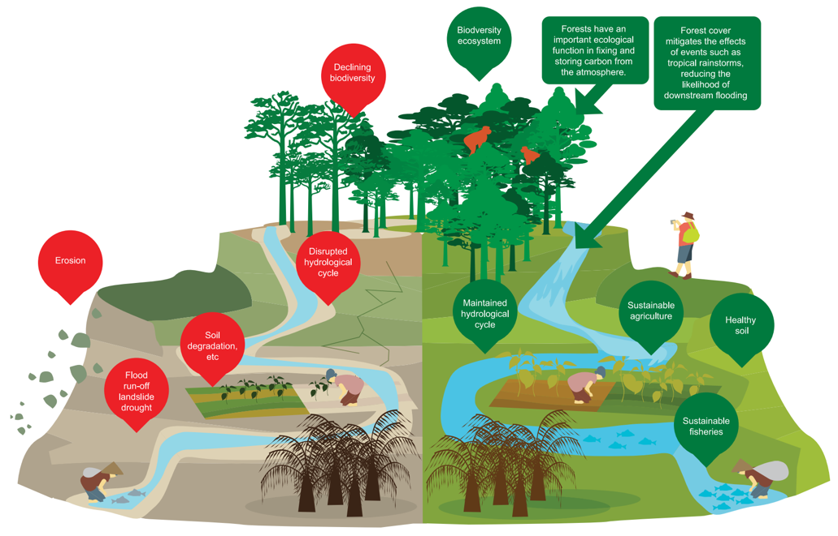
STEP 4
Analyze impacts on society, economy and the environment - Tasks
Diagram illustrating the impacts of business as usual (left) and green economy scenarios (right).
Identify impacts of the issue on society, the economy and the environment.
Identify indicators relevant to the issue analyzed, considering its social, economic and environmental impacts.
Relate causes to sectoral impacts using
the causal relations identified in step 3.
Source: WWF, 2012
Notes:
This fourth step extends the analysis to the impacts that the underperforming trend may have on other social, economic and environmental indicators. In so doing, additional issues in need of intervention could be identified, addressed and prioritised, thus realising synergies.
Source: Cosslett, Christopher E. and Annawati van Paddenburg, Eds., 2012: Heart of Borneo: Investing in Nature for a Green Economy. A Synthesis Report. WWF Heart of Borneo Global Initiative. Jakarta.

Slide 20
KEY QUESTIONS
How does the problem affect the system and its socio-economic and environmental performance?
Are the impacts of the problem immediate or emerging slowly, and do they last for a long time?
Notes:
These questions focus on outcomes, both positive and negative. The use of indicators across several sectors is necessary to correctly identify and assess issues, as well as their impacts. In this respect, it is useful to organise key impacts and their respective indicators by sector of pertinence, such as energy, water and agriculture, or by dimension of development, such as social, economic and environmental indicators. This highlights how diverse the impacts of a given issue can be.

Slide 21
THE DRIVERS, PRESSURES, STATE, IMPACT AND RESPONSE MODEL OF INTERVENTION
A schematic representation of the DPSIR Framework.
Indicators are a tool to identify, prioritise and track issues, as well as their causes and cross-sectoral effects.
DRIVING forces
RESPONSES
PRESSURES
The DPSIR provides a step-by-step description of the causal chain between economic activity and impacts, such as loss of biodiversity, ecosystem degradation and diminished human welfare or well-being.
IMPACTS
STATE of the environment
Source: UNEP, 2014
Notes:
DPSIR (drivers, pressures, state, impact and response model of intervention) is a causal framework for describing the interactions between society and the environment.
Source: UNEP, 2014: Using indicators for Green Economy policymaking

Slide 22
EXAMPLE: SUSTAINABLE AGRICULTURE IN BOSNIA AND HERZEGOVINA
Strengths | Weaknesses | Challenges | GE Opportunities
42% of the total land is mountain area. 62% of agricultural soil in mountain areas. Sheep and goat rearing (dairy products, meat, skins). Growing organic honey production. | Only 0.03% of total agriculture area is under organic cultivation (UNEP et al., 2007; FIBL and IFOAM, 2013). Sheep milk yield amounted to only 18,774 tons in 2008 (FAO, 2009). Dairy products, meat and skins are mainly used for subsistence. | Unsustainable expansion of agriculture production may lead to land use changes and deforestation. Increase in the exposure of mountain areas to floods, landslides and erosion. Climate change effects (e.g. increased rainfall) could deplete mountain resources. | The expansion of ecological agriculture and organic farming, to avoid damage to the ecosystem while increasing food production and creating employment and income. Incentivize the survival of mountain traditions, creating wealth for shepherds and farmers.
Notes:
The table provides examples for indicators of issue identification, for the specific case of sustainable agriculture. The table is an excerpt of the Green Economy Assessment carried out for Bosnia and Herzegovina and shows strengths and weaknesses of the country in relation to agriculture, as well as challenges and opportunities for the introduction of sustainable agriculture.

Slide 23
REFLECTION POINT
What indicators would you consider to be relevant for GHG emissions?
Module 2, Section 2: Issue Identification
Notes:
This question is proposed to summarise the content of the previous slides, on indicators for issue identification. It is suggested that all of the four steps are followed, one by one, in sequence, with the students providing a complete answer.

Slide 24
3
Policy Formulation
@shutterstock

Slide 25
INDICATORS FOR POLICY FORMULATION
Issue identification and agenda setting
Policy formulation - assessment
While indicators for problem identification help to frame the issue, indicators for policy formulation help to design solutions.
Policy monitoring and evaluation
Decision-making
Policy implementation
Notes:
The second phase of the integrated policymaking cycle consists of defining policy goals followed by policy formulation. While indicators for issue identification help to frame the issue, indicators for policy formulation help to design solutions. Focus is given to the use of indicators that help to assess the adequacy of the interventions analysed, taking into account their repercussions on the key stakeholders of the economy and impact across sectors.

Slide 26
EXAMPLES OF INDICATORS FOR POLICY FORMULATION
POLICY | EXAMPLES
Green investment | R&D Investment (% of GDP) EGSS Investment ($/year)
Fiscal reform | Fossil fuel, water and fishery subsidies ($ or %) Fossil fuel taxation ($ or %) Renewable energy incentive ($ or %)
Pricing | Carbon price ($/ton) Value of ecosystem services (e.g. water provision)
Green procurement | Expenditure in sustainable procurement ($/year and %) CO₂ and material productivity of government operations (ton/$)
Green job skills training | Training expenditure ($/year and % of GDP) Number of people trained (people/year)
Notes:
Question for students: What differences do you see between the indicators for issue identification and policy formulation?

Slide 27
INDICATORS FOR POLICY IDENTIFICATION - STEPS
1
2
Establish targeted, measurable, ambitious, while achievable or realistic, and time-bound (SMART) objectives.
Analyze costs and benefits of available options, such as investments, and enabling conditions, including incentives or disincentives, regulations and social interventions.

Slide 28

STEP 1
Identify desired outcomes: define policy objectives - Tasks
Analyze indicators of sectoral and environmental issues.
Select target indicators tailored to the national context, with the help of existing global and regional targets:
  Set specific targets to address the causes of the problem.
  Set specific targets to reduce the impacts of the problem.
@shutterstock
Notes:
The identification of desired outcomes in terms of policy objectives is based on the results of the issue identification phase and precedes the definition and choice of policy interventions. It is therefore a crucial step for decision makers, as policy objectives will frame the specific steps taken in order to address the issue. Targets or objectives could focus on a specific issue, the causes of an issue, or the performance of the sector or the economy as a whole. In order to define specific targets or objectives, the choice of indicators at the adequate scale and level of disaggregation is critical.

Slide 29
KEY QUESTIONS
What is the desired outcome that can be reached through investment and enabling policies?
What is the key target to be reached?
Notes:
This question moves the discussion to outcomes, triggering thinking towards target setting.

Slide 30

STEP 2
Identify intervention options and output indicators - Tasks
Identify indicators representing and measuring the main investment and the policy enabling conditions considered.
Identify indicators representing and measuring the sectoral effectiveness of the intervention considered.
@shutterstock
Notes:
There are two main ways to influence behaviour and shape future trends in order to reach stated objectives: investments and enabling policies, which include provision of incentives or disincentives, public targets mandated by law (regulation) and social interventions. Current and past investments and policies adopted for solving similar issues, that is, addressing similar causes, should be analysed to evaluate their efficiency and effectiveness as well as to identify the emergence of potential side effects.

Slide 31
KEY QUESTIONS
What is the level of investment required to achieve stated targets?
What are the policy instruments available to address the negative environmental trends?
What are current and past policies adopted for the same objective?
What should be changed?
Notes:
These questions aim to link targets to interventions. A discussion could also start at this point to assess whether known interventions implemented in the past have led the system to reach the target or not, in terms of investment or policy effectiveness.

Slide 32
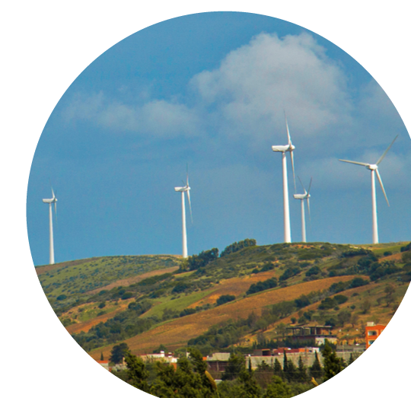
EXAMPLE: RENEWABLE ENERGY IN TUNISIA
Subsidy: 20% of the cost of Solar Water Heaters (SWH) served by the National Agency for Energy Conservation (ANME) through the National Fund for Energy.
Credit from commercial banks for financing the residual cost of an SWH for the consumer, granted over a period of five years.
Three types of commercialized SWH in the residential sector: 200L, 300L and 500L.
@shutterstock

Slide 33
REFLECTION POINT
What indicators would you use if you were to analyze the introduction of incentives for electric cars?
Module 2, Section 3: Policy Formulation
Notes:
This question is meant to summarize the discussions that have taken place up to this stage for indicators of policy formulation.

Slide 34
4
Policy Assessment
@shutterstock

Slide 35
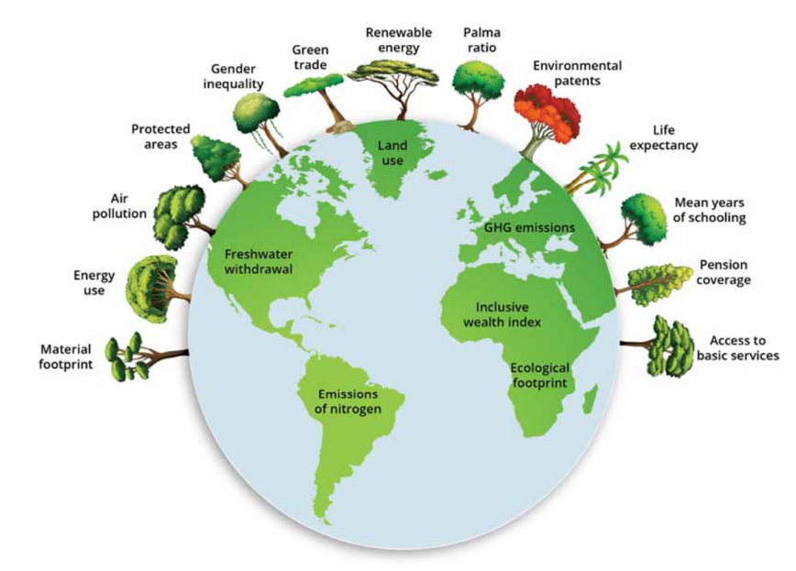
INDICATORS FOR POLICY ASSESSMENT
Issue identification and agenda setting
Policy formulation - assessment
Policy monitoring and evaluation
Source: UNEP, 2016
Decision-making
Policy implementation
Support the estimation and evaluation of policy impacts across sectors, with a focus on indicators for socio-economic impacts and well-being.
Notes:
Once objectives and targets have been defined and intervention options identified, a policy assessment needs to be carried out to estimate the long-term impacts of implementation, to evaluate the effectiveness of each option in supporting sustainable development and to inform decision-making. While indicators for problem identification help to frame the issue and indicators for policy formulation help to design solutions, impact indicators support the estimation of the cross-sectoral impacts of the interventions chosen.
Source: UNEP, 2016: Green Economy Progress (GEP) Measurement Framework. Workshop "Measuring the Value of Forests in a Green Economy", Geneva, 21 Oct 2016.

Slide 36
INDICATORS FOR POLICY ASSESSMENT - STEPS
1
2
3
Estimate policy impacts across sectors.
Analyze impacts on the overall well-being of the population.
Analyze advantages and
disadvantages, and inform decision-making.
36

Slide 37
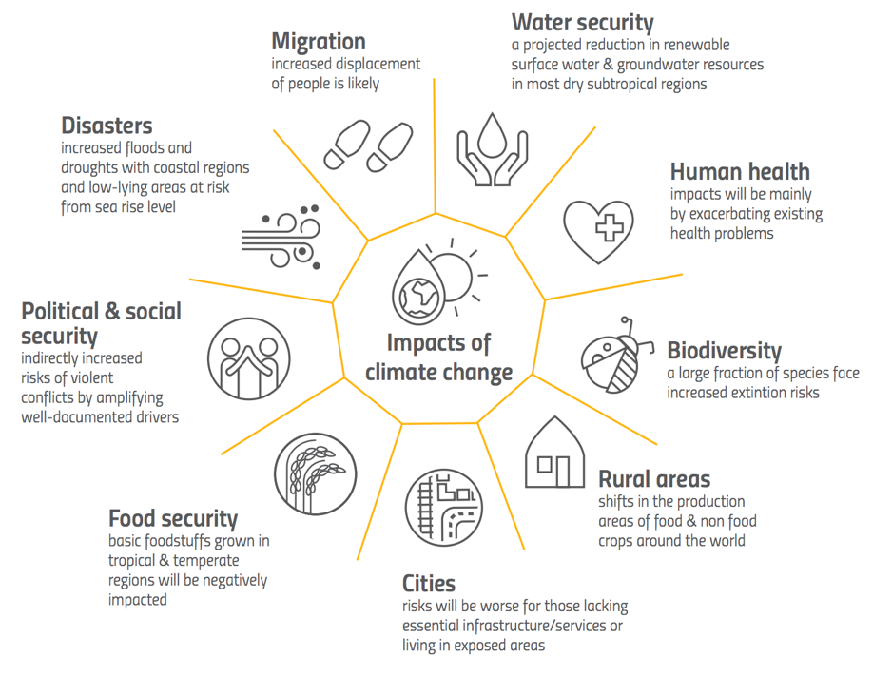
STEP 1
Estimate policy impacts across sectors - Tasks
Impacts of climate change
Select and analyze indicators of investment realized and policy impacts on other sectors.
Source: UNCCD, 2017
37
Notes:
First, measure the effectiveness of the policy intervention in addressing the issue at hand, such as through investment created, then move on to the measurement of the cross-sectoral impacts of the investment/policy to evaluate whether the investment/policy is effectively contributing to sustainable development.
Source: UNCCD, 2017: Global Land Outlook - First Edition.

Slide 38
KEY QUESTION
Is the policy having positive/negative impacts on other sectors?
Notes:
This question helps student to think of whether any relevant trade-offs emerge from policy implementation.

Slide 39
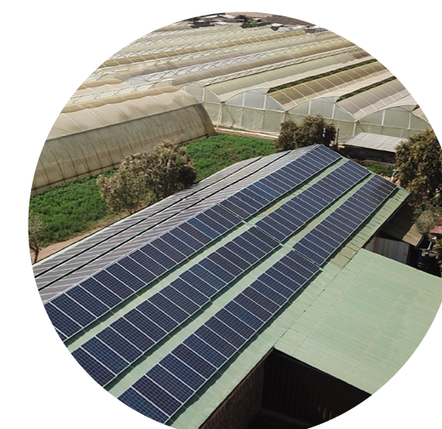
EXAMPLE: FEED-IN TARIFFS IN KENYA
Estimated electricity generation capacity: 1300 MW.
Increased economic competitiveness.
Reduced greenhouse gas emissions.
@shutterstock
39
Notes:
Estimate policy impacts across sectors.

Slide 40

STEP 2
Analyze impacts on the overall well-being of the population - Tasks
What's inclusive health?
Select and analyze indicators of policy impacts on investment, employment, total wealth, access to resources, etc.
Select and analyze composite indicators of well-being, such as Inclusive Wealth, Human Development Index (HDI), Gender-related Development Index (GDI) and Genuine Progress Indicator (GPI).
Source: UNEP, 2018
Notes:
The IGE is a vehicle for attaining sustainable development. For this reason, economic, social and environmental impact indicators need to be identified in the policy assessment phase and monitored, focusing on how IGE investments and policies contribute to the improvement of well-being.
Source: UNEP, 2018: Inclusive Wealth Report 2018. Inclusive Wealth of the World: Measuring Sustainability and Well-Being.

Slide 41
KEY QUESTION
What is the impact of the investment or policy on the
overall well-being of the population?
Notes:
This question allows students to reflect on the societal impacts of the investment or policy intervention. This is a critical step towards estimating the sustainable development impacts of the IGE.

Slide 42
EXAMPLES OF INDICATORS FOR POLICY ASSESSMENT
WELL-BEING & EQUITY | EXAMPLES
Employment | Construction (person, %) Operation and management (person, %) Income generated ($/year) Gini coefficient
EGSS performance | Value added ($/year) Employment (jobs) CO₂ and material productivity (e.g. $/ton)
Total wealth | Value of natural resource stocks ($) Net annual value addition/removal ($/year) Literacy rate (%)
Access to resources | Access to modern energy (%) Access to water (%) Access to sanitation (%) Access to health care (%)
Health | Level of harmful chemicals in drinking water (g/litre) Number of people hospitalised due to air pollution (person) Road traffic fatalities per 100,000 inhabitants (transport-related)
42
Notes:
When it comes to societal impacts and well-being, it is important consider both direct and indirect benefits of the IGE. Direct benefits include, for example, new jobs for installing and maintaining renewable energy infrastructure, or increased food security as a result of ecological agriculture practices. Indirect benefits include, for example, reduced occurrence of diseases linked to air or water pollution.

Slide 43

STEP 3:
Analyze advantages and disadvantages and inform decision-making - Tasks
Identify indicators to estimate the cost of reaching selected targets (i.e. required investments).
Identify indicators to evaluate expected benefits and avoided costs of the investment and interventions considered.
Identify and analyze indicators that highlight the presence of possible synergies and/or side effects.
@shutterstock
43
Notes:
The goal of policy formulation, including the assessment of the likely impact of the interventions chosen, is to design a policy package that can effectively solve the problem and equitably allocate the economic burden, as well as the benefits, across the key actors in the economy.
An analysis of advantages and disadvantages is necessary to identify the winners and losers, concerning both required investments and benefits. Simply put, this analysis would generally compare investment and avoided costs, or added benefits, depending on the issue.

Slide 44
KEY QUESTIONS
What is the economic cost of the targets, with the
enabling intervention(s) selected?
How does it compare to the cost of inaction?
What are the economic and cross-sectoral benefits
of policy options in the short-, medium- and long-term?
Which options are expected to generate the maximum
cross-sectoral benefit with the least cost?
Notes:
These questions highlight how important it is to identify benefits and costs of a given target or action. This is because the cost is often centralized, with one or two actors investing, but many people and organizations may benefit from that investment, such as public infrastructure and public services, including hospitals and roads. It is important to know the total benefits and costs, as well as who will accrue such benefits and costs.

Slide 45
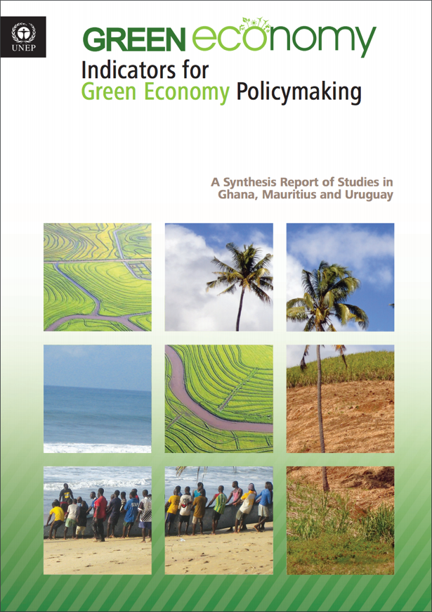
APPLICATION OF INDICATORS FRAMEWORK IN PRIORITY SECTORS AT COUNTRY LEVEL
Ghana
Agriculture, forestry, water, waste management and sanitation, energy and extractive industries.
Mauritius
Agriculture, energy, transport, manufacturing, tourism, waste and water sectors.
Uruguay
Agriculture, industries, livestock and transport sectors.
Source: UNEP, 2015
45
Notes:
Consultative process in policymaking is critical:
Selection of sectors and identification of policies and areas of action were completed in a series of workshops with relevant stakeholders, including representatives of key ministries.
The process is time consuming and imposes some challenges but ensures greater validity and cooperation on data building in the future.
Packaging indicators covering broader aspects of GE generate important benefits:
Show multiple overlapping benefits in terms of economic growth, poverty reduction and environmental outcomes.
Facilitates analysis of potential causal loops and interrelations among different dimensions of GE.
Source: UNEP, 2015: Indicators for Green Economy Policymaking – A Synthesis Report of Studies in Ghana, Mauritius and Uruguay.

Slide 46
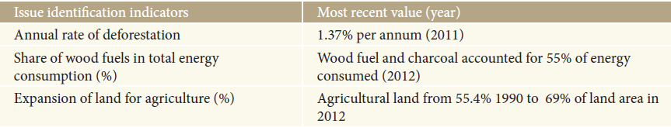
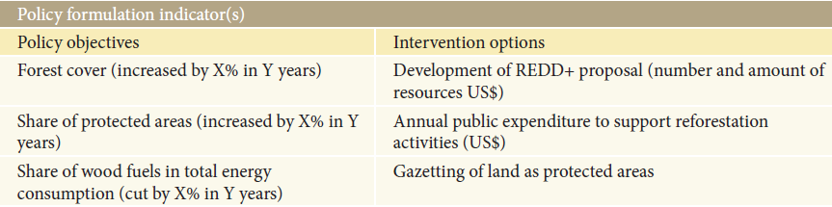
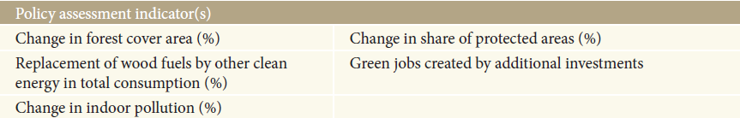
Indicators for policymaking process: Example from Ghana
46
Notes:
This slide and the next two are examples from the synthesis report on Indicators that could illustrate how to carry out the analysis at the country level.
Ghana has the highest deforestation rate in Africa. This presents a major threat to Ghana’s environmental stability. Reducing the shrinking of the country’s forest coverage has become a national priority. Since deforestation is partly due to a failure to properly value forests, the work on indicators includes a consideration of the range and value of forest ecosystem services. Indicators also include the measurement of externalities generated by other sectors and activities, such as agriculture and land-clearing for human settlement, as well as the policies to address the externalities.

Slide 47
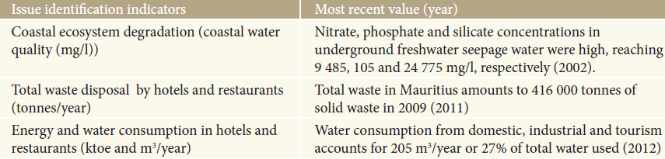
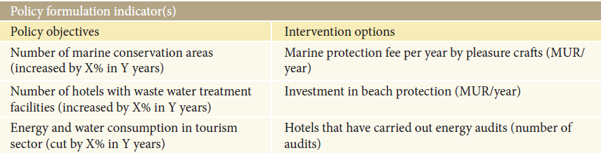
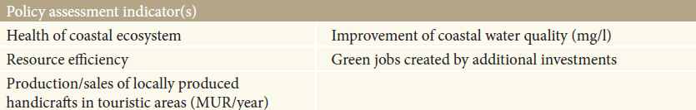
Indicators for policymaking process: Example from Mauritius
47
Notes:
The government predicts a significant increase in the number of tourists arriving in the country in the foreseeable future. In the policy formulation stage, specific targets can be set (step 1) to measure progress towards the achievement of policy objectives within a given time frame. In step 2, decision-makers use indicators to assess a number of different instruments, including comparing their costs and benefits, to induce green investments in the sector and create the enabling conditions for a shift to more sustainable development of tourism.

Slide 48
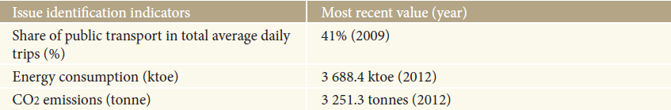
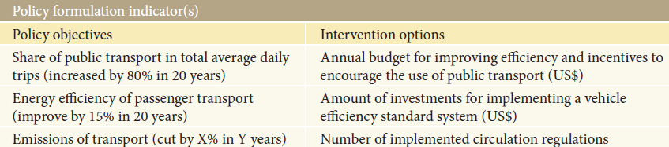
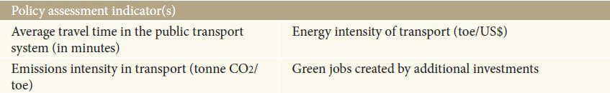
Indicators for policymaking process: Example from Uruguay
48
Notes:
Increasing public transportation is one of the priority issues in Uruguay’s transport sector. According to the results of the Household Survey on mobility and the opinion of the System of Urban Public Transport 2009 (Municipality of Montevideo, 2010), a systematic decline in the modal share of public transport (buses) has been recorded since 1996, falling from 57 per cent to 41 per cent in 2009. Another important aspect is the low use of railways in transporting cargo. Estimates are that rail transport only covers five per cent of the total volume of cargo transported annually.
The high concentration of private cars is generating congestion problems at the city level. The result is an increase in average travel times, higher fuel consumption and related CO2 emissions. The diagram presents a set of relevant indicators that address some of the main issues identified in the transport sector.

Slide 49
REFLECTION POINT
What indicators would you use to assess the outcomes of the establishment of a natural park?
Module 2, Section 4: Policy Assessment
49
Notes:
This is a summary question for the identification of policy assessment indicators. The goal is to identify indicators of outcomes across sectors, for different actors, as well as costs and benefits.

Slide 50
5
Policy Monitoring
and Evaluation
@shutterstock

Slide 51
INDICATORS FOR POLICY MONITORING & EVALUATION
Issue identification and agenda setting
Support the assessment of the performance of the intervention implemented.
Indicators for issue identification are compared to target indicators to evaluate whether the situation is improving.
Actual policy impacts on the economy and overall well-being of the population are compared to the expectations defined in the policy assessment phase.
Policy formulation - assessment
Policy monitoring and evaluation
Decision-making
Policy implementation
51
Notes:
The last stage of the integrated policymaking cycle is the monitoring and evaluation of policy impact. Indicators for policy monitoring and evaluation support the assessment of the performance of the intervention implemented. This approach focuses on the use of indicators already identified in the previous three steps: issue identification, policy formulation and assessment.

Slide 52
INDICATORS FOR POLICY MONITORING & EVALUATION - STEPS
1
2
3
Measure policy impacts in relation to the environmental issue (indicators for issue identification).
Measure the investment leveraged (indicators for policy formulation).
Measure impacts across sectors and on the overall well-being of the population (indicators for policy assessment).
52
Notes:
Firstly, it is important to measure if the problem has been solved. Secondly, the performance of the policy in addressing the problem should be evaluated in relation to the resources it has mobilised. For this reason, to assess the effectiveness of the policy instrument chosen, the investment disbursed should be measured, either directly, for example, in the form of capital investment and/or incentives, or indirectly, such as private investment triggered by the allocation of incentives, laws and regulations, or by the pricing of externalities. Thirdly, the impact on well-being (societal impacts) should be measured to assess the contribution of the investment to sustainable development.

Slide 53
KEY QUESTIONS
Is the policy implemented contributing to solving the problem?
Are the costs estimated in line with actual expenditure?
Is implementation progressing as planned?
Is there any cross-sectoral impact as a result of
policy implementation?
Is the policy contributing to inclusiveness and well-being?
Notes:
These questions are meant to summarize all the tasks for the use of indicators for monitoring and evaluation (M&E). The result of the discussion should be that we need all of the indicators identified and discussed earlier. There is no need to identify new indicators.

Slide 54
QUIZ
Link the indicators on the left-hand side to the following steps of the decision-making cycle:
Job creation from recycling
1
Issue Identification
Water pollution from waste
2
Policy Formulation
Tons of waste landfilled
3
Policy Assessment
Percentage of waste collected
4
Ban on single use plastics
Policy Monitoring & Evaluation
Municipal solid waste tax
54
Notes:
Issue Identification: Tons of waste landfilled and water pollution from waste.
Policy Formulation: Ban on single use plastics and municipal solid waste tax.
Policy Assessment: Tons of waste landfilled, water pollution from waste, job creation from recycling and percentage of waste collected.
Policy Monitoring & Evaluation: All indicators.

Slide 55
6
The GEP Measurement Framework
@shutterstock
Notes:
Source: PAGE, 2017: Green Economy Progress Measurement Framework Application. United Nations Partnership for Action on Green Economy.

Slide 56
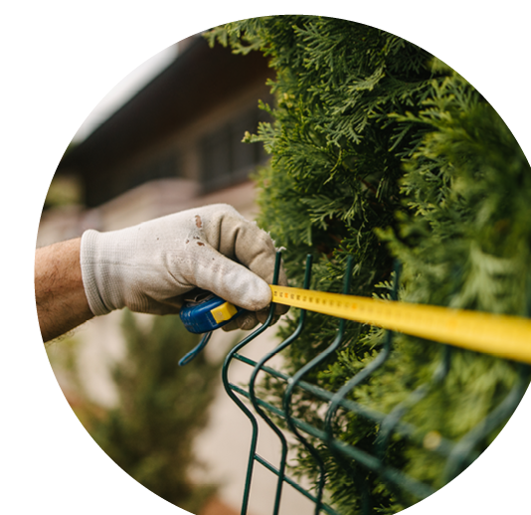
GEP MEASUREMENT FRAMEWORK: OBJECTIVES
At the international level:
Develop a framework that provides a useful tool for countries to measure their progress towards an IGE.
Measure progress in green economy areas, many related to the SDGs, and compare efforts across countries and over time to identify gaps and opportunities.
At the national level:
Measure progress in achieving national priorities.
@shutterstock
56
Notes:
The GEP Measurement Framework intends to achieve three objectives:
The first objective is to contribute to monitoring progress in implementing the sustainable development goals (SDGs) through direct links with selected SDGs. It will help to monitor progress towards specific SDG targets and support the measurement and implementation of the 2030 Agenda for Sustainable Development.
The second objective is to assess progress towards national goals in priority areas. The framework allows countries to include national indicators and targets in their “customised GEP” measurement framework to track progress in specific areas. The GEP Measurement Framework can serve as a signal to countries to change their development paths by designing or reforming national policies to promote the transition to an IGE. By tracking their green economy progress over time, countries can evaluate how quickly they are able to achieve specific targets and so measure the speed of their movement towards an IGE.
Thirdly, the GEP Measurement Framework brings transparency and accountability to policymaking and draws public attention to sustainable development challenges, also highlighting the importance of achieving progress in an integrated manner across a range of IGE concerns. It can reveal both the challenges in reducing reliance on carbon fuels and the opportunities to become resource efficient and socially inclusive. Thus, it may serve to inspire policymakers and to galvanise civil society to push for more ambitious IGE agendas. It may also help policymakers to identify policy gaps where more resources are required to increase the speed and scope of making their economies greener and more inclusive.
In addition, when applied across countries, the GEP Measurement Framework can compare countries’ efforts towards the transition to an IGE. The GEP Measurement Framework helps countries to assess where they stand, relative to other countries, in key IGE areas.

Slide 57
THE GEP MEASUREMENT FRAMEWORK
GEP Measurement Framework
The GEP Index tracks progress in green economy indicators, relative to the desired changes, that impact current well-being.
The Dashboard of progress on sustainability indicators monitors the sustainability of well-being, that is, the well-being of future generations.
GEP+ ranking of progress is carried out by comparing progress on indicators in the dashboard with progress measured by the GEP index.
GEP Index
Dashboard of Sustainability
GEP+ Ranking by area of least progress
Source: PAGE, 2017
57
Notes:
The GEP Measurement Framework is composed of a GEP Index and a companion Dashboard of Sustainability indicators. The Figure presents the GEP Measurement Framework and its parts.
The GEP Index is used to track the changes in green economy indicators relative to desired changes, which directly or indirectly impact current human well-being. It captures particular characteristics of the Inclusive Green Economy concept with a set of multidimensional indicators that cover aspects of the dimensions of sustainability. The GEP Index reflects the weighted progress achieved by countries with respect to targets set within planetary boundaries and relevant thresholds across several indicators. The value of the GEP Index enables countries to gain an overview of their progress towards greening the economy.
The Dashboard of Sustainability aims to monitor the long-term sustainability of any short-term progress, as measured by the GEP Index. It tracks some of the main forms of natural capital, such as freshwater and land, as well as other key stocks of capital, such as human health, which affect long-term sustainability. A country that manages to conserve the value of its natural assets (i.e. non-decreasing stocks of natural capital), for example, will be considered to be making progress. In this way, the dashboard acts to monitor the lasting prospects of green economy progress within a given country, highlighting impacts on the environment and society.
A final ranking of progress in achieving targets is obtained by comparing progress on the indicators in the dashboard with any green economy progress made, as measured by the GEP Index. This ranking is called the GEP+.

Slide 58
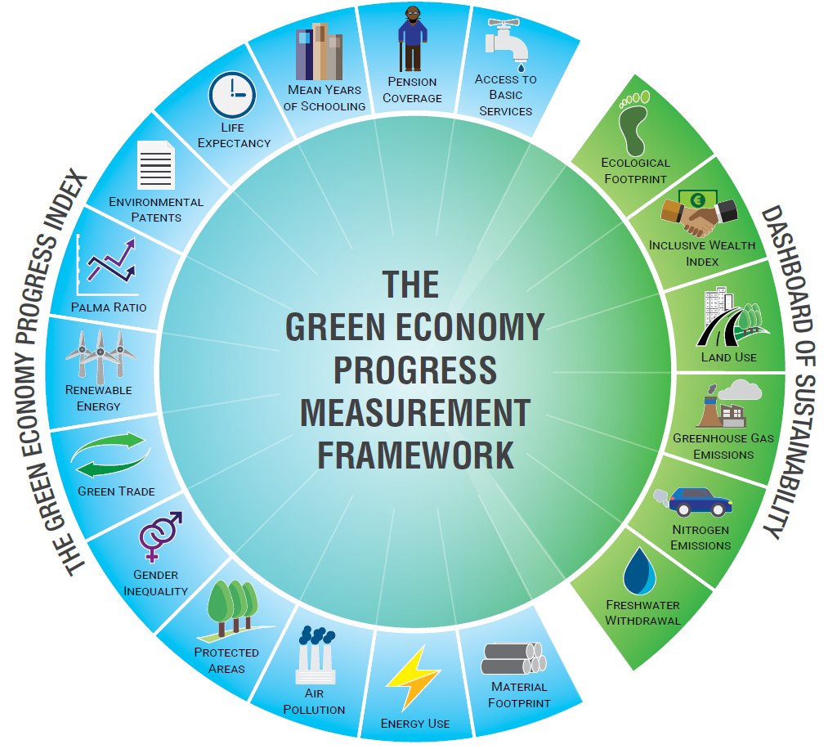
INDICATORS
GEP index: 13 indicators
Dashboard: six indicators
The Green Economy Progress Measurement Framework’s parts.
Source: PAGE, 2017
58
Notes:
To decide which indicators should be included in the GEP Measurement Framework, the following selection criteria were used:
The first selection criterion is to identify indicators that are related to the challenge that an Inclusive Green Economy seeks to address and/or to a category of the new generation of capital. The indicators should capture policy outcomes in areas in which policymakers could invest more resources to green their economies and make them more inclusive, such as access to basic services.
The second selection criterion is data coverage. For indicators to be useful in comparing the progress made by countries in greening their economies, indicators must be adequate in terms of country development, both developed and developing, and time coverage, with information for countries from all regions and degrees of development, and with observations over a period of at least two years. The two years considered in the GEP Index in this initial instance are 2004 and 2014, and the data is averaged over a five-year period around these years. This approach was chosen based on the availability of comparative data and because it takes time for green economy indicators to fully reflect policy changes. The temporal frame can be updated as more data becomes readily accessible. Indicators that fulfil the first selection criterion and for which there is good data coverage were preferred.
The third selection criterion is data access. Data should be publicly available through international organisations with the mandate of collecting and harmonising global databases and, in some cases, from NGOs with excellent records of accomplishment in the regular production of indicators, such as the World Resources Institute and the Global Footprint Network. This will allow the results of the GEP Index to be replicated, tested and expanded.
The fourth and final criterion, which applies solely to the indicators in the Dashboard of Sustainability, is that they should be widely recognised as representing a planetary boundary, such as land, water and emissions, and have an estimated threshold value derived from the literature.
It is important to note that it was not possible to include some indicators of interest in the GEP Index, either because they are still at a preliminary stage of development, such as green jobs, or because data is proprietary, such as renewable energy investments.

Slide 59
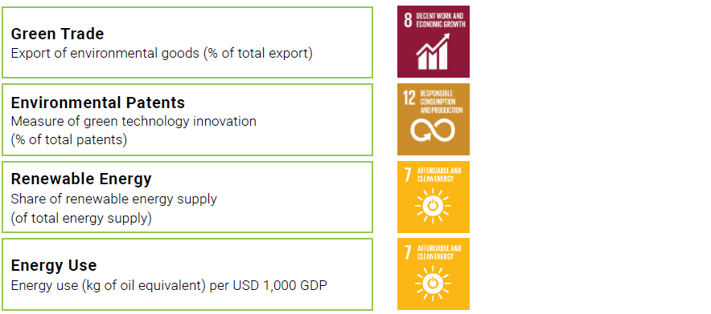
MAPPING INDICATORS WITH SDGS
Green Trade
Export of environmental goods (% of total export)
Environmental Patents
Measure of green technology innovation
(% of total patents)
Renewable Energy
Share of renewable energy supply
(of total energy supply)
Energy Use
Energy use (kg of oil equivalent) per USD 1,000 GPD
Source: PAGE, 2017
59
Notes:
The GEP Measurement Framework has strong linkages with many of the SGDs. It has 14 direct links to 10 of the 17 SDGs.
Regardless of the nature of its future use, the GEP Measurement Framework constitutes a useful tool in bridging national and international assessment of progress and assisting countries as they seek to monitor and deliver on the SDGs. This will help not only in the monitoring process but also in the integration and articulation of policies by enhancing the linkages between IGE policies to the overall objectives of sustainable development.

Slide 60
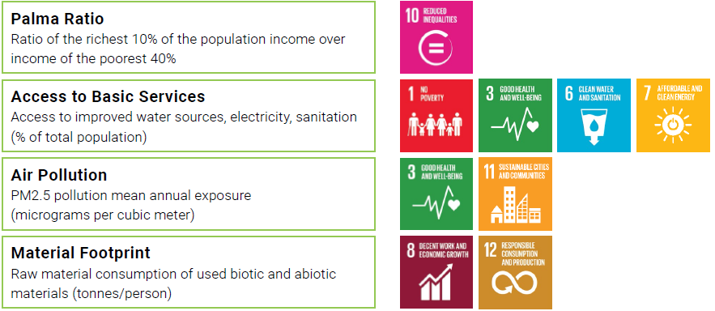
MAPPING INDICATORS WITH SDGS
Palma Ratio
Ratio of the richest 10% of the population income over income of the poorest 40%
Acess to Basic Services
Access to improved water sources, electricity, sanitation (% of total population)
Air Pollution
PM2.5 pollution mean annual exposure
(micrograms per cubic meter)
Material Footprint
Raw material consumption of used biotic and abiotic materials (tonnes/person)
Source: PAGE, 2017
60
Notes:
The GEP Measurement Framework has strong linkages with many of the SGDs. It has 14 direct links to 10 of the 17 SDGs.
Regardless of the nature of its future use, the GEP Measurement Framework constitutes a useful tool in bridging national and international assessment of progress and assisting countries as they seek to monitor and deliver on the SDGs. This will help not only in the monitoring process but also in the integration and articulation of policies by enhancing the linkages between IGE policies to the overall objectives of sustainable development.

Slide 61
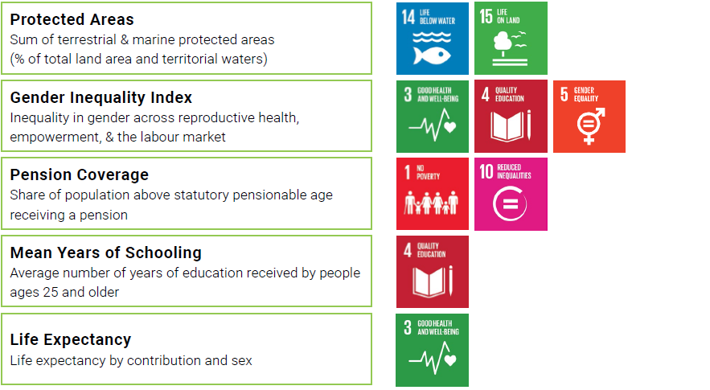
MAPPING INDICATORS WITH SDGS
Protected Areas
Sum of terrestrial & marine protected areas
(% of total land area and territorial waters)
Gender Inequality Index
Inequality in genders across reproductive health, empowerment, & the labour market
Pension Coverage
Share of population above statutory pensionable age
receiving a pension
Mean Years of Schooling
Avarage number of years of education received by people ages 25 and older
Life Expectancy
Life expectancy by contribution and sex
Source: PAGE, 2017
61
Notes:
The GEP Measurement Framework has strong linkages with many of the SGDs. It has 14 direct links to 10 of the 17 SDGs.
Regardless of the nature of its future use, the GEP Measurement Framework constitutes a useful tool in bridging national and international assessment of progress and assisting countries as they seek to monitor and deliver on the SDGs. This will help not only in the monitoring process but also in the integration and articulation of policies by enhancing the linkages between IGE policies to the overall objectives of sustainable development.

Slide 62
GEP INDEX
Intended to measure the progress in achieving the transition towards an inclusive green economy (IGE) based on three main ideas:
1
Identifying key dimensions to be associated with an IGE, each approximated by one or several variables.
2
Focusing on progress, i.e. changes rather than levels.
3
Measuring progress relative to targets and thresholds. Targets refer to desired changes, whereas thresholds define some critical levels.
62

Slide 63
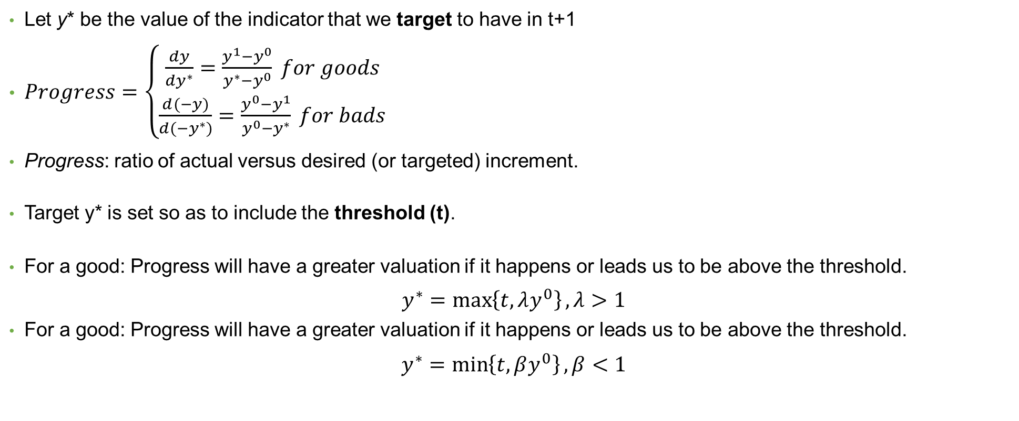
METHODOLOGY: PROGRESS
Let y* be the value of the indicator that we target to have in t+1
$Progress=\left\{\begin{aligned}\frac{dy}{dy^{∗}}=\frac{y^{1}−y^{0}}{y^{∗}−y^{0}} for goods \\ \frac{d(−y)}{d{(−y}^{∗})}=\frac{y^{0}−y^{1}}{y^{0}−y^{∗}} for bads\end{aligned}\right.$
Progress: ratio of actual versus desired (or targeted) increment.
Target y* is set so as to include the threshold (t).
For a good: Progress will have a greater valuation if it happens or leads us to be above the threshold.
$$y^{∗}=\max\left\{t, λy^{0}\right\}, λ>1$$
For a good: Progress will have a greater valuation if it happens or leads us to be above the threshold.
$$y^{∗}=\min\left\{t, βy^{0}\right\}, β<1$$
63
Notes:
Green economy progress on each individual indicator is measured as the ratio between the actual change observed and the desired change with respect to a target for that indicator.

Slide 64
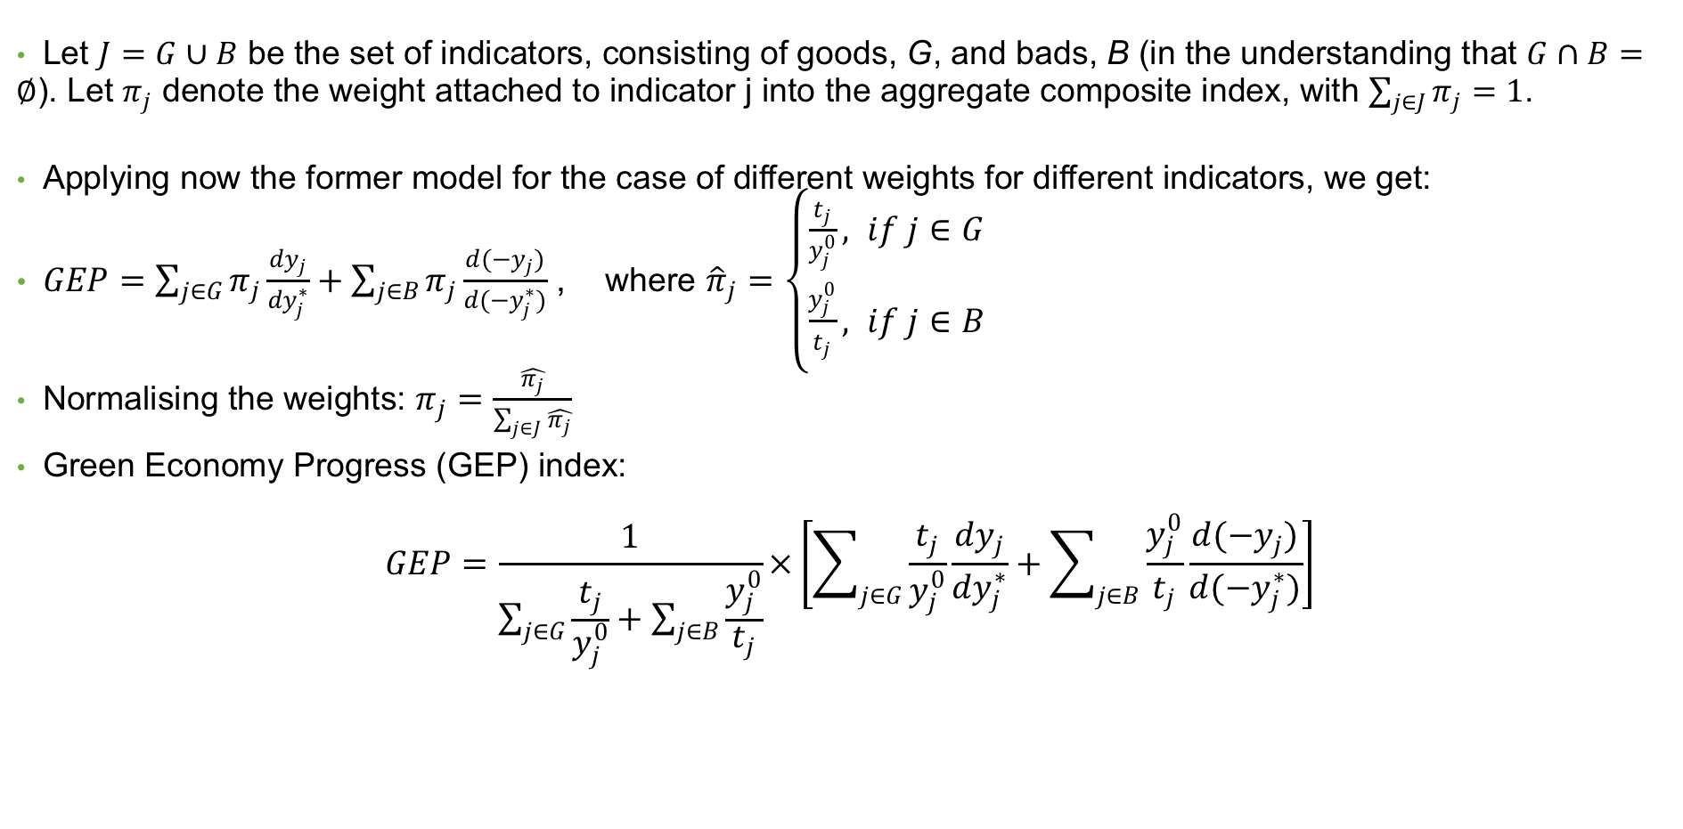
METHODOLOGY: GEP INDEX
Let $J=G∪B$ be the set of indicators, consisting of goods, G, and bads, B (in the understanding that $G∩B=∅$). Let $π_{j}$ denote the weight attached to indicator j into the aggregate composite index, with $\sum_{j∈J}{π_{j}=1}$.
Applying now the former model for the case of different weights for different indicators, we get:
$GEP=\sum_{j∈G}{π_{j}}\frac{{dy}_{j}}{{dy}_{j}^{∗}}+\sum_{j∈B}{π_{j}}\frac{{d(−y}_{j})}{{d(−y}_{j}^{∗})}$ , where ${\hat{π}}_{j}=\left\{\begin{aligned}\frac{t_{j}}{y_{j}^{0}}, if j∈G \\ \frac{y_{j}^{0}}{t_{j}}, if j∈B\end{aligned}\right.$
Normalising the weights: $π_{j}=\frac{\hat{π_{j}}}{\sum_{j∈J}{\hat{π_{j}}}}$
Green Economy Progress (GEP) index:
$$GEP=\frac{1}{\sum_{j∈G}{\frac{t_{j}}{y_{j}^{0}}}+\sum_{j∈B}{\frac{y_{j}^{0}}{t_{j}}}}×\left[\sum_{j∈G}{\frac{t_{j}}{y_{j}^{0}}\frac{{dy}_{j}}{{dy}_{j}^{∗}}+\sum_{j∈B}{\frac{y_{j}^{0}}{t_{j}}\frac{{d(−y}_{j})}{{d(−y}_{j}^{∗})}}}\right]$$
64
Notes:
Green economy progress in the multidimensional case is measured by the aggregation of progress across indicators for each country into a composite index. This index provides an overall picture of progress achieved by each country and allows cross-country comparisons within peer groups of countries. For a meaningful comparison across indicators within a country and across countries, a weighting system combines progress across different indicators and emphasises the areas most in need of improvement. This is, in essence, the GEP Index.

Slide 65
OVERALL RANKING
Aggregating information in the GEP index and dashboard
Rank all index-dashboard profiles but do not combine their information into a synthetic index.
When comparing progress based on the GEP index and the dashboard, countries are ranked according to their least-performing progress.
65
Notes:
Finally, to assess GEP relative to planetary boundaries, the progress achieved in the GEP Index indicators is compared with progress made in the indicators of the Dashboard of Sustainability. The purpose is to highlight whether planetary boundaries have been overstepped. It should be noted that the thresholds of indicators in the Dashboard and of some indicators in the GEP Index are determined on the basis of scientific literature, while other thresholds in the GEP Index are empirically determined.
Although the GEP Index should not be combined with the Dashboard of Sustainability as a composite measure of sustainable development, the information from the two instruments can, nonetheless, tell us which countries are in more favourable positions than others. This methodology allows us to rank all Index–Dashboard profiles but not to combine the index and dashboard information into a synthetic index. The ranking is produced by applying the Protective Criterion, which allows us to order countries in terms of their worst achievement but considering only the dimensions on which they differ. When comparing countries’ progress based on the GEP Index and the Dashboard, countries are ranked according to their least-performing type of progress, based on the principle of Priority to the Worst Achievement. This methodology sends the policy message that a country making substantial progress on only a few aspects of an IGE will not necessarily be doing better than one that is moving forward in all areas. Ranking countries based on the area in which they are making the least progress gives countries the incentive to implement a more balanced and integrated policy approach that is aimed at moving forward across the broad spectrum of an IGE.

Slide 66
METHODOLOGY: TARGETS AND THRESHOLDS
Targets: Ambitious but feasible (countries characteristics)
  Proportion of country’s initial condition. Varies by HDI group (top 10% best performing by group)
  Countries exceeding threshold: reducing gap (threshold and initial condition)
  Assign most stringent between the two
Thresholds: mix data and research driven
  Goods (bads): value of 25th (75th) percentile of distribution in 2000
  Environment: air pollution (WHO), material footprint per capita (Stefan Bringezu, 2015), protected areas (Aichi Biodiversity Targets)
66
Notes:
For a “good”, the target of a country is calculated on the basis of the 10 per cent best performing countries in the distribution. In other words, a country should achieve a target that is based on an increase in y that is at least as good as the one achieved by the 10 per cent best performing countries in its relevant comparison group. Similarly, for a “bad”, the target of the country is set to achieve a reduction as significant as the reduction of the 10 per cent best performing countries in the relevant comparison group. In other words, a country should have as a target a reduction in y that is as big as the one achieved by the 10 per cent best performing countries in the relevant comparison group.
Thresholds are determined based on the data and internationally recognised scientific sources. For “goods” (“bads”), the value of the threshold is set at the value of the 25th (75th) percentile of the distribution in 2004. Countries should never go below (or above) the value achieved by the bottom 25 per cent (top 75 per cent) of countries in 2004 for this indicator. Internationally recognised scientific sources are used for environmental indicators, including recommendations on air pollution from the World Health Organization (WHO, 2014); on material footprint per capita from Stefan Bringezu (2015); and on protected areas from Aichi Biodiversity Targets (Leadly et. al., 2014).

Slide 67
RESULTS GEP INDEX
BY INDICATOR
Variable | Obs | Mean | Std. Dev. | Min | Max
material footprint | 104 | -1.83 | 5.57 | -52.53 | 1.43
air pollution | 105 | -0.13 | 0.89 | -5.70 | 1.23
protected areas | 101 | 0.15 | 0.35 | -0.04 | 2.44
energy use | 102 | 0.37 | 0.46 | -1.43 | 2.03
green trade | 93 | 0.10 | 0.30 | -0.28 | 1.61
green technology innovation | 54 | 0.13 | 0.98 | -0.92 | 5.98
renewable energy source | 101 | 0.04 | 0.36 | -0.78 | 1.11
Palma ratio | 96 | 0.06 | 0.68 | -2.04 | 1.74
gender inequality index | 98 | 0.39 | 0.30 | -0.28 | 1.46
access to basic services | 71 | 0.38 | 0.23 | -0.05 | 1.00
mean years of schooling | 103 | 0.39 | 0.25 | -0.42 | 1.04
pension coverage | 66 | 0.22 | 0.96 | -4.55 | 2.19
life expectancy | 103 | 0.39 | 0.20 | -0.32 | 1.48
Source: PAGE, 2017
67
Notes:
Given data availability, it was possible to calculate progress for 13 indicators for the two data points of analysis, 2004 and 2014, for a total of 105 countries. The table presents summary statistics for these 13 indicators (to later be aggregated into the GEP Index, which will be covered in the next section). On average, progress by countries in the sample was highest on the indicators measuring education, life expectancy, gender inequality and energy use, meaning education and life expectancy increased while gender inequality and energy use decreased. On the other hand, material footprint and air pollution saw, on average, the most significant regress, with material footprint and air pollution increasing.

Slide 68
RESULTS GEP INDEX
BY COUNTRY
Source: PAGE, 2017
68
Notes:
The figure shows the values of the GEP Index for each of the 105 countries in the sample. Most of the countries are above the 0 line, meaning that they are making progress towards an Inclusive Green Economy. However, the figure also shows that some countries are making significant regress, such as Mongolia and Uruguay.

Slide 69
RESULTS DASHBOARD
BY INDICATORS
Indicator | Obs. | Mean | Std. Dev. | Min | Max
Freshwater withdrawal | 79 | -0.07 | 1.65 | -10.93 | 1.28
Greenhouse gas emissions | 104 | -0.31 | 0.68 | -3.74 | 0.84
Emissions of nitrogen | 102 | -0.35 | 1.11 | -5.07 | 1.48
Land use | 104 | -0.31 | 1.03 | -4.24 | 1.54
Ecological footprint | 92 | -0.34 | 0.82 | -4.95 | 1.02
Inclusive Wealth Index | 100 | 0.31 | 0.52 | -1.11 | 1.84
Inclusive Wealth Index (Natural Capital) | 100 | -5.84 | 7.48 | -26.41 | 5.21
Source: PAGE, 2017
69
Notes:
The table shows that, on average, countries are experiencing regress in the dashboard indicators. In other words, countries are on average exceeding planetary boundaries. The only indicator for which the majority of countries are making progress is the Inclusive Wealth Index, with an average progress of 0.31. One striking result is that, across all indicators, some countries are experiencing significant regress, where progress is lower than -1. In addition, no country has a progress value greater than one for greenhouse gas emissions, one of the areas for which there are significant global concerns in terms of environmental sustainability (Rockstrom, J. et al., 2009).

Slide 70

FINAL REMARKS
The GEP Index shows that in 2014, 83 out of 105 countries (79 per cent) managed to achieve progress in their transition towards an Inclusive Green Economy, as compared to the year 2004.
Progress on the green economy, as measured by the GEP Index, shows important differences in results across geographical regions and development groups.
Results from the dashboard show that, on average, countries are making regress in the sustainability indicators.
@shutterstock
70
Notes:
There are important challenges: increasing material footprint and overstepped planetary boundaries.
The overall ranking (applying the Protective Criterion) shows that only 17 out of 100 countries were able to make progress in the dashboard and the GEP index.
Methodology is flexible for country application, even across subjects. Specific indicators reflecting national priorities, sub-national measurement, time frame, etc.
Integration with modelling. Subset of core indicators that can be tracked when implementing the IGEM, so that we could also see the potential impact on overall progress.

Slide 71
End of Module 2.
Thank you for your attention!

