Slide 1
Module 3 – Overview of modeling approaches and models
Course: Inclusive Green Economy (IGE) modelling
Date / Place / Name

Slide 2
OVERVIEW
1 Overview of methods
2 Overview of models
3 Interpretation of results
4
In depth review: Integrated Green Economy Modelling (IGEM) framework

Slide 3
1
Overview of Methods

Slide 4
UNDERSTANDING SIMULATION MODELS
A model is a simplification of reality.
It includes variables and equations and uses data.
There are three main methods for solving equations:
The method used influences the type of data inputs required and the approach to policy analysis.
optimization
econometrics
simulation
Notes:
Models are constructs that aim at explaining reality, in a simplified way. They are made of variables and equations and use data for parametrization, calibration and validation.
There are three main methods used to “solve” models and generate results: optimization, econometrics and simulation.

Slide 5
REFLECTION POINT
Have you used models before?
What type of model, and for what type
of analysis?
Module 3, Section 1: Overview of Methods
Notes:
This question allows students to share their experience with models. Hopefully, the students have worked with, or heard of, various models in various sectors. This will show that there are many models, and that these may be used in the same way in different sectors.

Slide 6
METHODOLOGIES: OPTIMIZATION
Solves model equations by finding an optimal solution based on an “objective function”.
One or more “constraints” can be considered in the formulation of the objective function.
Optimization can lead to a snapshot (next optimal level), or a sequence of stages,
with explicit time and a semi-continuous approach.
Notes:
Optimization models are used to find the optimal intervention, based on a set of constraints.

Slide 7
POLL
What stage of the policymaking process can profit the most from the use of optimization models?
Issue identification
Policy formulation
Policy assessment
Notes:
The correct answer is policy formulation. This is because optimization models estimate the “optimal state” of the system, allowing primarily for policy packages to be formulated by estimating the outcomes of specific targets, rather than testing specific policy interventions that would allow the system to reach such targets.

Slide 8
METHODOLOGIES: ECONOMETRICS
Estimates the correlation between one or more variables in the system.
Uses historical trends to forecast possible future changes.
Assumes that the drivers of change of the past remain relevant (but not the only ones) for the future.
Allows the analysis to be extended to capture more indicators, if data is available.
Notes:
Econometric models are used to assess policy outcomes, based on past experience and trends, by taking advantage of the autoregressive nature of many macroeconomic data

Slide 9
POLL
What stage of the policymaking process can profit the most from the use of econometric models?
Issue identification
Policy formulation
Policy assessment
Notes:
The correct answer is al three - issue identification, policy formulation and policy assessment. This is because econometric models estimate projections based on trends, hence allowing the estimation of potential emerging trends that are undesirable, and policy formulation and policy outcomes estimate projections based on real data, hence planned policies can be simulated, which helps to define targets and evaluate results.

Slide 10
METHODOLOGIES: SIMULATION
Focuses on “causal-descriptive” relations.
Represents drivers of change of the past, as well as possible emerging ones for the future.
Can be top-down, such as System Dynamics, or bottom-up, such as Agent-Based Modelling.
Emphasizes how structure drives behavior (feedback loops) and shifts dominance of drivers of change.
Notes:
Simulation models are more “exploratory” and aimed at generating new behavior, primarily based on causality, such as System Dynamics or Agent-Based models. Depending on the type of econometric model, they can also be used for simulations.

Slide 11
POLL
What stage of the policymaking process can profit the most from the use of simulation models?
Issue identification
Policy formulation
Policy assessment
Notes:
The correct answer is all three, with particular emphasis on policy formulation and policy assessment. Differently from the other models, the analysis with simulation tends to be more systemic, allowing the expansion of the boundaries of policy assessment to all dimensions of development.

Slide 12
SUMMARY OF METHODOLOGIES
METHODOLOGY | MODEL FORMULATIONS | TIME HORIZON | ANALYSIS APPROACH | TYPE OF SIMULATION
Optimization | Constraints, objective function | Snapshot, short term | Bottom up (sectoral), Top-down (macro) | Target based, backward looking
Econometrics | Correlations, causal | Short and medium term | Top-down | Forward looking
Simulation | Causal, descriptive | Short, medium and long-term | Top-down, Bottom-up | Forward looking
Notes:
Depending on the type of econometric model and the identification strategy, econometric models could help in explaining causal impacts of policies.

Slide 13
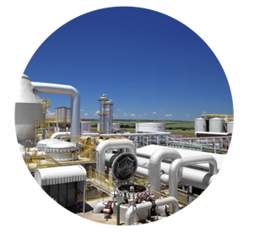



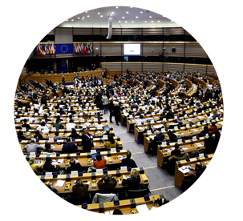
TYPES OF ASSESSMENT
Economic assessment
@shutterstock
Environmental
assessment
@shutterstock
Integrated
assessment
@shutterstock
Social
assessment
@shutterstock
Governance
assessment
@shutterstockv
Notes:
There are five main types of assessments that are used in the policymaking process and that can be supported by the use of simulation models.

Slide 14
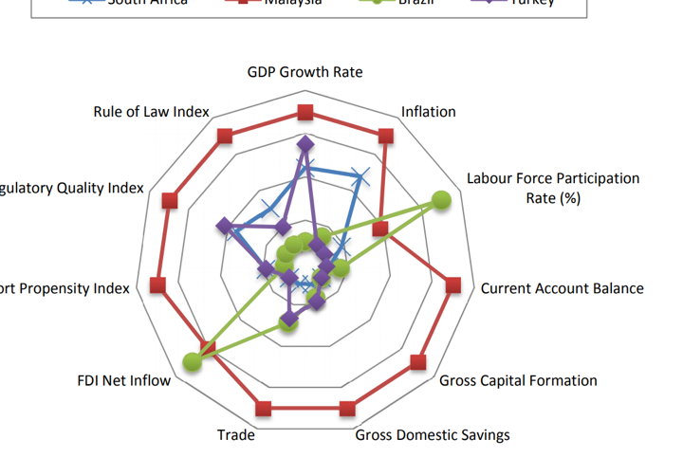
ECONOMIC ASSESSMENT
Macroeconomic Indicators
South Africa
Malaysia
Brazil
Turkey
Designed to support the analysis of policies, projects and investments with respect to their expected economic outcome.
An example of this type of framework is the methodology for conducting feasibility studies.
GDP Growth Rate
Rule of Law Index
Inflation
Regulatory Quality Index
Labour Force
Participation Rate (%)
Export Propensity Index
Current Account Balance
FDI Net Inflow
Gross Capital Formation
Trade
Gross Domestic Savings
Source: ILO, 2016
Notes:
An economic assessment is an assessment framework designed to support the analysis of policies, projects and investments with respect to their expected economic outcome. An example of this type of framework is the methodology for conducting feasibility studies.
Feasibility study refers to an evaluation of the likelihood that a given policy, project, investment or business achieves stated objectives. These studies are commonly used to assess the economic soundness of projects/policies by quantifying the expected return on investment. Feasibility studies are conducted using a variety of methodologies and tools, including cost-benefit analysis, life-cycle analysis, and simulation models.
Source: ILO, 2016: The enabling environment for sustainable enterprises in South Africa. International Labour Office, Geneva.

Slide 15
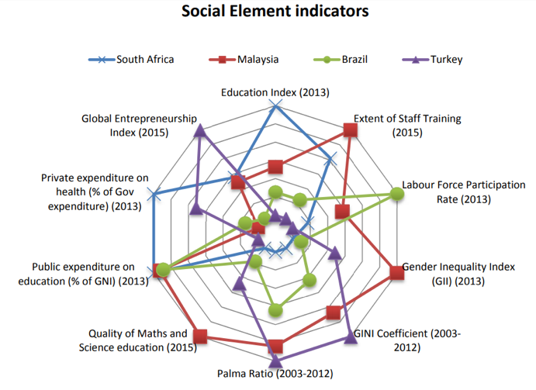
SOCIAL ASSESSMENT
Social Element Indicators
Provides guidance on how to evaluate policy impacts on different social groups, and review and monitor key governance indicators.
An example is Poverty and Social Impact Analysis (PSIA), which facilitates the assessment of policy inclusiveness and pro-poor orientation.
South Africa
Malaysia
Brazil
Turkey
Education Index (2013)
Global Entrepreneurship Index (2015)
Extent of Staff Training (2015)
Private expenditure on health (% of Gov expenditure) (2013)
Labour Force Participation Rate (2013)
Public expenditure on education (% of GNI) (2013)
Gender Inequality Index (GII) (2013)
Quality of Maths and Science Education (2015)
GINI Coefficient (2003-2012)
Palma Ratio (2003-2012)
Source: ILO, 2016
Notes:
A social assessment is a framework that provides guidance to decision makers on how to evaluate policy impacts, such as inclusiveness, on different social groups, as well as reviewing and monitoring key governance indicators in relation to policy objectives, as a means of identifying gaps and capacity building needs. A widely used methodology for conducting social assessments is Poverty and Social Impact Analysis (PSIA), which facilitates the assessment of policy inclusiveness and pro-poor orientation.
Source: ILO, 2016: The enabling environment for sustainable enterprises in South Africa. International Labour Office, Geneva.
An example dedicated to the analysis of social and distributive impacts of fiscal policies is Gabriela Inchauste and Nora Lustig, Editors, 2017: The Distributional Impact of Taxes and Transfers: Evidence from Eight Low- and Middle-Income Countries. Available at: https://elibrary.worldbank.org/doi/abs/10.1596/978-1-4648-1091-6_ch1

Slide 16
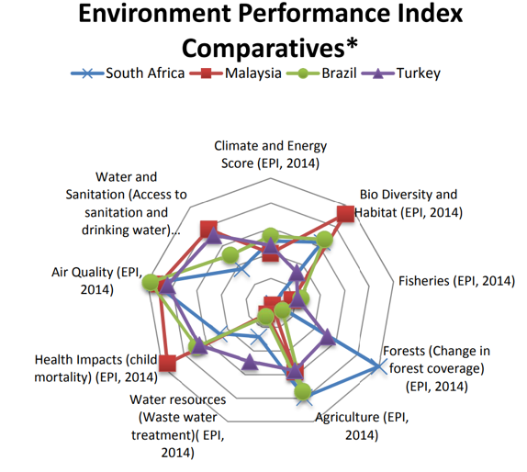
ENVIRONMENTAL ASSESSMENT
Environment Performance
Index Comparatives
Includes frameworks that combine tools
for the evaluation of the environmental
impacts of development strategies, policies,
projects and investments.
Examples include:
(1) Strategic Environmental Assessment (SEA)
(2) Environmental Impact Assessments (EIA)
South Africa
Malaysia
Brazil
Turkey
Climate and Energy Score (EPI, 2014)
Water and Sanitation (Access to sanitation and drinking water…)
Bio Diversity and Habitat (EPI, 2014)
Air Quality
(EPI, 2014)
Fisheries (EPI, 2014)
Health Impacts (child mortality) (EPI, 2014)
Forests (Change in forest coverage) (EPI, 2014)
Water resources (Waste water treatment) (EPI, 2014)
Agriculture (EPI, 2014)
Source: ILO, 2016
Notes:
Environmental assessment: this category includes methodological frameworks that combine tools for the evaluation of the environmental impacts of development strategies, policies and projects, such as audits, and investments. They include: (1) Strategic Environmental Assessments (SEA), for strategies/policies; (2) Environmental Impact Assessments (EIA), for projects; and (3) environmental audits, primarily for existing assets, such as buildings.
Source: ILO, 2016: The enabling environment for sustainable enterprises in South Africa. International Labour Office, Geneva.

Slide 17
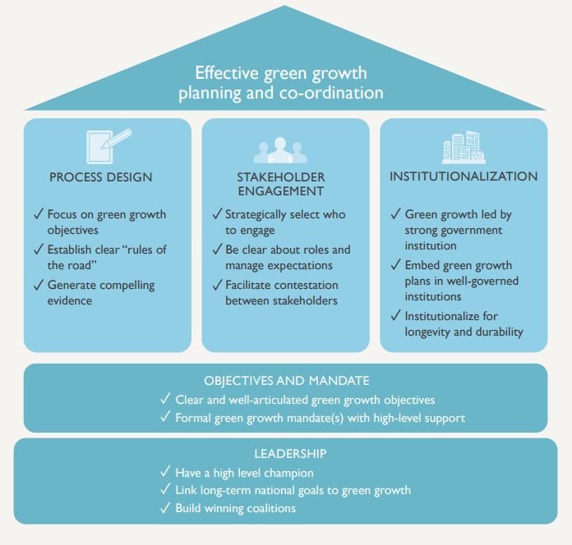
GOVERNANCE ASSESSMENT
Foundations for green growth planning and co-ordination
IGE policies require efficient and
transparent institutional frameworks
and processes at both the national
and local levels.
There are six key principles: participation,
fairness, decency, accountability,
transparency and efficiency.
Source: GGBP, 2014
Notes:
Governance assessment: the formulation, implementation, monitoring and evaluation of integrated IGE policies requires efficient and transparent institutional frameworks and processes at both the national and local levels. In order to conduct governance assessments, decision makers can adopt specific methodological frameworks, such as UNDP’s governance assessment.
Source: GGBP, 2014: Green Growth in Practice - Lessons from Country Experience. Green Growth Best Practice.

Slide 18
INTEGRATED ASSESSMENT
The structure of the integrated green economy modelling framework
An assessment that estimates policy
outcomes for various sectors, economic
actors and dimensions of development,
as well as over time.
As an example, Decision Support
Systems (DSS) provide valuable
guidance to decision makers for the
integrated evaluation of IGE policies.
SD
IGEM
Green IO-SAM
ECONOMY
ENVIRONMENT
Green CGE
ECONOMY
SOCIETY
SOCIETY
ENVIRONMENT
Source: UNEP, 2017
Notes:
Integrated assessment: the methodological frameworks listed up to now allow the assessment of different dimensions of IGE. On the other hand, approaches exist to conduct a more comprehensive (or integrated) IGE assessment. As an example, by integrating multiple data and tools in a unique assessment framework, Decision Support Systems (DSS) provide valuable guidance to decision makers for the integrated evaluation of IGE policies. An example is the IGEM model, which integrates all dimensions of development in the modelling framework.
Source: UNEP, 2017: The Integrated Green Economy Modelling Framework - An overview. United Nations Environment Programme 2017, on behalf of PAGE. Available here: https://www.un-page.org/files/public/20170728_report-layout-online.pdf

Slide 19
2
Overview of Models

Slide 20
OVERVIEW OF MODELS
Many models are available to support the assessment of the outcomes of IGE investments.
Some capture few, some many of the characteristics of the IGE.
Both qualitative and quantitative models can be used
for IGE assessments.
Notes:
The following slides focus on selected examples:
Qualitative: Delphi analysis, decision tree and causal loop diagrams.
Quantitative: Income and expenditure surveys, input-output tables, Social Accounting Matrix (SAM), partial equilibrium models, Computable General Equilibrium Models (CGE), macroeconometrics and System Dynamics (SD).

Slide 21
OVERVIEW OF MODELLING APPROACHES
Refer to the underlying mathematical theories and frameworks that can be used to create and simulate (or solve) quantitative simulation models.
Usefulness of models depends on their match to the definition of a green economy, which depends on the local context, the quantitative outputs they generate to effectively inform decision-making, and how easy they are to customise and use.
Notes:
Modelling approaches refer to the underlying mathematical theories and frameworks that can be used to create and simulate (or solve) quantitative simulation models. These methodologies could therefore be considered “dynamic”, as they allow for generating future projections: a) forecasting; b) scenario building.
An important criteria for understanding the usefulness of models is to explore their match to the definition of a green economy, which would vary depending on the national context, and the quantitative outputs required to effectively inform decision-making. As a result, the main criteria to be considered include the capability of models to represent the social, economic and environmental dimensions of the problems and opportunities analysed, as well as their capability to carry out investment and policy analysis. As an additional layer of the analysis, models are assessed for their ease of customization and use. This is relevant for specific country implementation, where data, time and financial resources may be scarce, and trade-offs need to be addressed.

Slide 22
MODELLING USEFULNESS DEPENDS ON THEIR SUPPORT OF THE POLICYMAKING PROCESS
Ex-ante modelling can generate “what if” projections on scenarios with no action, as well as the potential impact of proposed policies.
Ex-post modelling can support impact evaluation.
Improvements to the model and updated projections
enhance policy decision making.
Notes:
Ex-ante modelling can generate “what if” projections on scenarios with no action, and on the expected (and unexpected) impacts of proposed policy options on a variety of key indicators. In addition, various methodologies can assist in the cost-benefit and multi-criteria analysis, and subsequent prioritization of policy options. Ex-post modelling can support impact evaluation by improving the understanding of the relations among key variables in the system and by comparing the projected performance with initial conditions and historical data. This can be done by considering individual interventions or a policy package. Improvements to the model and updated projections allow decision makers to refine targets and objectives, building on synergies and positive spillovers across sectors.

Slide 23
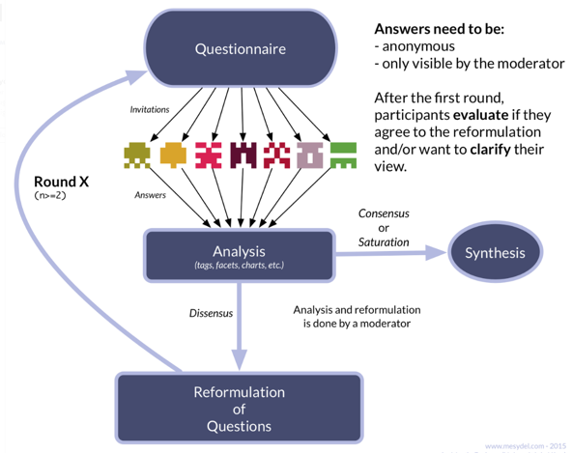
QUALITATIVE MODEL: Delphi Analysis
The Delphi Method
The Delphi method consists of a multi-round survey to converge towards a common solution or view.
At every round following the first one, the participants are given the results of the previous rounds.
Thus, they are asked to reconsider their judgements based on the opinions of others.
This helps them converge towards a common solution or view.
Source: Rivière, 2018
Notes:
Delphi Analysis is a method to elicit knowledge through the use of surveys. Delphi was developed in the early 1960’s by the RAND Corporation (European Commission, 2006). It has since been applied in many foresight activities at the national level, as well as in numerous industrial/commercial strategic assessments. The core of the Delphi method is a multi-round survey. The underlying hypothesis of this method is that experts in a field have expectations for the likely future development (expert knowledge) of their field, and it is possible to identify outliers by involving a large enough group of participants and sharing the result of each survey. Practically, at every round following the first one, the participating experts are given the results of the previous rounds. Thus, the participants are asked to reconsider their judgments based on the opinions of their peers. As a result, Delphi could be considered an anonymous group discussion. While introducing some of the advantages of a discussion into the survey, the anonymity of the process ensures that the opinions of influential individuals do not dominate the findings. Instead the most likely or convincing developments are identified based on rational arguments (European Commission, 2006).
Source: Rivière, M., 2018: What is the Delphi method and what is it used for? Last accessed: Dec 12, 2019 https://blog.mesydel.com/what-is-the-delphi-method-and-what-is-it-used-for-feb2d26f917a

Slide 24

EXAMPLE
EurEnDel is the largest energy Delphi study that was ever conducted in Europe, with around 3,000 experts participating over a time frame of 30 years .
It aims to describe trends in the development of energy technologies, and to identify research and development needs in the energy sector.
@shutterstock
Notes:
EurEnDel is the largest energy Delphi study that was ever conducted in Europe, with around 3,000 experts participating over a time frame of 30 years (European Commission, 2006). The focus of the study was the technological development of the energy sector. The aim of the EurEnDel Delphi study is to describe trends in the development of energy technologies, and to identify research and development needs in the energy sector (EurEnDel, 2004). EurEnDel achieves its goal by combining prospective and normative foresight elements, and hence focusses on likely developments and future requirements of the energy market. Over the years, EurEnDel has developed a multitude of social and technological perspectives, scenarios and policy recommendations.

Slide 25
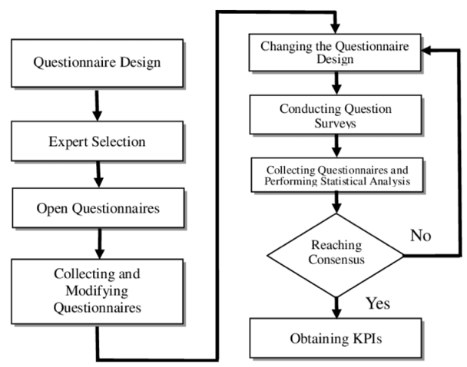
DELPHI ANALYSIS
Data source(s)
  Expert practitioners and researchers
Data Availability
  Delphi is a data collection method, which
  requires thorough analysis of the current
  situation before execution
Accessibility and Typical Users
  Highly accessible
  Results are an overview of expert opinions
  on specific questions or topics
Source: Cheng et al., 2011
Notes:
Source: Cheng, Yu-Tien & Chou, Han-Hsin & Cheng, Ching-Hsue, 2011: Extracting key performance indicators (KPIs) new product development using mind map and Decision-Making Trial and Evaluation Laboratory (DEMATEL) methods. African Journal of Business Management.

Slide 26
REFLECTION POINT
What do you think is the core contribution of qualitative models in the context of an IGE assessment?
Module 3, Section 2: Overview of Models
Notes:
This question aims to address the extent to which models can support an IGE assessment, beginning with qualitative models, which help frame and contextualize the problem or future issue.

Slide 27
QUALITATIVE MODEL: Causal Loop Diagram (CLD)
A CLD consists of variables connected by arrows denoting the causal influences among the variables. Feedback loops are also identified in the diagram.
CLDs support the identification of policy outcomes using a systemic approach.
Notes:
A causal loop diagram (CLD) is a map of the system analysed, or, better, a way to explore and represent the interconnections between the key indicators in the analysed sector or system (Probst & Bassi, 2014). As indicated by John Sterman, “A causal diagram consists of variables connected by arrows denoting the causal influences among the variables. The important feedback loops are also identified in the diagram. Variables are related by causal links, shown by arrows. Link polarities describe the structure of the system. They do not describe the behaviour of the variables. That is, they describe what would happen if there were a change. They do not describe what actually happens. Rather, it tells you what would happen if the variable were to change.” (Sterman, 2000)

Slide 28
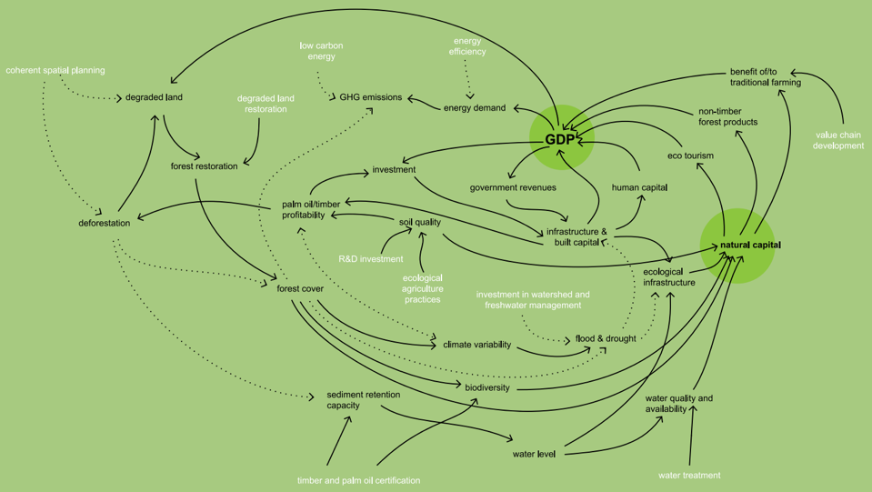
CAUSAL LOOP DIAGRAMS
Source: Van Paddenburg et. al. 2012
Notes:
In the Heart of Borneo study carried out by WWF, CLDs were developed through a participatory exercise as part of a cross-sectoral modelling exercise. The CLD was used to guide the development of a suite of interconnected mathematical models (Land Change Modeler, System Dynamics and InVEST), and led to the identification of relevant feedback loops and policy entry points (Van Paddenburg, Bassi, Buter, Cosslett, & Dean, 2012). The CLD shows the central role of GDP and natural capital for the Heart of Borneo, as well the important set of interconnections existing between GDP and natural capital. What emerges from this exercise is that natural capital is a key enabler of economic activity and social development, as well as that economic activity has so far represented a threat to the natural capital. A critical balancing loop underlies the development path of the Hearth of Borneo, indicating that maintaining natural capital is the most effective option to sustain the economy and society.
Source: Van Paddenburg, Bassi, Buter, Cosslett, & Dean, 2012: Heart of Borneo: Investing in Nature for a Green Economy. WWF. Heart of Borneo Global Initiative.

Slide 29
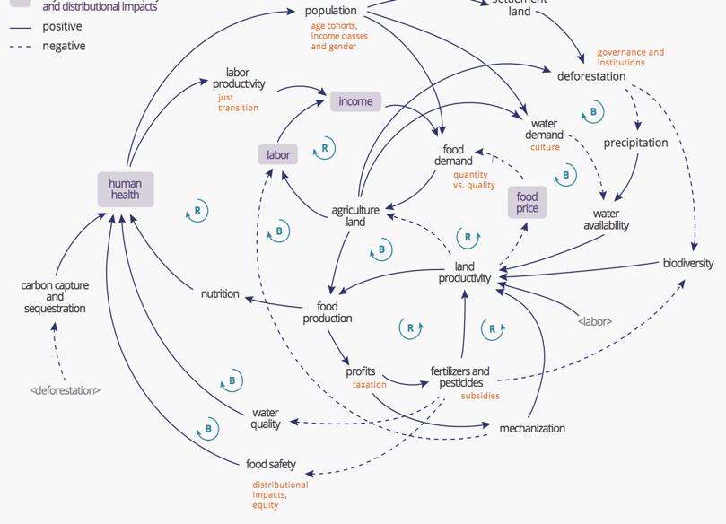
EXAMPLE
Illustrative Causal Loop Diagram of a generic eco-agri-food system (Source: Zhang et al. 2018)
CLDs have been used extensively to carry out qualitative assessments of policy impacts.
TEEB developed a CLD to explain the dynamics existing in the eco-agri-food system.
Source: TEEB, 2018
Notes:
UN Environment has also used CLDs to map the complexity of the eco-agri-food system in their latest TEEB report for agriculture and food (Zhang, 2018). The CLD highlights several reinforcing loops, such as demand driving production, production leading to income creation and income stimulating demand, as well as various balancing loops, such as the more agricultural land there is, the more deforestation, the lower biodiversity and land productivity, leading to a greater need for agricultural land. Further, it shows how human health is central to the realization of a sustainable eco-agri-food system.
Source: TEEB, 2018: Measuring what matters in agriculture and food systems. A synthesis of the results and recommendations of TEEB for Agriculture and Food’s Scientific and Economic Foundations Report.

Slide 30
REFLECTION POINT
What was your experience working with CLDs?
What do you think are the main strengths and weaknesses of CLDs?
Module 3, Section 2: Overview of Models
Notes:
This question allows students to reflect on their experience of creating a CLD in modules 1 and 2. It would be good to discuss the implementation process of the CLDs, such as what leads to the co-creation of the model and the creation of a shared understanding, and the content, such as the potential to identify entry points for investments and policy interventions.

Slide 31
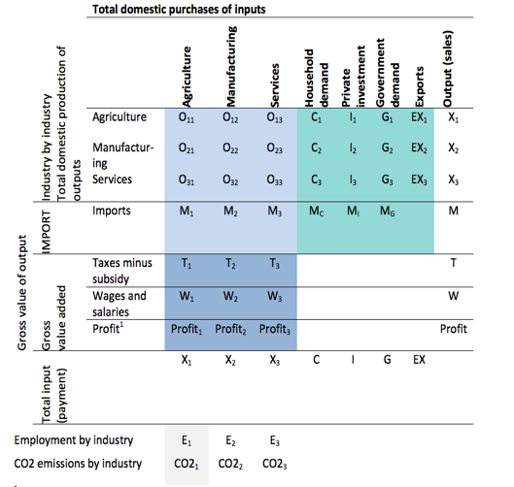
QUANTITATIVE MODEL: Sectoral Input-Output (I-O) Tables
I-O table in symbols
Represent inputs and outputs of several economic activities, physical and/or monetary.
An input-output model replaces the data in an input-output table with equations.
I-O models can be descriptive and prescriptive.
Source: ILO,2017
Notes:
Input-output tables (Leontief, 1951) represent inputs and outputs of several economic activities. These inputs and outputs can be physical and/or monetary. Input-output tables are frequently used to estimate physical and monetary flows across value chains.
An input-output model of production and distribution of goods and services replaces the data in an input-output table with equations. These equations explain the relationship between inputs and outputs of a given process. In other words, the model uses productivity multipliers that serve for the calculation of the output values given a specific set and quantity of inputs, or it estimates the required inputs for a given value of output (Tcheremnykh, 2003).
Descriptive I-O models generate information about the current state of the economy (production, employment, imports/exports and gross value added).
Predictive I-O models look forward to evaluate policy impacts.
Source: ILO, 2017: How to measure and model social and employment outcomes of climate and sustainable development policies. Training guidebook.

Slide 32
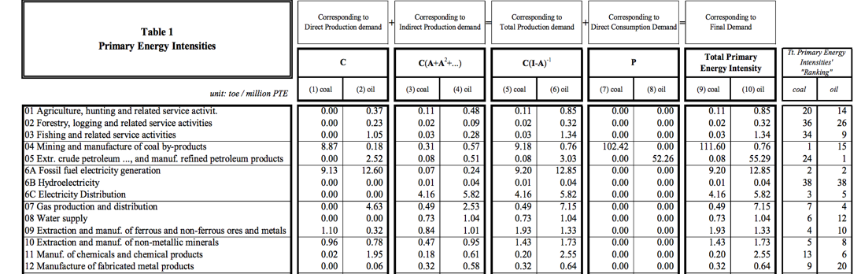
EXAMPLE
Cruz (2002) applied the I-O methodology to analyze energy flows and CO2 emissions in the Portuguese economy.
The I-O model distinguishes between energy demand by final consumers and direct and indirect energy requirements from industries.
Source: Cruz, 2002
Notes:
Cruz (2002) applied the I-O methodology to analyse energy flows and CO2 emissions in the Portuguese economy. The I-O model distinguishes between energy demand by final consumers (direct consumption demand) and direct and indirect energy requirements from industries (production demand). It is an extension of a traditional I-O model of the economy that is capable of capturing the impact of economic actions on the environment (CO2 emissions) and energy demand (fossil fuels).
Source: Cruz, 2002: Energy-Environment-Economy Interactions: An Input-Output Approach Applied to the Portuguese Case. 7th Biennial Conference of the International Society for Ecological Economics, “Environment and Development: Globalisation & the Challenges for Local & International Governance”, Sousse (Tunisia), 6–9 March 2002.

Slide 33
REFLECTION POINT
What do you think is the most useful application of I-O models?
Sectoral level (e.g. for industries) or macroeconomic?
Module 3, Section 2: Overview of Models
Notes:
This question provides an opportunity to discuss I-O models in more depth. They are frequently used for a variety of policy assessments, at sectoral level for economic performance, for employment estimates and emissions.

Slide 34
QUANTITATIVE MODEL: Computable General Equilibrium (CGE)
Models supply and demand behaviour across all markets in an economy.
Widely used to analyse the aggregate welfare and distributional impacts of policies.
Optimize the benefits for various economic actors.
Source: Banerjee, Onil, 2019.
Notes:
A general equilibrium approach models supply and demand behaviour across all markets in an economy. Analysis is typically conducted using computable general equilibrium (CGE) models (see, for instance, Lofgren & Diaz-Bonilla (2010)). CGE models are a standard tool of empirical analysis, and are widely used to analyse the aggregate welfare and distributional impacts of policies whose effects may be transmitted through multiple markets, or contain menus of different tax, subsidy, quota or transfer instruments (Sue Wing, 2004).
CGE models optimize utility for economic actors. The three conditions of market clearance, zero profit and income balance are employed to simultaneously solve the setting of prices and the allocation of goods and factors that support general equilibrium.
Source: Sue Wing, I., 2004: Computable General Equilibrium Models and Their Use in Economy-Wide Policy Analysis: Everything You Ever Wanted to Know (But Were Afraid to Ask). Joint Program on the Science and Policy of Global Change MIT. Cambridge, MA, USA.
Source: Banerjee, Onil & Cicowiez, Martin & Horridge, Jonathan & Vargas, Renato, 2016: A Conceptual Framework for Integrated Economic–Environmental Modeling. The Journal of Environment & Development.

Slide 35
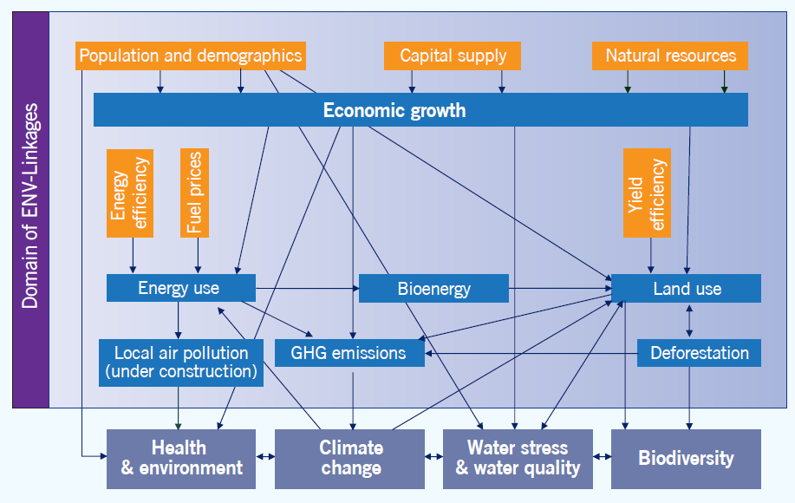
EXAMPLE
The ENV-Linkages model is a multi-sectoral and multi-regional dynamic CGE model, based on microeconomic foundations.
It is used to generate the results for the OECD Environment Outlook to 2050.
It uses the Global Trade Analysis Project (GTAP) as data input.
Source: OECD, 2012.
Notes:
The OECD model is a multi-sectoral and multi-regional dynamic CGE model, based on microeconomic foundations. ENV-Linkages is the successor to the OECD GREEN model, and is used to generate the results for the OECD Environment Outlook to 2050 (OECD, 2012), which examines likely future economic, environmental and social developments up to 2050, given the current state of policy. In the context of response measures, the greater disaggregation is useful for analysing existing policies that are sector-specific. For example, the model can be used to simulate sector-, region- and pollutant-specific taxes. It is also useful for looking at policies of emission permit trading.
Source: OECD, 2012: OECD Environmental Outlook to 2050: The Consequences of Inaction. Paris.

Slide 36
REFLECTION POINT
The concept of equilibrium is frequently debated.
To what extent do you see it as a realistic assumption for economic models?
Module 3, Section 2: Overview of Models
Notes:
This question is about the underlying assumption of partial and general equilibrium models, which has been debated constantly in the modelling community. Equilibrium brings consistency to models, but in reality we are never in a perfect equilibrium. However, comparing different equilibrium could facilitate interpreting implications of several transitional dynamics

Slide 37
QUANTITATIVE MODEL:
System Dynamics
Integrated quantitative approach (causal descriptive) utilized to understand situations for complex issues.
Methodology that allows the integration of social, economic and environmental indicators.
The pillars are feedback, delays and non-linearity.
Models can be top-down or bottom-up.
Source: Bassi, 2015
Notes:
System Dynamics (SD) is an integrated quantitative (modelling) approach (causal descriptive) utilized to understand situations for complex issues. SD is a flexible methodology that allows the integration of social, economic and environmental indicators in a single framework of analysis.
SD models are based on the assumption that structure drives behaviour and use causal relationships to link variables.
The pillars of SD models are feedback, delays and non-linearity. Models can be customized to analyse the socioeconomic implications of actions across sectors (social, economic and environmental) and actors, such as households, the private sector and the government, within and across countries.
SD models can be top-down or bottom-up, general or partial equilibrium.
The image shows the underlying structure of the Green Economy Model (GEM), which captures built, human, social and natural capital.
Source: Bassi, A.M., 2015: Moving towards integrated policy formulation and evaluation: the Green Economy Model (GEM). Environmental and Climate Technologies, Volume 16, Issue 1.

Slide 38

EXAMPLE
UNEP Green Economy Report
The model developed for the Green Economy Report is a System Dynamics model that largely draws upon the Threshold 21 family of models.
It integrates variables and data at the macro level, while allowing for sectoral disaggregation.
Simulates the main short-, medium- and longer-term impacts of investing in a green economy.
Source: UNEP, 2011
Notes:
The Threshold 21 (T21) World model (T21-World) is structured to analyze medium-long term development issues. The model integrates in a single framework the economic, social and environmental aspects of development planning. The level of aggregation used to represent the sectors analysed makes it well suited to look at resource allocation issues among different sectoral areas of intervention. T21 was conceived to complement budgetary models and other short-medium term planning tools by providing a comprehensive and long-term perspective on development.
T21 is useful at four levels in the planning process.
Firstly, the participatory process of model development provides insights on the coherence and consistency of objectives, hypotheses and data used for policymaking in different sectors.
Secondly, the base run simulation of the model offers an outlook into key development issues.
Thirdly, alternative scenarios provide an understanding of how different strategic choices or external conditions can impact future development, and how policies synergistically interact.
Fourthly, the resulting development plan provides a clear basis for action in the various sectors, as well as for monitoring and evaluation of performance.
T21-World is designed to cover the most important long-term issues analysed in this report. Its structure includes both monetary and physical indicators, to fully analyse the impacts of investments on natural resources, low carbon development, economic growth and job creation.
Source: https://naturwissenschaften.ch/service/publications/76477-unep-green-economy-report-2011

Slide 39
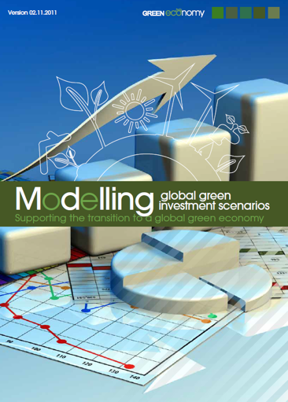
GLOBAL GREEN ECONOMY MODELLING WITH SYSTEM DYNAMICS
UNEP Global Green Investment Scenarios
An attempt to shed light on the benefits of Green Economy interventions at the global level.
First modelling exercise of this kind, using a systems approach in a GE context.
Source: UNEP, 2012
Notes:
Conducted involving more than 100 experts.
Aligned with existing projections in all sectors. In fact, it is an exercise of knowledge integration.
Source: UNEP (2012). Modelling global green investment scenarios. Supporting the transition to a global green economy.

Slide 40
POLL
System Dynamics has been used very often for IGE, Circular Economy and Climate Adaptation assessments. Why?
Highly standardized approach and model.
Strong stakeholder engagement to conceptualize and create the model, creating local ownership.
Useful method for “knowledge integration”, which allows to better represent the IGE concept in a model.
Notes:
Options B and C are correct. Option A highlights a drawback: customization takes time and an SD model may be more time consuming to create than a more standardized optimization or econometrics model.

Slide 41

COMPLEMENTARITY IS CRITICAL FOR MODELLING USEFULNESS
A transition to an Inclusive Green Economy requires a combination of policy interventions with crosscutting impacts.
Complementarity strengthens the analysis and addresses some of the weaknesses of each methodology with inputs from others.
@shutterstock
Notes:
A transition to an Inclusive Green Economy requires a combination of policy interventions with crosscutting impacts. A single model, therefore, is often inadequate to answer all the essential questions.
Complementarity is important as it strengthens the analysis and addresses some of the weaknesses of each methodology with inputs from others. Further, the simultaneous use of different methodologies supports the broader involvement of various stakeholders (technical and political) in policy formulation and evaluation. This latter aspect is particularly important, since different government agencies typically have different modelling tools.
For example, an SD model may help us track the impacts of renewable energy investments on total economic output, carbon emissions and access to clean energy, but it is not so good at showing the short-term impacts on jobs across sectors. In this case, the use of IO-SAM in combination with a CGE model can make up for that deficiency. This is exactly the approach of the Integrated Green Economy Modelling Framework that will be discussed later on in this module.
Another example is when policymakers are more interested in forecasting or doing impact evaluation than conducting scenario building. In this case, econometric modelling could give a more precise answer. The statistical inference from the data’s behaviour of econometric models will be more helpful in estimating particular parameters, establishing and quantifying causal impacts, and carrying out forecasting.

Slide 42
3
Interpretation of Model Results

Slide 43
REFLECTION POINT: How the underlying method influences model results
Do you remember what the three methods were?
How do you think they influence the results of a model?
Module 3, Section 3: Interpretation of Model Results
Notes:
The results of a model are estimated by methods to solve equations: optimization, econometrics and simulation.
The use of different methods can lead to different results.

Slide 44
HOW THE UNDERLYING METHOD INFLUENCES MODEL RESULTS
Static models
Optimization models
Dynamic models
Tend to overestimate policy impacts (lack of feedback).
These include I-O (e.g. SAM) and linear models.
Tend to underestimate policy impacts (when producing a snapshot).
These include CGE models, energy optimization models.
Capture short-term impacts (otherwise seen as possible overestimate).
Capture medium to
longer term impacts (otherwise seen as possible underestimate).
Module 3, Section 3: Interpretation of Model Results
Notes:
Static models can overestimate policy impacts, since corrective measures (via feedback) are not accounted for.
Optimization models can underestimate policy impacts, since corrective measures are captured and “worse before better” dynamics may not emerge if snapshot (instead of time-explicit results) are generated.
Dynamics models that treat time explicitly are likely to capture both short-term impacts (otherwise considered to be an overestimate) and medium to longer term impacts (otherwise considered to be an underestimate), providing more effective support to policymaking. These include System Dynamics models.

Slide 45
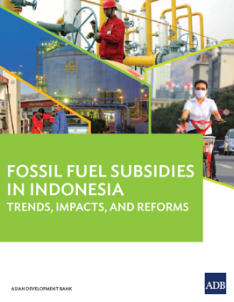

EXAMPLE: MODELLING THE IMPACTS OF SUBSIDY REFORM
Problem statement:
Is keeping subsidies inefficient and costs too much?
Fossil fuel subsidy removal increases energy prices.
100% reallocation of subsidy savings improves all key indicators relative to business as usual (BAU), but it does not reduce public deficit.
Fossil fuel subsidies in Thailand: trends, impacts, and reforms.
Source: ADB, 2015
Module 3, Section 3: Interpretation of Model Results
Notes:
If we use the example of fossil fuel subsidy removal, we can consider three problem statements related to total costs, distributional impacts and the effectiveness of mitigation options.
Sources:
Asian Development Bank, 2015 (a): Fossil fuel subsidies in Thailand: trends, impacts, and reforms. Mandaluyong City, Philippines: Asian Development Bank, 2015.
Asian Development Bank, 2015 (b): Fossil fuel subsidies in Indonesia: trends, impacts, and reforms. Mandaluyong City, Philippines: Asian Development Bank, 2015.

Slide 46
EXAMPLE: MODELLING THE IMPACTS OF SUBSIDY REFORM
Problem statement:
Who will be impacted if we remove subsidies?
No compensation has negative impacts on all households, but it reduces emissions and lowers public deficit.
Problem statement:
What are the impacts of providing compensation?
Reallocation to all households shows generally better impacts than compensating only the bottom 40%, but it is not as effective in lowering public deficit.
Module 3, Section 3: Interpretation of Model Results

Slide 47
MODELLING APPROACH
Three groups of models used:
Social Accounting Matrix (SAM) for short-term economic impacts (static assessment), including detailed distributions analysis;
CGE and macroeconometric model for assessing macroeconomic impacts, short, medium and longer term;
MARKAL models for assessing impacts for the energy sector.
Module 3, Section 3: Interpretation of Model Results
Notes:
There is no single model that can answer the four key questions posed earlier. We need to use various models: SAM, CGE or macroeconometric model and MARKAL.

Slide 48
Sectoral and geographically disaggregated impact analysis for households (e.g., savings).
Reallocation of funding. Distributional effects and opportunities.
Economic flows across the key actors of the economy.
SAM
Social Accounting Matrix
Energy sector analysis. Optimization of energy supply, at least cost.
Macro Model
Markal
Macroeconomic assessment. Economic impact of energy prices.
Module 3, Section 3: Interpretation of Model Results
Notes:
This and the following slides present the modelling approach adopted for the assessment of fossil fuel subsidy removal, where interconnections between these three types of models were identified.
The combined use of these three tools is necessary to generate coherent projections and to analyse them in the context of rationalizing fossil fuel subsidies. In this respect, several policy-related questions can be analysed, starting from the various options for subsidy removal (e.g. what reduction, by when, and in which shape/form), and ending with the potential reallocation of avoided public expenditure (to which household groups, and with which policy intervention option). Additional analyses become relevant depending on the scenarios simulated, including the differences between short- and long-term impacts as well as policy and system responses.

Slide 49
DIRECT IMPACTS
Economic flows across the key actors of the economy.
SAM
Producer and consumer subsidies
Social Accounting Matrix
Energy sector analysis. Optimization of energy supply, at least cost.
Macro Model
Markal
Macroeconomic assessment. Economic impact of energy prices.
Producer subsidies (primarily)
Module 3, Section 3: Interpretation of Model Results
Notes:
MARKAL is used to generate information on energy production costs, taking into account producer subsidies. With energy costs and consumer subsidies, energy market prices can be estimated. Energy prices are then used to estimate energy demand (and possibly GDP and other macroeconomic flows) in MACRO, and inflation. MACRO is used in conjunction with the SAM to estimate GDP and household income, as well as consumption, savings and investment. With data from the household survey, it is possible to disaggregate impacts by income classes and location, and also estimate household energy costs. This is done by combining estimates on energy demand (potentially using driving needs, such as distance from the workplace, and household or housing size) and energy prices, obtained from the MARKAL and MACRO. Finally, income, originating from the SAM and the household survey, will also be used to estimate household energy demand at the micro level, in addition to using prices and specific needs.

Slide 50
INDIRECT IMPACTS
Economic flows across the key actors of the economy.
Estimated using the SAM, possibly also assuming a future growth rate for the main financial flows.
SAM
Producer and consumer subsidies
Social Accounting Matrix
Energy sector analysis. Optimization of energy supply, at least cost.
Macro Model
Markal
Macroeconomic assessment. Economic impact of energy prices.
Producer subsidies (primarily)
Module 3, Section 3: Interpretation of Model Results
Notes:
MARKAL is used to generate information on energy production costs, taking into account producer subsidies. With energy costs and consumer subsidies, energy market prices can be estimated. Energy prices are then used to estimate energy demand (and possibly GDP and other macroeconomic flows) in MACRO, and inflation. MACRO is used in conjunction with the SAM to estimate GDP and household income, as well as consumption, savings and investment. With data from the household survey, it is possible to disaggregate impacts by income classes and location, and also estimate household energy costs. This is done by combining estimates on energy demand (potentially using driving needs, such as distance from the workplace, and household or housing size) and energy prices, obtained from the MARKAL and MACRO. Finally, income, originating from the SAM and the household survey, will also be used to estimate household energy demand at the micro level, in addition to using prices and specific needs.

Slide 51
INDUCED IMPACTS
Economic flows across the key actors of the economy.
Estimated using the SAM, possibly also assuming a future growth rate for the main financial flows.
SAM
Producer and consumer subsidies
Social Accounting Matrix
Energy sector analysis. Optimization of energy supply, at least cost.
Macro Model
Markal
Macroeconomic assessment. Economic impact of energy prices.
Producer subsidies (primarily)
Module 3, Section 3: Interpretation of Model Results
Notes:
MARKAL is used to generate information on energy production costs, taking into account producer subsidies. With energy costs and consumer subsidies, energy market prices can be estimated. Energy prices are then used to estimate energy demand (and possibly GDP and other macroeconomic flows) in MACRO, and inflation. MACRO is used in conjunction with the SAM to estimate GDP and household income, as well as consumption, savings and investment. With data from the household survey, it is possible to disaggregate impacts by income classes and location, and also estimate household energy costs. This is done by combining estimates on energy demand (potentially using driving needs, such as distance from the workplace, and household or housing size) and energy prices, obtained from the MARKAL and MACRO. Finally, income, originating from the SAM and the household survey, will also be used to estimate household energy demand at the micro level, in addition to using prices and specific needs.

Slide 52
Sectoral and geographically disaggregated impact analysis for households (e.g., savings).
Reallocation of funding. Distributional effects and opportunities.
Economic flows across the key actors of the economy.
Household income, consumption, savings and investment
SAM
Social Accounting Matrix
Disposable income
Energy demand
Gross Domestic Product
Energy costs
Energy sector analysis. Optimization of energy supply, at least cost.
Macro Model
Markal
Macroeconomic assessment. Economic impact of energy prices.
Energy production costs
Energy (market) prices
Module 3, Section 3: Interpretation of Model Results
Notes:
In summary:
-The SAM and MACRO are particularly useful in analysing consumer subsidies from a macroeconomic perspective, with data, such as household surveys, being necessary to carry out a detailed assessment of the impact on households, such as considering income classes, regional differences among the population and other social factors.
MARKAL and MACRO are needed to analyse producer subsidies, with the former emphasizing the biophysical dimensions of the energy sector, and the latter estimating the economic impacts of decisions on energy supply.

Slide 53
MAIN CHARACTERISTICS OF THE MODELS CHOSEN – INDIA EXAMPLE
Model | Base year | Household and sectoral disaggregation | Energy sources | Impacts modelled | Reallocation assumptions
India
SAM | 2007-08 with subsidy adjustment | 5 rural and 4 urban (employment-based) household groups; 78 economic sectors. | Oil, gas, coal and electricity. | Direct and indirect | Compensation to households and reallocation to government budget
MARKAL | 2011 | Rural and urban households; residential, commercial, industrial (with energy-intensive manufacturing sectors) and transport. | Detailed primary and secondary energy supply. | Direct | No compensation and reallocation
E3MG | 2011 | 42 economic sectors, 5 rural and 4 urban (employment-based) household groups | Primary and secondary energy supply (22 different users of 12 different fuel types). | Direct | Compensation to households and budget/deficit reduction
Module 3, Section 3: Interpretation of Model Results
Notes:
About E3MG
E3MG is a sectoral econometric model that has been developed with the intention of analysing long-term energy and environment interactions within the global economy and assessing short and long-term impacts of climate-change policy. It is very similar to E3ME in structure and closely links economic outcomes with energy policy.
It has a particular focus on taxes and subsidies, making it highly relevant to analysis of these response measures. Its global nature also makes it a useful tool for assessing the deployment of new technologies in developing countries.
Source: https://unfccc.int/topics/mitigation/workstreams/response-measures/modelling-tools-to-assess-the-impact-of-the-implementation-of-response-measures/response-measures-models-e3mg

Slide 54
MAIN CHARACTERISTICS OF THE MODELS CHOSEN
Model | Base year | Household and sectoral disaggregation | Energy sources | Impacts modeled | Reallocation assumptions
India
SAM | 2007-08 with subsidy adjustment | 5 rural and 4 urban (employment-based) household groups; 78 economic sectors. | Oil, gas, coal and electricity. | Direct and indirect | Compensation to households and reallocation to government budget
MARKAL | 2011 | Rural and urban households; residential, commercial, industrial (with energy-intensive manufacturing sectors) and transport. | Detailed primary and secondary energy supply. | Direct | No compensation and reallocation
E3MG | 2011 | 42 economic sectors, 5 rural and 4 urban (employment-based) household groups | Primary and secondary energy supply (22 different users of 12 different fuel types). | Direct | Compensation to households and budget/deficit reduction
Indonesia
SAM | 2008 with subsidy adjustment | 4 rural and 4 urban (employment-based) household groups; 25 economic sectors. | LPG, NGV, gasoline, diesel, kerosene and electricity. | Direct and indirect | Compensation to households and reallocation to government budget
MARKAL | 2010 | Agriculture, construction, households;, commercial, industrial (with energy-intensive manufacturing sectors) and transport – with four "regions" reflecting Java, Kalimantan, Sumatra, and other islands. | Detailed primary and secondary energy supply. | Direct | No reallocation
E3MG | 2011 | 42 economic sectors, 5 rural and 4 urban (employment-based) household groups | Primary and secondary energy supply (22 different users of 12 different fuel types). | Direct | Compensation to households and budget/deficit reduction
Thailand
SAM | 2010 | Agriculture and non-agriculture, household groups by decile; 10 employment groups; 79 economic sectors. | 18 sectors, including diesel, natural gas and electricity | Direct and indirect | Compensation to households and reallocation to government budget
MARKAL | 2007 with subsidy adjustment | Rural and urban households; residential, commercial, industrial (with energy-intensive manufacturing sectors) and transport. | Detailed primary and secondary energy supply. | Direct | No reallocation
CGE | 2007 with subsidy adjustment | 65 economic sectors (24 agricultural and 41 non-agricultural), 200 household income groups | Petroleum (gasoline, diesel and natural gas). | Direct | Compensation to households and budget/deficit reduction
Module 3, Section 3: Interpretation of Model Results

Slide 55
Comparative assessment of results
 |  | India | Indonesia | Thailand
SAM: Short-term (2012), full compensation to all HH, remainder to gov. expenditure | GDP | -0.4 | -1.3 | 2.02
Macro: Long-term (2020), compensation to all HH, remainder to gov. deficit | GDP | 0.04 | -0.09 | -1
 | % change in CPI | 0.58 | 3.15 | -1
Module 3, Section 3: Interpretation of Model Results
Notes:
The magnitude of the impacts is quite different for economic assessments.
The SAM presents amplified negative impacts of subsidy removal relative to the E3MG and CGE models.
The projections for energy demand originating from MARKAL and E3MG show fairly marked differences. This is reflected in different emission reduction forecasts.
More specifically:
The SAM’s projected reasonable impacts in relation to the potential short-term impacts of fossil-fuel subsidy removal. As anticipated, the nature of the model was to amplify impacts relative to other models but this was at least consistent with the magnitude of subsidies (as a share of GDP). Given the static nature of the model, SAMs are not appropriate (and their results should not be used) to project medium and longer-term analysis.
The macroeconomic models show more conservative results (both positive and negative), which is consistent with the underlying methodology used and the time horizon considered. The impacts on GDP, especially for the reallocation scenarios, may not be very realistic. This is because one of the key advantages of the removal of fossil fuel subsidies is to lower the public deficit, which (in these models) do not flow through to the key macroeconomic indicators. In addition, possible behavioral changes have to be considered, and the underlying assumptions of both E3MG (which relies on history) and the CGE model (which assumes rational behavior) may not hold true in reality.
MARKAL results are realistic and indicate that in some cases there is potential for fuel switching that would lower the energy bill for consumers. This would then imply that the impacts projected by the SAM and macroeconomic models may be more positive if fuel switching could be taken into account in those models (i.e. either a smaller negative impact, or a larger positive one in the reallocation scenarios).

Slide 56
Comparative assessment of results
 |  | India | Indonesia | Thailand
MARKAL long-term ~2030 | GHG emissions (% change) | -1.8 | -5.1% | -2.8%
E3MG long-term ~2030 | GHG emissions (% change) | -1.3 | -9.3% | n/a
Module 3, Section 3: Interpretation of Model Results
Notes:
These results highlight that it is important to consider the methodology used when assessing model results, even if the same data and underlying scenario assumptions are used by different models and modelling teams.
There are specific strengths to each model, but the most nuanced picture of reform only emerged once all three were run together, and in some cases with results being fed from one model into another. This multi-tiered approach to modelling fossil-fuel subsidy reform was highly useful in helping to contextualize and analyze results and ought to be considered by others analyzing the impacts of reform.

Slide 57
REFLECTION POINT
When asked to perform a policy assessment, do you begin with:
1. What model can I use?
2. How can I adapt
my model?
Module 3, Section 3: Interpretation of Model Results
Notes:
This is a question that is meant to test students: it highlights whether they would tend to apply their knowledge and adapt existing models they are familiar with (option 2), or whether they would “step back”, put the issue or opportunity to be analysed at the forefront and assess what is the best model available to carry out the analysis required (option 1). At this stage, it is hoped that most students would prefer to use the latter approach, or option 1 in the circle.

Slide 58


4
In depth review:
Integrated Green Economy Modelling (IGEM) framework

Slide 59
BACKGROUND
Since the launch of the Green Economy Report (GER) in 2011, UNEP has supported countries in developing Green Economy Policy Assessments (GEPAs).
GEPAs have been carried out in South Africa, Kenya, Rwanda, Senegal, Burkina Faso, Uruguay, Ghana, Mauritius, Mozambique, Peru, and Mongolia.
Module 3, Section 4: Integrated Green Economy Modelling (IGEM) framework

Slide 60
WHAT IS THE IGEM FRAMEWORK?
The Integrated Green Economy Modelling (IGEM) was designed to:
Answer increasingly complex requests from governments;
Support countries with solid quantitative tools to inform the design and implementation of green economy policies;
Advance the process of implementing and monitoring some of the Sustainable Development Goals (SDGs).
Module 3, Section 4: Integrated Green Economy Modelling (IGEM) framework
Notes:
The Integrated Green Economy Modelling (IGEM) framework aims to integrate three modelling techniques (System Dynamics, CGE and I-O SAM) to refine impact analysis of green policies and investments in the economy. It was designed to:
Answer increasingly complex requests from governments;
Support countries with solid quantitative tools to inform the design and implementation of green economy policies;
Advance the process of implementing and monitoring some of the Sustainable Development Goals (SDGs).

Slide 61
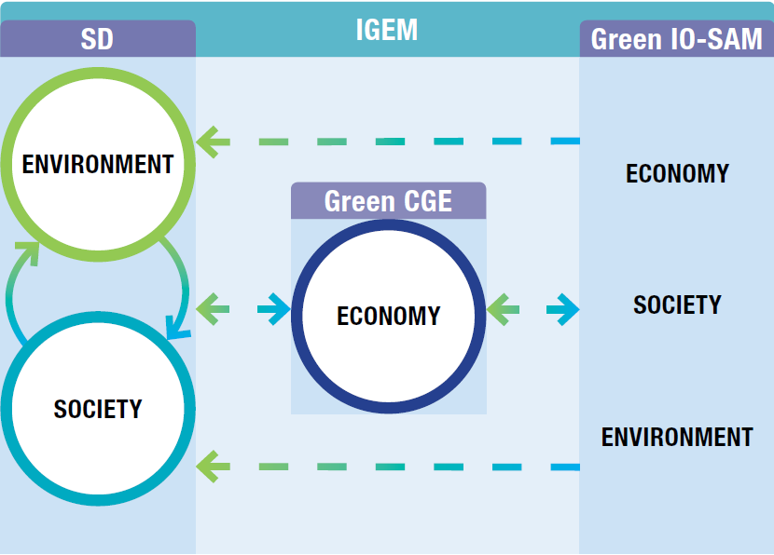
DIAGRAM OF THE IGEM FRAMEWORK SHOWING THE LINKAGES BETWEEN THE SD, CGE AND I-O SAM MODELS
Source: PAGE, 2017
Module 3, Section 4: Integrated Green Economy Modelling (IGEM) framework
Notes:
The two main added values of the IGEM framework project are:
Develop some general guidelines on how to “green” the I-O SAM, the CGE and the SD models;
Develop a methodology on how to link these “greened” models.
A green I-O SAM model is featured by making the green sectors explicitly distinguished from their like sectors, which are run based on conventional technologies and practices.
Disaggregation or creation of new green sectors may require specific data and I-O techniques, depending on the request for resolution at the sector, process or technology levels.
The process of sector disaggregation includes two steps:
A conventional I-O model with aggregation of green and non-green sectors will be disaggregated to present detailed green sectors;
A green SAM will be constructed based on the built-up green I-O model.
Spatial extensions of the I-O SAM:
A national or regional economy within a country is often an open system which interacts with other countries or regions.
To capture the spatial impacts associated with trade, an MRIO model can present the locations of the origin and destination of individual trade flows.
Source: PAGE, 2017: The Integrated Green Economy Modelling Framework – Technical Document.

Slide 62
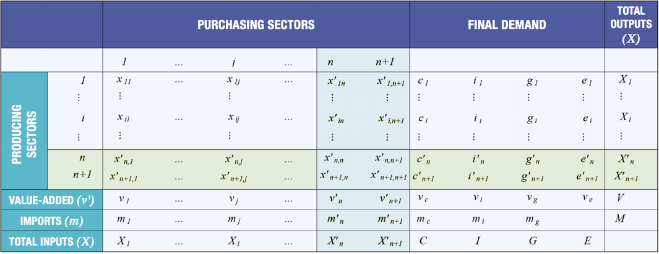
STEP 1: CREATE AN EXPANDED (OR GREEN) I-O
Disaggregating an I-O table with a green sector
Source: PAGE, 2017
Module 3, Section 4: Integrated Green Economy Modelling (IGEM) framework
Notes:
Source: PAGE, 2017: The Integrated Green Economy Modelling Framework – Technical Document.

Slide 63
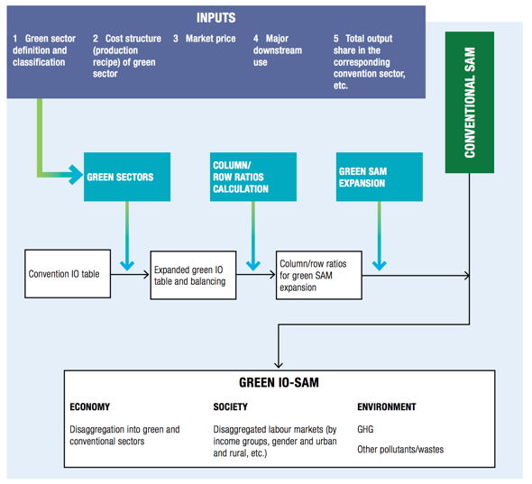
STEP 2: CREATE AN EXPANDED (OR GREEN) SAM
Diagram on how to prepare a green SAM based on a green
I-O
Source: PAGE, 2017
Module 3, Section 4: Integrated Green Economy Modelling (IGEM) framework
Notes:
Source: PAGE, 2017: The Integrated Green Economy Modelling Framework – Technical Document.

Slide 64
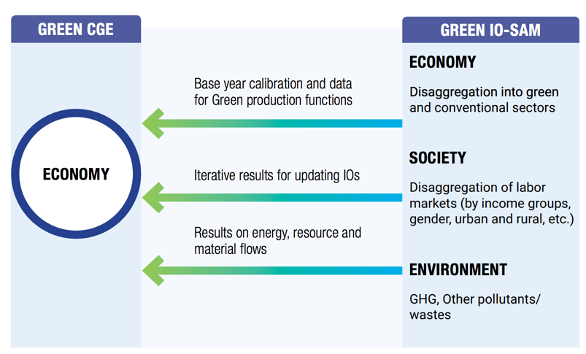
GREEN CGE AND GREEN I-O SAM
Diagram of the linkages between the CGE model and the I-O SAM model
Source: PAGE, 2017
Module 3, Section 4: Integrated Green Economy Modelling (IGEM) framework
Notes:
A standard CGE may be transformed into a “green” CGE by:
Using input data on green sectors coming from the expanded I-O SAM;
Making specific modifications to the conventional CGE model to reflect the use of environmentally efficient technologies.
These two approaches can be integrated.
The CGE would be modified in three ways to be greened:
Incorporating the latest data available in the SAM used in the simulations.
Improved treatment of specific sectors, such as water.
Re-aggregate sectors from the new input-output tables and a special “green” production sector is constructed.
Source: PAGE, 2017: The Integrated Green Economy Modelling Framework – Technical Document.

Slide 65
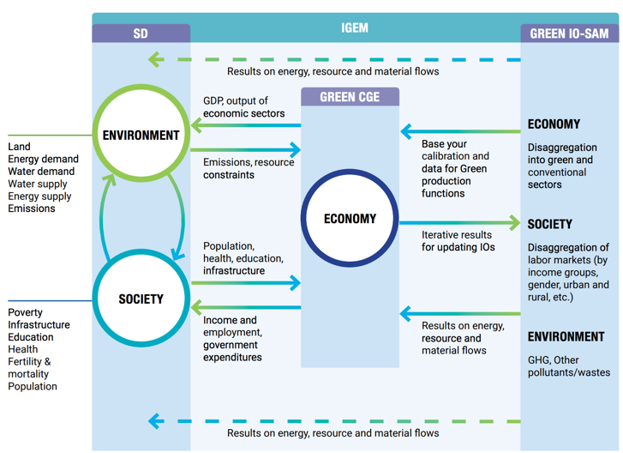
DIAGRAM OF IGEM FRAMEWORK INFORMATION STRUCTURE
Diagram of the IGEM framework information structure
Source: PAGE, 2017
Module 3, Section 4: Integrated Green Economy Modelling (IGEM) framework
Notes:
Greening the models – SD:
The System Dynamics model component of the IGEM framework is designed to focus on green policy analysis and to work in concert with the green CGE and green I-O SAM models;
To do so, a green version SD model was developed with the sector structure necessary to address the green economy policies under consideration, while keeping the model tractable for interlinking with the CGE and I-O components of the IGEM framework.
Linking the models – the I-O SAM with the CGE:
The I-O SAM is the database of an empirical CGE model;
An I-O table is usually used to build the production function for the intermediate inputs and value-added composite at the top level of the nesting approach;
The base-year SAM is usually used for the calibration of a CGE model.
Linking the models – the CGE with the SD:
To ensure consistency between the CGE and the SD models, the following conditions need to be fulfilled:
Parameter selection;
Variable trends;
Other common variables;
Model calibration;
Initial conditions.
Linking the models – the CGE with the SD:
The IGEM framework integrates two types of linkages between the CGE and the SD model:
A soft linkage - the entire scenario is run on one model, the results are fed into the other model, and vice versa;
A hard linkage - the CGE and SD models are manually coupled. Each model is run for two-year iterations. After each iteration, designated output values from each model are transferred as inputs to the other model.
Source: PAGE, 2017: The Integrated Green Economy Modelling Framework – Technical Document.

Slide 66
TARGETS VERSUS INVESTMENT DRIVEN
The IGEM can be applied in two ways to analyse green economy policies:
following a target-driven approach;
x
following an investment-driven approach.
Module 3, Section 4: Integrated Green Economy Modelling (IGEM) framework

Slide 67
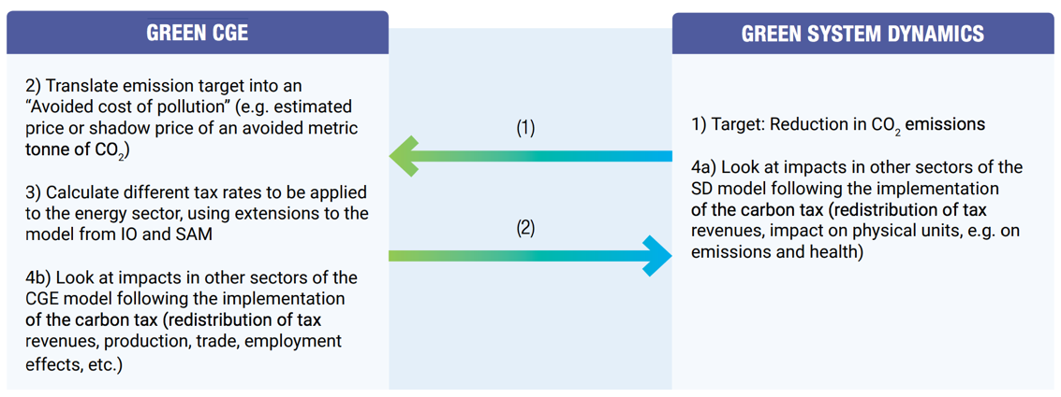
TARGET-DRIVEN APPROACH
Source: PAGE, 2017
Module 3, Section 4: Integrated Green Economy Modelling (IGEM) framework
Notes:
A target for emission reduction is first determined (e.g. 30% reduction by 2030 relative to the BAU scenario).
The economic value of such emission reduction is estimated, by first calculating what amount of tons of CO2 have to be avoided and then multiplying such an amount by a monetary value (e.g. USD 30/ton of CO2).
Based on the carbon intensity of different fuels, and the energy intensity of different sectors, a corresponding tax rate can be estimated. With the introduction of a carbon tax, energy prices increase and consumption declines, with the size of the decline depending on model specifications for the sensitivity of demand to price changes, and/or in relation to fuel switching.
4a) and 4b) Assessment of the impacts across sectors.
With the approach indicated in the slide, it is not possible to estimate the investment required for a specific technology or intervention (e.g. solar power, or energy efficiency). This is because a CGE model typically does not include specific technologies for energy consumption and production and is a top-down rather than bottom-up model, so the policy input that can be used is a change in prices, rather than an investment. On the other hand, if the CGE model were coupled with an energy model (e.g. MARKAL or similar, or even a more detailed energy model built with System Dynamics) specific investments could be simulated and tested with the model. This would be a different approach, where investment (rather than a carbon tax) is used as a policy intervention in the model. Once again, the type of model used, and its respective method for solving equations, determines how the IGE assessment should be set up.
An alternative way to carry out the target approach, is to do an iterative process of investment approach several times until the target is reached. See the next slide for more information on the investment-driven approach.
Source: PAGE, 2017: The Integrated Green Economy Modelling Framework – Technical Document.

Slide 68
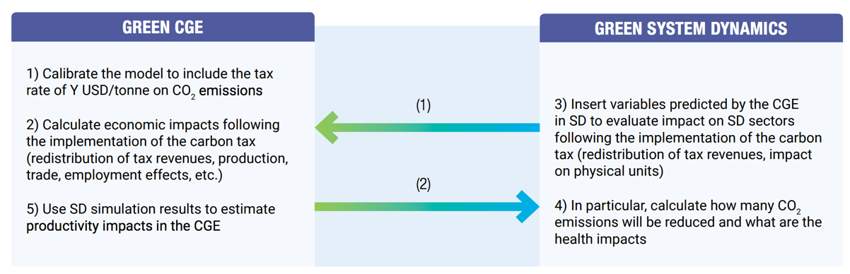
INVESTMENT- (OR PRICE-) DRIVEN APPROACH
Source: PAGE, 2017
Module 3, Section 4: Integrated Green Economy Modelling (IGEM) framework
Notes:
Source: PAGE, 2017: The Integrated Green Economy Modelling Framework – Technical Document.

Slide 69
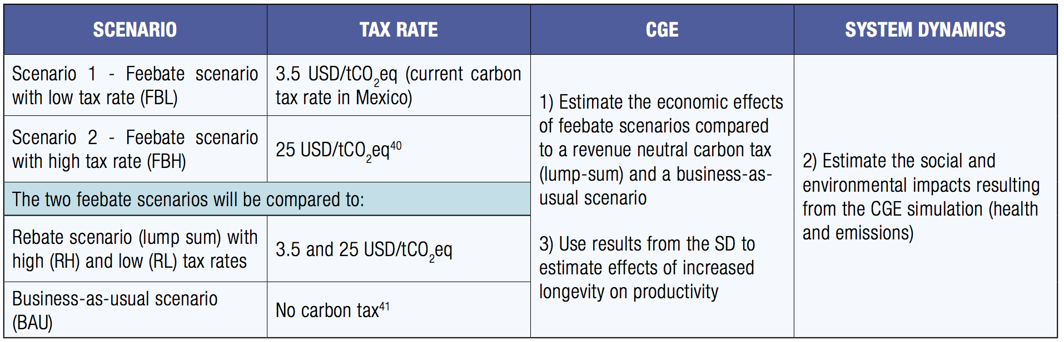
CARBON TAX SCENARIOS TESTED BY THE IGEM FRAMEWORK
Source: PAGE, 2017
Module 3, Section 4: Integrated Green Economy Modelling (IGEM) framework
Notes:
Mexico is the world’s 13th largest emitter of CO2 emissions and projected to be the world’s fifth largest economy in 2050.
Mexico introduced a carbon tax in 2014 in order to create awareness of CO2 emissions, to put a price to carbon and to promote the use of cleaner fuels.
The carbon tax applies only to the use of fossil fuels.
The approximate price of carbon was set at 3.5 USD/tCO2eq.
Source: PAGE, 2017: The Integrated Green Economy Modelling Framework – Technical Document.

Slide 70
CONCLUSIONS – on Greening
The IGEM framework shows:
The CGE can be greened through the inclusion of additional sectors and/or by using a green I-O SAM as input;
The SD model can be greened by disaggregating a particular sector to address environmental and social questions of interest to policymakers.
Module 3, Section 4: Integrated Green Economy Modelling (IGEM) framework

Slide 71

CONCLUSIONS – on Coupling
The IGEM framework identifies the main entry points between the models and how this linkage can be reinforced following different rounds of integration.
In Mexico, GDP growth is enhanced when the effect of lower emissions on longevity and, later, on labor productivity is taken into account. Linkages go in both directions (CGE SD)
@shutterstock
Module 3, Section 4: Integrated Green Economy Modelling (IGEM) framework

Slide 72
End of Module 3.
Thank you for your attention!

Slide 73
Annex A
Additional Information About Different Models

Slide 74
DELPHI ANALYSIS
Resources required
  Approximately 45 days; each round of questionnaires (four in total) has to be carefully prepared and analysed.
Potential for integration with other methods and tools
  Can be used in combination with other methods (receiving and providing inputs).
  Provides inputs to the formulation of scenarios and identification of suitable methods.
  Supports the validation of model results.
Module 3, Annex A: Additional Information About Different Models

Slide 75
DELPHI ANALYSIS
Strengths
  Supports the identification of adequate quantitative methods..
  Data needs are fairly low.
  Complementary with many different analysis methods.
Weaknesses
  The emergence of new knowledge might be hampered by the process itself.
  Delphi investigators need to be cognisant and exercise caution.
  Narrow focus on experts with knowledge about technologies/policies.
  The quality of results is ultimately dependent on the participation of experts in the process of knowledge elicitation.
Module 3, Annex A: Additional Information About Different Models
Notes:
Strengths:
Particularly relevant to support the identification of adequate quantitative methods as well as to set them up with coherent assumptions.
While the process is resource intensive, the data needs are fairly low.
Complementary with many different analysis methods.
Weaknesses:
The emergence of new knowledge might be hampered by the process itself.
Delphi investigators need to be cognisant, exercise caution and implement the proper safeguards in dealing with the issue of modelling opinions.
Narrow focus on experts with specific knowledge about technologies/policies.
The quality of results is ultimately dependent on the participation of experts in the process of knowledge elicitation.

Slide 76
QUALITATIVE MODEL: Decision Tree (DT)
A decision support tool that uses a binary tree-like graph or model to identify and map the relationship between inputs and outputs.
DT explicitly maps the structure of a system and related intervention options.
Starting from the indicator that is affected by the policy to be analysed, each branch corresponds to a possible outcome.
DT diagrams can be qualitative and quantitative.
Module 3, Annex A: Additional Information About Different Models
Notes:
A decision tree (DT), also known as Classification And Regression Tree (CART), is a decision support tool that uses a binary tree-like graph or model to identify and map the relationship between inputs and outputs (Liu, Rather, Chen, & Bak, 2013).
DT explicitly maps the structure of a system and related intervention options. Starting from the indicator that is directly affected by the policy to be analysed, each branch of the tree diagram corresponds to a possible outcome (Covaliu, 2001). As the tree diagram expands, these branches represent direct, indirect and induced policy outcomes.

Slide 77
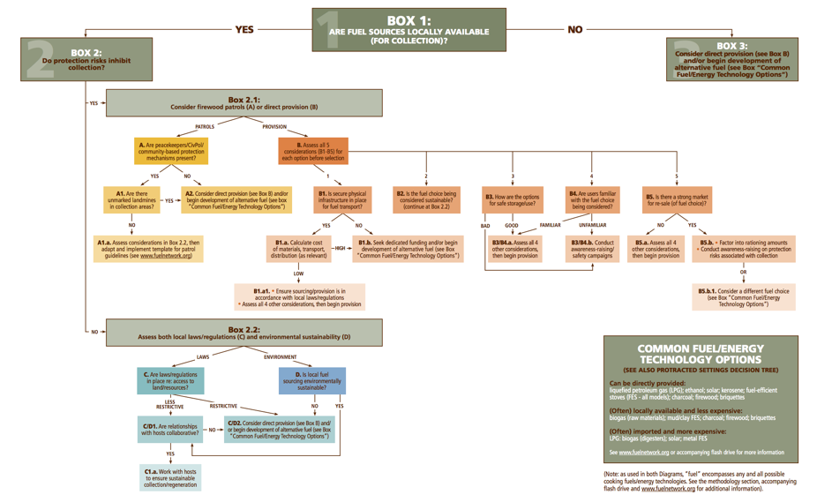
DECISION TREE
(EXAMPLE)
Decision tree diagram for choosing a cooking fuel strategy in acute emergencies
Source: IASC, 2009
Module 3, Annex A: Additional Information About Different Models
Notes:
Source: IASC, 2009: Decision tree diagrams on factors affecting choice of fuel strategy in humanitarian settings.

Slide 78
DECISION TREE
Data source(s)
  Expert elicitation or case study review.
Data Availability
  Data is generally available from other studies or historical databases.
  Depending on the size of the DT, additional research may be required to carry out validation.
Accessibility and Typical Users
  Qualitative DT are easily accessible by a wide range of audiences.
  They concern key questions or trade-offs, and typical users are policy makers and stakeholders that are involved in the decision-making process.
Module 3, Annex A: Additional Information About Different Models

Slide 79
DECISION TREE
Resources required
  Simple decision trees are usually created within days through a multi-stakeholder workshop.
  The validation of the DT takes, depending on its size, approximately one month. Most of the work can be done in-house.
Potential for integration with other methods and tools
  Can be used in combination with various other methods, using inputs from other modelling exercises and providing inputs for the identification of suitable methods and models.
Module 3, Annex A: Additional Information About Different Models

Slide 80
DECISION TREE
Strengths
  Identifies and maps the relationship among key indicators of performance.
  Data needs for small DT are typically low, only increasing as the tree grows.
  Time requirement to develop a DT and conduct a (light) validation in a workshop setting can be as low as 1-2 days.
Weaknesses
  It often results in the creation of very complex diagrams.
  The number of nodes and output indicators grows exponentially.
  The DT diagram does not capture (feedback) loops.
Module 3, Annex A: Additional Information About Different Models
Notes:
Strengths:
Can be utilized to identify and map the relationship existing among key indicators of performance.
Data needs for small DT are typically low. However, they increase as the tree grows.
The time requirement to develop a DT and conduct a (light) validation in a workshop setting can be as low as 1-2 days.
Weaknesses:
The explicit depiction of the structure of a system (or policy outcomes) often leads to the creation of very complex diagrams.
The number of nodes and output indicators grows exponentially.
The DT diagram does not capture (feedback) loops and hence does not allow the capture of how certain policy outcomes affect one another.

Slide 81
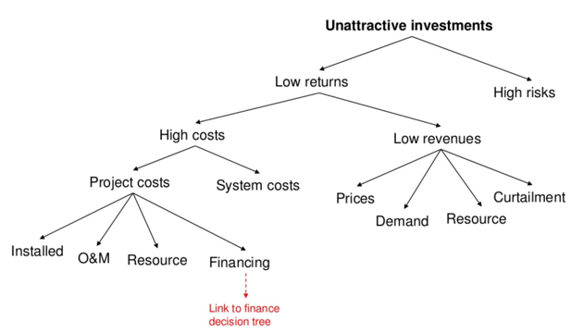
EXAMPLE
The Inter-Agency Standing Committee (IASC) developed a decision tree diagram for fuel strategies in humanitarian settings.
The goal is to identify and map a range of fuel-related issues, and to illustrate that different local contexts require different (socio-) technological solutions.
The tree provides guidance on strategic approaches (long- and short-term) that can be deployed to tackle the issues at hand.
Source: Pueyo, 2017
Module 3, Annex A: Additional Information About Different Models
Notes:
The Inter-Agency Standing Committee (IASC) developed a decision tree diagram based on factors that affect the choice of fuel strategy in humanitarian settings (IASC, 2009). The decision tree model provides practical guidance on developing effective, holistic coordination and response mechanisms for a range of concerns associated with the collection, supply and use of energy by households in humanitarian settings. The goal of these diagrams is to identify and map a range of fuel-related issues, and to illustrate that different local contexts require different (socio-) technological solutions. The tree provides guidance on the identification of strategic approaches (long- and short-term) that can be deployed to tackle the issues at hand.
Source: Pueyo, A., 2017: Overview of the GGDA project. Institute for Development Studies (IDS), London. Available here: https://www.slideshare.net/idsuk/ana-pueyo-green-growth-diagnostics-for-africa

Slide 82
CAUSAL LOOP DIAGRAMS (CLD)
Data source(s)
  Data for causal loop diagrams can be obtained from literature and from experts, or during group model building exercises.
Data Availability
  Data for model development, such as information on the local context, is generally available.
  Both qualitative and quantitative data can be used for developing a CLD.
Accessibility and Typical Users
  Highly accessible; results consist of a system map and underlying feedback loops.
  Typical users range from researchers to decision makers.
Module 3, Annex A: Additional Information About Different Models

Slide 83
CAUSAL LOOP DIAGRAMS
Resources required
  Very low time requirement.
  A CLD can be created in three hours (or up to 2 days) with a group of 20 – 30 stakeholders.
  Depending on the context, a whiteboard and markers, or a laptop with projector and modelling software are sufficient.
Potential for integration with other methods and tools
  Can directly support several other methods (formulate scenarios, identify policy impacts, explore the dynamics of the system and select appropriate quantitative methods).
Module 3, Annex A: Additional Information About Different Models

Slide 84
CAUSAL LOOP DIAGRAMS
Strengths
  Identifies and represents the interconnections between indicators in the sector.
  Supports the identification of policy packages using a systemic approach.
  Highly compatible and complementary with other methods.
Weaknesses
  Quality related to the knowledge used to develop the diagram.
  The selection of experts for creating the CLD is critical.
  To avoid biased policy assessments, both systemic boundaries and relationships between variables must be captured correctly.
  The estimation of causal relations cannot be performed as the causal diagram is qualitative.
Module 3, Annex A: Additional Information About Different Models
Notes:
Strengths:
Well suited to explore and represent the interconnections between the key indicators in the analysed sector or system.
Supports the identification of policy outcomes using a systemic approach.
Highly compatible and complementary with other methods presented.
Weaknesses:
The effectiveness of a CLD is directly related to the quality of the work and the knowledge used to develop the diagram.
The selection of experts for creating the CLD is critical for ensuring that all variables are captured.
To avoid biased policy assessments, both systemic boundaries and relationships between variables must be captured correctly.
The estimation of the strength of causal relations cannot be guaranteed as the causal diagram is a qualitative tool.

Slide 85
QUANTITATIVE MODEL: Household Income & Expenditure Survey (HIES)
A statistical survey to study the economic behaviour of households.
This survey is the primary data source for the creation of Input-Output tables and the Social Accounting Matrix.
It is carried out with a frequency of between one and five years, and includes the following information:
  Household characteristics, income, consumption and saving, wealth in terms of real estate, financial assets and liabilities.
Module 3, Annex A: Additional Information About Different Models
Notes:
A household income and expenditure survey (HIES) is a statistical survey to study the economic behaviour of households. This survey is the primary data source for the creation of Input-Output tables and the Social Accounting Matrix.
The HIES survey is generally carried out regularly, with a frequency of between one and five years, and includes the following information:
Household characteristics (number of income earners, gender, age, education and job status);
Income: (wage and salaries, income from self-employment, pensions and other financial transfers, and income from financial assets and real estates);
Consumption and saving (food consumption, expenses for housing, health and insurance, spending on durable goods and household savings);
Wealth in terms of real estate, financial assets and liabilities.

Slide 86
HOUSEHOLD INCOME AND EXPENDITURE SURVEY
Data source(s)
  Primary survey
Data Availability
  Data is generally available through respondents.
  Quality and accuracy depends on the clarity of the survey and the participants targeted.
Accessibility and Typical Users
  HIES are generally accessible, and typically developed and maintained by national government departments, such as the ministry of finance and the ministry of social development.
Module 3, Annex A: Additional Information About Different Models

Slide 87
HOUSEHOLD INCOME AND EXPENDITURE SURVEY
Resources required
  Creating a new survey, its dissemination and collection of results takes, on average, between six and 12 months.
Potential for integration with other methods and tools
  It is the primary data source for household assessments, to estimate impacts on consumption, expenditure and income.
  Outcomes can be used to customize and calibrate several models.
Module 3, Annex A: Additional Information About Different Models

Slide 88
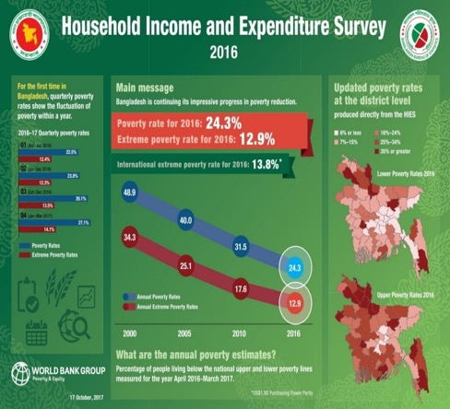
HOUSEHOLD INCOME AND EXPENDITURE SURVEY
Strengths
  Primary data source for studies assessing policy impacts on consumption, income and expenditure.
  Time required: between six and 12 months.
Weaknesses
  The design stage is crucial, regarding the quality of the survey and the pool for respondents.
  Requires a large number of households surveyed and comprehensive geographical coverage, along with a good representation across income classes.
  Not possible to customize an existing HIES database; any customization requires preparing a new survey.
Source: World Bank, 2017
Module 3, Annex A: Additional Information About Different Models
Notes:
Strengths:
Primary data source for studies that aim to assess policy impacts on consumption, income and expenditure.
The survey, its dissemination and the collection of results takes, on average, between six and 12 months.
It is not possible to customise an existing HIES database as in the case of models; any customization requires preparing a new survey.
Weaknesses:
Limitations are primarily at the design stage, regarding the quality of the survey and the pool for respondents.
The more households surveyed, and the more comprehensive the geographical coverage, along with a good representation across income classes, the higher the quality and reliability of the results. Sometimes representativeness across different demographics is not possible, which limits the understanding of key inequalities.

Slide 89
SECTORAL INPUT-OUTPUT (I-O) TABLES
Data source(s)
  National and sectoral statistics.
Data Availability
  Data from national statistics (at the country level) is generally available.
  Sectoral data on material and energy flows may be lacking.
Accessibility and Typical Users
  I-O tables are accessible, and developed and maintained by the Ministry of Finance, the Central Bank or the National Statistical Office (for economic I-O tables), sectoral ministries (for biophysical I-O tables) and universities (for integrated and multi-country I-O tables).
Module 3, Annex A: Additional Information About Different Models

Slide 90
SECTORAL INPUT-OUTPUT (I-O) TABLES
Resources required
  Building a new I-O table is a labour- and resource- intensive process.
  The time required to develop a new model depends on the number of sectors considered and can take between two months and a year.
Potential for integration with other methods and tools
  Can be used to parameterise and initialise other quantitative models.
  Provides an indication of ripple effects across sectors for possible short-term policy impacts.
Module 3, Annex A: Additional Information About Different Models

Slide 91
SECTORAL INPUT-OUTPUT (I-O) TABLES
Strengths
  I-O models capture ripple effects (upstream and downstream) across the value chain.
  Used as input for more complex and sophisticated national and/or sectoral models.
Weaknesses
  The effort required to create an I-O table can be regarded as a limitation.
  Strong focus on the interdependence between industries but lack of other interdependences.
  Generally assumes fixed prices and fixed I-O multipliers (or ratios).
Module 3, Annex A: Additional Information About Different Models
Notes:
Strengths:
I-O models can be used to capture ripple effects (upstream and downstream) across the value chain.
Are often used as input for more complex and sophisticated national and/or sectoral models.
Results of I-O models can be used to parameterise other mathematical models.
Weaknesses:
The effort required to create an I-O table can be regarded as a limitation itself.
Strong focus on the interdependence between industries through production and consumption but lack of other interdependences.
Generally assumes fixed prices and fixed I-O multipliers (or ratios), neglecting changes in resource efficiency.

Slide 92
QUANTITATIVE MODEL: Social Accounting Matrix (SAM)
A comprehensive, economy-wide input-output table with details of all transactions that have taken place between economic agents in an economy.
A SAM displays the macro- and meso-economic accounts of a socio-economic system in a square matrix, ensuring that all inflows equal the sum of the outflows.
The SAM can be regarded as an extension of an I-O table.
Module 3, Annex A: Additional Information About Different Models
Notes:
The Social Accounting Matrix (SAM) is a comprehensive, economy-wide input-output table with details of all transactions that have taken place between economic agents, such as private businesses, the public sector and the rest of the world, during a given period of time (usually one year) in an economy (Round, 2003).
A SAM displays the macro- and meso-economic accounts of a socio-economic system in a square matrix, ensuring that all inflows equal the sum of the outflows (UNEP, 2014: Using models for green economy policymaking). Each row of the SAM gives receipts of an account while the column gives the expenditure. The total of each row is supposed to be equal to the total of each corresponding column.

Slide 93
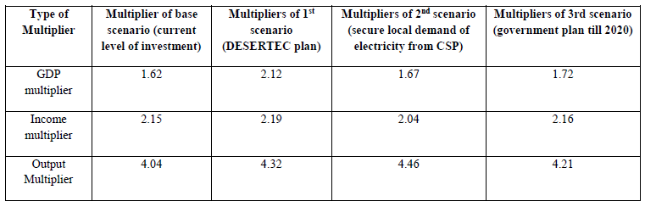
EXAMPLE
SAM analysis for evaluating renewable energy initiatives in Egypt.
The analysis aimed at examining what initiatives would yield the highest benefits for Egypt, for GDP and household income.
Source: Farag and Komendantova, 2014
Module 3, Annex A: Additional Information About Different Models
Notes:
Farag and Komendantova, 2014, applied a SAM analysis for evaluating renewable energy initiatives in Egypt. These initiatives were expected to allow Egypt to export renewable electricity to Europe, in addition to better satisfying domestic demand. The analysis aimed at examining what initiatives would yield the highest benefits for Egypt in terms of macroeconomic output (GDP) and household income. Different scenarios were analysed against the expected change in (1) the production costs of electricity; (2) sectoral production and GDP; and (3) household income, based on which policy recommendations for specific initiatives were formulated.

Slide 94
SOCIAL ACCOUNTING MATRIX (SAM)
Data source(s)
  Input-output tables, System of National Accounts (SNA), industrial statistics, consumption
  expenditure surveys and foreign trade statistics.
Data Availability
  High data requirements but data is generally available (e.g. GTAP database).
  Multipliers need to be derived ad hoc.
Accessibility and Typical Users
  Access is generally constrained to trained personnel but most SAMs are developed in Excel, which reduces barriers.
  Commonly used for analysing how policy impacts are distributed over economic actors.
Module 3, Annex A: Additional Information About Different Models

Slide 95
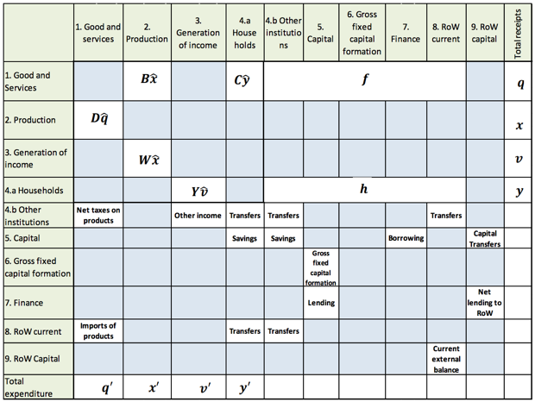
SOCIAL ACCOUNTING MATRIX (SAM)
Social accounting matrix structure in symbols
Resources required
  Creating a simple SAM from the SNA may take a month, a detailed SAM up to a year.
  Modifications can be performed in the range of two to four months.
Potential for integration with
other methods and tools
  Can be used to parameterise and initialise other quantitative models.
  Provides an indication of ripple effects across sectors for possible short-term policy impacts.
Module 3, Annex A: Additional Information About Different Models
Source: ILO, 2017
Notes:
Resources required:
Building and calibrating a new SAM is labor intensive but the time required depends on the level of detail.
Creating a simple SAM from the SNA may take a month, a detailed SAM up to a year.
Modifications can be performed in the range of two to four months.
Potential for integration with other methods and tools:
Can be used to parameterise and initialise other quantitative models.
Provides an indication of ripple effects across sectors for possible short-term policy impacts.
Source: ILO, 2017: How to measure and model social and employment outcomes of climate and sustainable development policies - Training guidebook.

Slide 96
SOCIAL ACCOUNTING MATRIX (SAM)
Strengths
  Extension of an I-O table, with an emphasis on private households and their socioeconomic relations.
  Large degree of flexibility regarding the disaggregation of the displayed information.
Weaknesses
  Might miss important policy outcomes due to a lack of data for the base year.
  Not suitable for investigating the medium- and long-term impacts of policy implementation.
  SAMs typically do not include physical flows.
Module 3, Annex A: Additional Information About Different Models
Notes:
Strengths:
Comprehensive, economy-wide input-output table with details of all transactions that have taken place between economic agents.
Extension of an I-O table, with an emphasis on private households and their socioeconomic relations but it is almost invariably limited to flows.
Provides a large degree of flexibility regarding the disaggregation of the displayed information.
Weaknesses:
Might miss important policy outcomes due to a lack of data for the base year.
Not suitable for investigating the medium- and long-term impacts of policy implementation.
SAMs present current information and do not allow for analysing “shocks” introduced to the system (i.e. fiscal policy).
SAMs typically do not include physical flows, such as energy consumption and quantities produced.

Slide 97
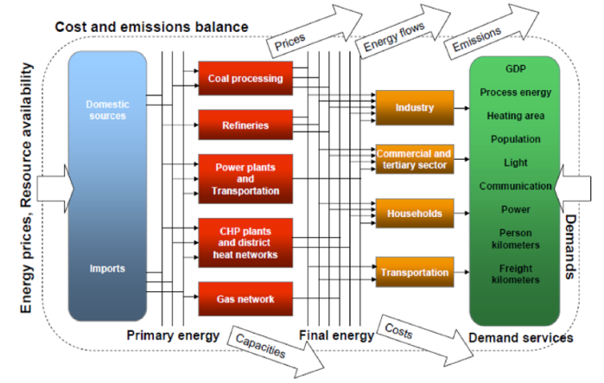
QUANTITATIVE MODEL: Partial Equilibrium models
A family of models that covers a single sector, generally at a high- level of detail.
PE models typically use a “bottom-up” approach, placing emphasis on individual technologies.
PE models primarily use optimization and simulation.
Source: Remme et al., 2001
Module 3, Annex A: Additional Information About Different Models
Notes:
Partial equilibrium (PE) models are a family of models that cover a single sector, generally at a high-level of detail when compared to economy-wide models, such as CGE models. They range from single-sector single-country models to single-sector multi-country models (FAO, 2006). PE models typically use a “bottom-up” approach, placing emphasis on individual technologies and estimating the impacts that the adoption of these technologies can have on demand and production in a given sector.
At their simplest level, PE models can be conceptualised as the interaction of supply and demand in a single market. In this market, the model estimates the effect that certain policy options, such as removal of a tariff in the energy sector, would have on the performance of the sector. Based on the new situation (without tariff) and specific elasticities for demand and supply, the PE model calculates a new equilibrium for the sector and provides output on a range of indicators (FAO, 2006).
Source: Remme, Goldstein, Schellmann & Schlenzig, 2001: MESAP/TIMES – Advanced decision support for energy and environmental planning.

Slide 98
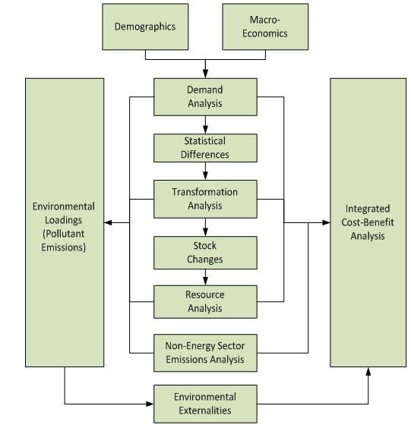
PARTIAL EQUILIBRIUM MODELS
Data source(s)
  Sectoral data, databases with technology parameters, such as cost, lifetime and efficiency, and potential adoption rates.
Data Availability
  Available from national and international databases.
Accessibility and Typical Users
  Specialised users, with depth of knowledge of the sector.
  Commonly used in sectoral analysis (country and regional).
  Typically developed and maintained by line ministries
  and academia.
Source: SEI, 2019
Module 3, Annex A: Additional Information About Different Models
Notes:
Data source(s):
Sectoral data, databases with technology parameters, such as cost, lifetime and efficiency, and potential adoption rates.
Data Availability:
Data is generally available from national and international databases.
Accessibility and Typical Users:
Specialised users, with depth of knowledge at the sectoral level.
Commonly used in sectoral analysis at the country and regional level.
Typically developed and maintained by line ministries and academia.
Source: Stockholm Environment Institute (SEI), 2019: LEAP: Introduction.

Slide 99
PARTIAL EQUILIBRIUM MODELS
Resources required
  Building and calibrating a new PE model requires two to six months, depending on the level of detail represented.
Potential for integration with other methods and tools
  Can be used in combination with macroeconomic models, to provide more realism using a bottom-up approach.
Module 3, Annex A: Additional Information About Different Models

Slide 100
PARTIAL EQUILIBRIUM MODELS
Strengths
  Typically uses a “bottom-up” approach, placing emphasis on individual technologies.
  Provides a realistic representation of the impact of adopting various technologies.
Weaknesses
  Reliance on sectoral boundaries leads to lack of dynamics (and feedback loops).
  Limited coverage of social, economic and environmental indicators.
  Focus on short-term impacts, given that longer term impacts are reflected in general equilibrium effects.
Module 3, Annex A: Additional Information About Different Models

Slide 101
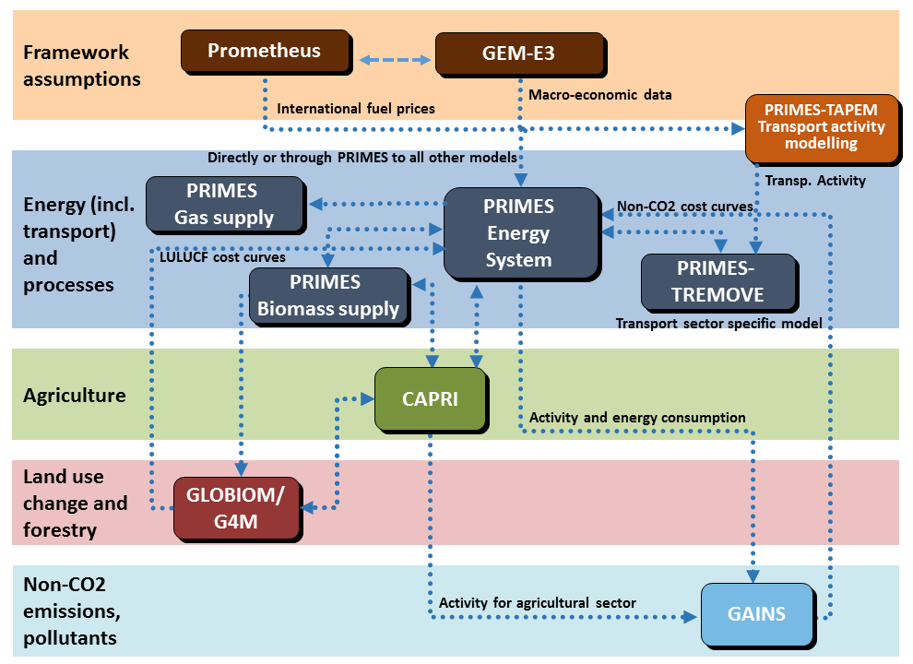
EXAMPLE
PRIMES is a partial equilibrium model of the energy market (E3MLab/ICCS, 2014).
It finds a price at which consumer and producer surplus are maximized, and at which supply equals demand.
Policy instruments examined include: emission and/or renewables targets, price-based policies, regulations, infrastructure policies and Emissions Trading Schemes.
Source: European Commission, 2020
Module 3, Annex A: Additional Information About Different Models
Notes:
PRIMES is a partial equilibrium model of the energy market, at an EU aggregate and individual member state level. It finds a price at which consumer and producer surplus are maximised, and at which supply equals demand. PRIMES assesses in detail several energy demands, such as transport, for which PRIMES has 15 transport modes, 103 vehicle types for road and non-road transport, a distinction between peak and off-peak travel, and three freight categories.
Policy instruments examined include: emission and/or renewables targets, price-based policies, such as carbon taxes, technology subsidies or trade tariffs, regulations, such as emission performance standards, infrastructure policies and Emissions Trading Schemes (ETS).
Source: European Commission, accessed 2020: Modelling tools for EU analysis. European Commission. Available here: https://ec.europa.eu/clima/policies/strategies/analysis/models_en

Slide 102
COMPUTABLE GENERAL EQUILIBRIUM (CGE)
Data source(s)
  Input-output table and/or Social Accounting Matrix.
Data Availability
  Use data from SAMs and/or input-output tables, so data is often dated.
  Additional data disaggregation may be required.
Accessibility and Typical Users
  Highly specialised.
  Generally very limited number of operational CGEs in a country.
  Developed and maintained by Ministry of Finance, Central Bank, academia, Multilateral Development Banks.
Module 3, Annex A: Additional Information About Different Models

Slide 103
COMPUTABLE GENERAL EQUILIBRIUM (CGE)
Resources required
  Building and calibrating a new CGE takes about 12 months.
  Using an existing model is likely to require some changes. An experienced user would need, on average, three to four months.
Potential for integration with other methods and tools
  Uses a SAM as input.
  Can be coupled with sectoral models, such as energy, for the addition of a bottom-up analysis, such as on technology.
Module 3, Annex A: Additional Information About Different Models

Slide 104
COMPUTABLE GENERAL EQUILIBRIUM (CGE)
Strengths
  Widely used to analyse aggregate welfare and distributional impacts of policies.
  Estimates first-, second- and third-order effects.
  Allows for indicators on a full set of impacts across an economy.
Weaknesses
  Assumption that optimisation is possible.
  Normally works under the assumption of full employment.
  Typical versions of the model do not incorporate social and human capital as a key factor of production.
Module 3, Annex A: Additional Information About Different Models
Notes:
Strengths:
Standard tool of empirical analysis and widely used to analyse aggregate welfare and distributional impacts of policies.
CGEs estimate all direct and indirect impacts, and follow impacts through time, allowing for a distinction between first-, second- and third-order effects.
Allows for indicators on a full set of impacts across an economy.
Weaknesses:
The main limitation of CGE models is the assumption that optimisation is possible.
CGE models normally work under the assumption of full employment.
Generally do not incorporate social and human capital as a key factor of production.
Critical thinking is needed to ensure that key relationships are adequately accounted for, as data is often imperfect, aggregated or “guesstimated”.
Analysis is very time intensive and does not allow prompt assessments.

Slide 105
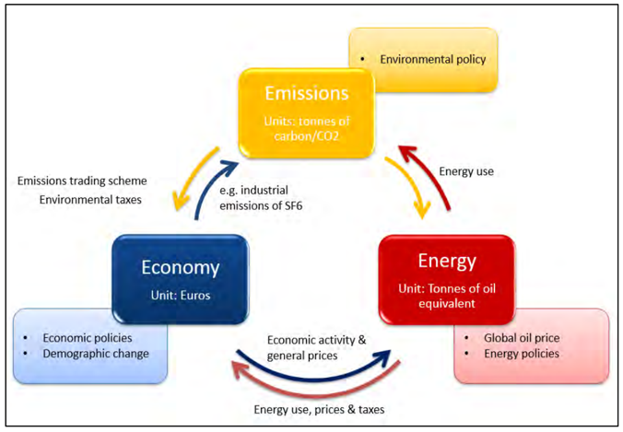
QUANTITATIVE MODEL: Macroeconometrics
Uses economic theory and statistical techniques to determine how a change in one variable is correlated with changes in others.
Top-down models used to analyse policy outcomes primarily on economic variables.
Used to assess similar questions to those evaluated by CGE models.
Source: Cambridge Econometrics, 2019.
Module 3, Annex A: Additional Information About Different Models
Notes:
Econometric models function by collecting historic data on a range of variables and using economic theory and statistical techniques to determine how a change in one variable is correlated with changes in others. Data on past correlation is then used to project future changes. A macroeconometric model takes this approach with regard to macroeconomic variables. As a result, this type of model is not based on an attempt to theorize how an economy works, instead it measures how it has evolved based on actual data. The reliance on data is certainly a strength, but also a weakness: past relationships may not accurately capture current or future relationships; and a more sophisticated attempt to model pathways of causation could take into account a range of factors not captured by past data.
Source: Cambridge Econometrics, 2019: E3ME Technical Manual v6.1.

Slide 106
MACROECONOMETRICS
Data source(s)
  Historical time series from the System of National Accounts, input-output table and/or Social Accounting Matrix.
Data Availability
  National data available from various sources.
  SAMs and/or input-output tables can also be used for model relationships.
Accessibility and Typical Users
  Highly specialised.
  Limited number of operational macroeconometric models in a country.
  Often developed by international organisations, universities and the Ministry of Finance.
Module 3, Annex A: Additional Information About Different Models

Slide 107
MACROECONOMETRICS
Resources required
  Building a new macroeconometric model requires at least four to six months.
  Using an existing model is likely to require some changes, which an experienced user could complete in one to two months.
Potential for integration with other methods and tools
  Can be used in combination with a SAM, especially for short-term assessments and for adding detail, such as disaggregation by income classes.
  Can also be coupled with sectoral models, such as energy, for the addition of a bottom-up analysis, such as on technology.
Module 3, Annex A: Additional Information About Different Models

Slide 108
MACROECONOMETRICS
Strengths
  Measures how an economy has evolved based on actual (historical) data.
  Well-defined links between economic sectors.
  Assessment of impacts of response measures.
Weaknesses
  Top-down modelling with heavy reliance on historical data.
  Assumes that future behavior will be similar to past behaviour.
  Quality of outputs related to quality of data.
  Typical macroeconometric models do not link well to microeconomic theories.
Module 3, Annex A: Additional Information About Different Models
Notes:
Strengths:
Measures how an economy has evolved based on actual (historical) data, rather than theorising how it might work.
Typically has well-defined links between economic sectors, which allows them to capture feedback and multiplier effects.
Relevant for assessing impacts of response measures through their capability to forecast several macroeconomic indicators, within and across countries, and to couple them with physical ones.
Weaknesses:
Top-down modelling with heavy reliance on historical data.
Assumes that future behavior will be similar to past behaviour.
The lack of good data represents a limiting factor for analysing the impacts implementing response measures.
‘Lucas Critique’: historical data is based on existing policy constraints and, should these policies change, firms and individuals are unlikely to act as they would have done previously.
Macroeconometric models do not link well to microeconomic theories.

Slide 109
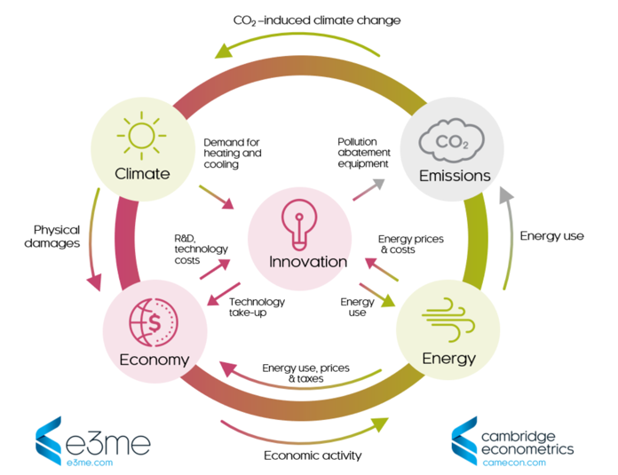
EXAMPLE
The E3ME is a model of the economy, energy systems and environmental emissions developed by Cambridge Econometrics.
The E3ME consists of 22 estimated sets of equations, each disaggregated by sector and by country.
The economic module contains 42 economic sectors, all linked by input-output relationships.
Source: Cambridge Econometrics, 2020.
Module 3, Annex A: Additional Information About Different Models
Notes:
The E3MG is a model of the economy, energy systems and environmental emissions developed by Cambridge Econometrics. The E3MG consists of 22 estimated sets of equations, each disaggregated by sector and by country. The estimation method utilises developments in time-series econometrics, in which dynamic relationships are specified in terms of error correction models (ECM) that allow dynamic convergence to a long-term outcome. The structure of the E3MG is based on the system of national accounts, with further linkages to energy demand and environmental emissions. The economic module in the E3MG contains a full representation of the national accounts and includes a sectoral disaggregation, with 42 economic sectors all linked by input-output relationships.
Source: Cambridge Econometrics, 2020: E3ME diagram. Available here: https://www.camecon.com/how/e3me-model/e3me-diagram/

Slide 110
SYSTEM DYNAMICS
Data source(s)
  Historical data obtained from national and international databases, or parameters that can be obtained through econometrics or from other models.
Data Availability
  National level generally available.
  Can also use qualitative information.
Accessibility and Typical Users
  Developed to analyse a specific problem or policy.
  Generally defined “white boxes”.
Module 3, Annex A: Additional Information About Different Models
Notes:
SD models are very transparent and users range across sectors and institutions.

Slide 111
SYSTEM DYNAMICS
Resources required
  Building and validating a new System Dynamics simulation model takes, on average, between one and six months.
  Depends on the size of the model and the extent to which stakeholders are actively involved in model development.
Potential for integration with other methods and tools
  It complements other approaches with a more systemic analysis.
  Can be used in combination with I-O, macroeconometric and CGE models.
  In a multi-method approach, it is suited for providing strategic directions and identifying the emergence of possible side effects.
Module 3, Annex A: Additional Information About Different Models

Slide 112
SYSTEM DYNAMICS
Strengths
  Flexible methodology that allows the integration of social, economic and environmental indicators.
  High customisation potential.
  Captures impacts of feedbacks, delays and non-linearities over time.
  Supports policy formulation with “what if” scenarios.
Weaknesses
  Requires experience and practice to correctly estimate the underlying feedback structure of the system.
  Requires a substantial amount of interdisciplinary knowledge.
  Typical model tends to oversimplify economic behavioural relationships and resources constraints.
Module 3, Annex A: Additional Information About Different Models

Slide 113

GLOBAL GREEN ECONOMY MODELLING
Integrated, cross-sectoral global model.
Simulates from 1970 to 2050.
Based on three pillars: causal loops (feedbacks), non-linearity and delays.
Integrates state of the art sectoral models.
Replicates existing scenarios within
one framework.
Source: UNEP, 2012
Module 3, Annex A: Additional Information About Different Models
Notes:
Integrated, cross-sectoral global model.
Simulates from 1970 to 2050.
Based on three pillars: causal loops (feedbacks), non-linearity, delays.
Integrates state of the art sectoral models.
Replicates existing scenarios within one framework, including:
United Nations’ World Population Prospects (WPP) (UNPD, 2009)
World Bank’s World Development Indicators (WDI) (WB, 2009)
OECD’s Environmental Outlook to 2030 (OECD, 2008)
FAO’s FAOSTAT (FAO, 2010) and State of World’s Forests (FAO, 2009)
McKinsey’s Charting Our Water Future report (McKinsey, 2009)
IEA’s World Energy Outlook 2009 (IEA, 2009), Sustainable Production of Second Generation Biofuels (IEA, 2010), Transport, Energy and CO₂ (IEA, 2009) and Energy Technology Perspectives to 2050 (IEA, 2008)
Global Footprint Network (GFN) reports (GFN, 2010)

Slide 114
COMPARISON OF SCENARIOS FOR SELECTED SECTORS AND ACTIONS
Module 3, Annex A: Additional Information About Different Models
Notes:
Both green and brown scenarios assume increased investments over the period 2010 to 2050. Green scenarios simulate additional investments that increase resource efficiency and reduce carbon intensity while creating jobs and stimulating economic growth. Efficiency improvements driven by investments can be achieved both directly – through the construction of more efficient infrastructure and the adoption of resource saving technologies – and indirectly – through technological advances due to relevant research and development. Examples include investments in renewable energy, such as power supply, and energy efficiency improvements. Further, investments are allocated to reduce deforestation and increase reforestation, or to reduce extractive capacity in the fishery sector and support the restoration of fish stocks.
The green scenarios are divided in two: Scenario G1: assumes that 1 per cent of global GDP is channelled annually through green investment. Scenario G2: assumes that 2 per cent of global GDP is channelled annually through green investment.
Two different methods were developed to simulate green economy investments and analyze them objectively: (1) The first approach simulated additional investments, both brown and green, across sectors; (2) The second approach shifts investments from business as usual (BAU) to green. In this case, investments are practically reallocated to green investment across sectors. The first approach is presented in this chapter. A comparison of the results obtained through the simulation of both methods is presented in Appendix I. In brief, our analysis indicates that when using the same assumptions, results of the simulations do not significantly differ from each other for most variables.

Slide 115
RESULTS: Growth and Sustainability
Outcomes over time
  Short-term: Brown scenarios perform best, then Green and BAU.
  Medium-/long-term: Green scenarios perform best, then Brown and BAU.
Overall
  Higher longer-term resilience in Green scenarios.
  Clear cross sector synergies allow a positive ROI for Green cases (3:1) to be reached, higher than Brown in the medium- and long-term.
Module 3, Annex A: Additional Information About Different Models
Notes:
Short term: Brown scenarios perform best, then Green and BAU. Higher growth fueled by resource extraction, cheap short-term options – BAU.
Medium-/long-term: Green scenarios perform best, then Brown and BAU. Higher growth driven by resource efficiency, which reduces costs and secures longer-term availability of key production inputs for the future.
Higher longer-term resilience in Green scenarios.
Clear cross sector synergies allow a positive ROI for Green cases (3:1) to be reached, higher than Brown in the medium- and long-term.

Slide 116
RESULTS: IN A NUTSHELL (GREEN VS. BROWN) – VARIOUS INDICATORS
Source: UNEP, 2011
Module 3, Annex A: Additional Information About Different Models
Notes:
The Green scenarios are forecast to be more economically viable, having the same employment level, lower poverty, improved nutrition, and much lower water stress and footprint relative to the Brown scenario.
Source: UNEP, 2011: Towards a Green Economy: Pathways to Sustainable Development and Poverty Eradication.

Slide 117
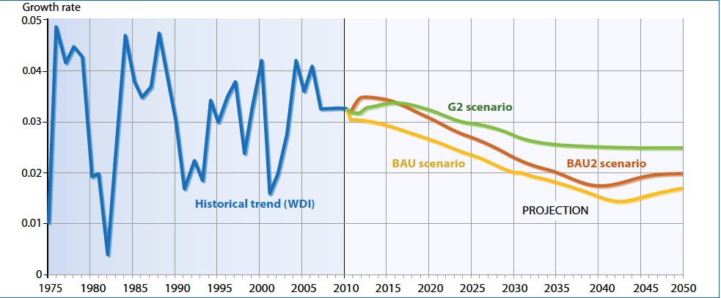
RESULTS: IN A NUTSHELL (GREEN VS. BROWN) - GDP GROWTH
Source: UNEP, 2011
Module 3, Annex A: Additional Information About Different Models
Notes:
The green scenarios, by promoting investment in key ecosystem services and a low carbon development, show slightly slower economic growth in the short- to medium-term, but faster and more sustainable growth in the longer-term. In this respect, the green scenarios show more resilience, by lowering emissions, reducing dependence on volatile fuels and using natural resources more efficiently and sustainably. In other words, the green economy investment scenarios take the earth off the collision course it is currently on with biophysical constraints.
Source: UNEP (UN Environment), 2011. Towards a Green Economy: Pathways to Sustainable Development and Poverty Eradication. DECEMBER 2011.

Slide 118
RESULTS: IN A NUTSHELL (GREEN VS. BROWN) – NATURAL RESOURCE STOCKS AND THE ECONOMY
Source: UNEP, 2011
Module 3, Annex A: Additional Information About Different Models
Notes:
Generally, the green economy scenarios show the marked beginning of the decoupling of economic development and natural resource uses. In fact, the key difference between green and brown investments is created by the projected future of stocks of natural resources.
BAU scenarios push consumption, stimulating economic growth in the short- and medium-term, practically exacerbating known historical trends of depletion of natural resources. In the longer-term, the decline of natural resources, such as fish stocks, forestland and fossil fuels, has direct negative impacts on GDP, through reduced production capacity, higher energy prices and growing emissions, and employment. Additional consequences may include large-scale migration driven by resource shortages, such as water, faster global warming and considerable biodiversity losses.
Source: UNEP, 2011: Towards a Green Economy: Pathways to Sustainable Development and Poverty Eradication.

Slide 119
RESULTS: IN A NUTSHELL (GREEN VS. BROWN) – CO2 EMISSIONS
Source: UNEP, 2011
Module 3, Annex A: Additional Information About Different Models
Notes:
As a result of green investments, global energy demand and CO₂ emissions will be mitigated considerably by 2050 relative to BAU. Even without explicitly modelling and analyzing the positive impacts on emissions of transitioning to conservation agriculture, we project a concentration in the range of 500-600 ppm in the green scenarios. This indicates a moderate to unlikely probability that global warming will be limited to 2º C, as indicated in the IPCC AR4 report (IPCC, 2007).
Source: UNEP, 2011: Towards a Green Economy: Pathways to Sustainable Development and Poverty Eradication.

Slide 120
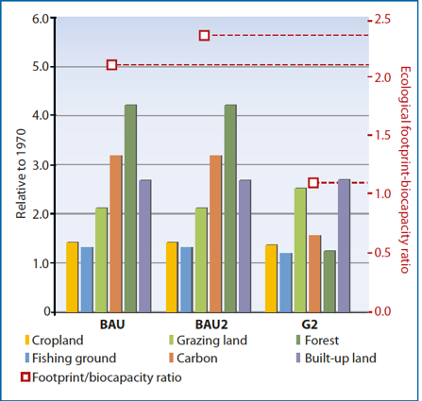
RESULTS: IN A NUTSHELL (GREEN VS. BROWN) – ECOLOGICAL FOOTPRINT (INDEX: 2010 =1)
Source: UNEP, 2011
Module 3, Annex A: Additional Information About Different Models
Notes:
Pressure on natural resources increases as GDP grows and becomes a brake on growth in both BAU1 and BAU2. Lower soil quality, higher water stress and fossil fuel prices all impact GDP negatively, in turn impacting indicators such as the HDI. Natural resources have varied impacts on our footprint, which pushes resource use to 2.2 times what Earth can sustainably generate by 2050 in the BAU2 case, from 1.5 in 2010 and 1.7 times in 2020.However, in G1 and G2, while investments support the transition to a lower carbon and more resource efficient economy, they generate higher GDP, as well as higher energy and water demand than it would have been otherwise. As a consequence, the green investments in support of the transition will be partially offset by growing GDP, which will limit conservation through a push in consumption. Synergies can be found in investments in energy efficiency and renewable energy, among others, because they generate a net reduction in fossil fuel demand, which in turn pushes prices below the BAU projection and generates considerable savings (or avoided costs) over time, despite the impact of the rebound effect.
Source: UNEP, 2011: Towards a Green Economy: Pathways to Sustainable Development and Poverty Eradication.

Slide 121
RESULTS: IN A NUTSHELL (GREEN VS. BROWN) – ENERGY EMPLOYMENT
Source: UNEP, 2011
Module 3, Annex A: Additional Information About Different Models
Notes:
Green investments allocated to energy efficiency are expected to create an additional 2.9 - 5.1 million jobs by 2050, causing the total energy employment in G2 to reach 23.4 million in 2050, 26% above the baseline. The figure shows the breakdown of energy employment, with energy efficiency being the grey area at the top.
Source: UNEP, 2011: Towards a Green Economy: Pathways to Sustainable Development and Poverty Eradication.

Slide 122
Annex B:
Additional information about IGEM

Slide 123
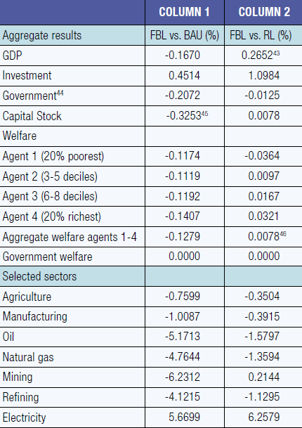
RESULTS FROM THE CGE – SCENARIO 1 (LEFT) AND 2 (RIGHT)
Aggregate and sectoral effects of a revenue-neutral carbon tax, in 2036.
Source: PAGE, 2017
Module 3, Annex B: Additional information about IGEM
Notes:
Source: PAGE, 2017: The Integrated Green Economy Modelling Framework – Technical Document.

Slide 124
RESULTS FROM THE SD – BAU SIMULATION
Source: PAGE, 2017
Module 3, Annex B: Additional information about IGEM

Slide 125
RESULTS FROM THE SD – FEEBATE SCENARIO
Module 3, Annex B: Additional information about IGEM
Source: PAGE, 2017
Notes:
Source: PAGE, 2017: The Integrated Green Economy Modelling Framework – Technical Document.

Slide 126
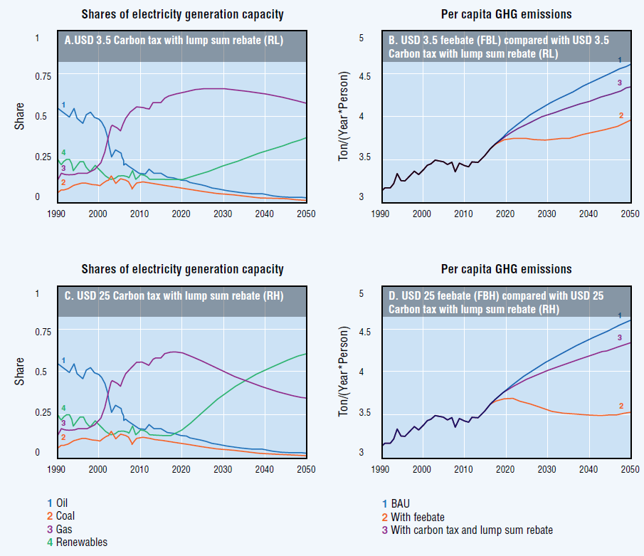
RESULTS FROM THE SD – REBATE SCENARIO
Module 3, Annex B: Additional information about IGEM
Source: PAGE, 2017
Notes:
Source: PAGE, 2017: The Integrated Green Economy Modelling Framework – Technical Document.

Slide 127
EVOLUTION OF THE SHARE OF RENEWABLE ENERGY CAPACITY FOLLOWING BAU, FBL, RL, FBH AND RH SCENARIOS
Source: PAGE, 2017
Module 3, Annex B: Additional information about IGEM
Notes:
Source: PAGE, 2017: The Integrated Green Economy Modelling Framework – Technical Document.

Slide 128
EXAMPLE OF RESULTS FROM THE IGEM
The IGEM simulated the dynamic CGE model in conjunction with the SD model, and used output gathered from the SD model to supplement and adjust the CGE input parameters.
It is estimated that a carbon tax would have positive impacts on the health of the population and labor productivity.
As a result, IGEM considers any increase in longevity equal to an increase in productivity.
Module 3, Annex B: Additional information about IGEM
Notes:
The IGEM simulated the dynamic CGE model in conjunction with the SD model, and used output gathered from the SD model to supplement and adjust the CGE input parameters.
It is estimated that, since the burning of fossil fuels generates particulates and other harmful waste, a carbon tax would have positive impacts on the health of the population, which in turn should increase productivity as healthier individuals typically work more and produce more.
Based on these assumptions, the IGEM was applied considering any increase in longevity equal to an increase in productivity.

Slide 129
RESULTS FROM THE IGEM
Aggregate and sectoral effects of a revenue-neutral carbon tax and a feebate scenarios, in 2036.
Source: PAGE, 2017
Module 3, Annex B: Additional information about IGEM

Slide 130
SUMMARY OF RESULTS FROM THE IGEM
Module 3, Annex B: Additional information about IGEM
Source: PAGE, 2017
Notes:
Source: PAGE, 2017: The Integrated Green Economy Modelling Framework – Technical Document.

