Slide 1
УЧЕБНЫЙ КУРС
______________________________
«Моделирование для инклюзивной «зеленой» экономики»

Slide 2
Краткое описание.
«Инклюзивная зеленая экономика» — это модель экономического развития, которая сочетает в себе принципы «зеленой экономики» (снижение рисков для окружающей среды и здоровья, устойчивое использование ресурсов) с «инклюзивностью», обеспечивая при этом более справедливое распределение благ и возможностей.
Такая модель предполагает, что экологическая трансформация должна быть социально справедливой, создавая новые рабочие места и возможности для всех слоев населения, а не только для избранных.

Slide 3
Где используется?
Моделирование инклюзивной зеленой экономики (IGE) - это мощный инструмент, позволяющий оценить инвестиции, необходимые для достижения этих целей и задач на комплексной основе.
Моделирование IGE используется для обоснования политических и инвестиционных оценок и процессов принятия решений с использованием существующих методов, обычно используемых экономистами и специалистами по государственной политике, и адаптации их к проведению анализа экономических, социальных и экологических последствий.

Slide 4
Разработка курса и использование материалов
Учебные материалы были разработаны в рамках инициативы "Партнерство для действий в интересах зеленой экономики" (PAGE), инициативы "Единая ООН", которая объединяет пять учреждений Организации Объединенных Наций – Программу ООН по окружающей среде, Международную организацию труда Программу развития ООН, Программу промышленного развития ООН Организация и Учебный и научно-исследовательский институт ООН.
Учреждения-партнеры также могут интегрировать компоненты курса можно включить в их существующий портфель курсов или использовать компоненты курса для серии семинаров.

Slide 5
Целевая аудитория курса
Целевая аудитория курса - студенты магистратуры.
Предварительные требования включают прохождение
(i) одного или нескольких курсов моделирования (экономических, например, в рамках курсов микро- и макроэкономики и/или курсов биофизического моделирования) и
знание оптимизации, эконометрики и/или моделирования; и/или
(ii) курсов по социальной, экономической и/или экологической политике. (например, с информацией об инструментах политики и методах оценки, таких как анализ затрат и выгод).
Этот курс потенциально может быть также предложен студентам старших курсов бакалавриата в их последний год обучения.
Решение о том, когда предлагать этот курс, будет частично зависеть от того, в какой степени курсы по макроэкономическому и отраслевому моделированию предлагаются на уровне бакалавриата или магистратуры.

Slide 6
После завершения курса студенты смогут:
Дать определение концепции инклюзивной зеленой экономики (IGE) и объяснить ее значение в контексте Повестки дня на период до 2030 года и устойчивого развития Цели (SDG).
Определить ключевые показатели (социальные, экономические и экологические), необходимые для проведения оценки IGE для секторов или активов, политики или инвестиций.
Определить соответствующие подходы и модели моделирования для оценки IGE и описать их преимущества и недостатки.
Определить требования к данным для использования различных методов/моделей.
Интерпретировать результаты различных упражнений по моделированию на основе используемого подхода к моделированию и имитационной модели.
Improve existing models to capture all three dimensions of sustainable development (economic, social and environmental), link existing models in an integrated framework, or create new and customized IGE models.
Provide examples of the use of simulation models, sectoral and integrated, for IGE assessments and explain how these models can support assessing progress towards the SDGs.

Slide 7
Course Structure and Content (Module 1)
Модуль 1 – Различные пути к инклюзивной зеленой экономике
Модуль 1 знакомит с концепцией инклюзивной зеленой экономики и ее основными инструментами политики, а также подчеркивает роль имитационных моделей в понимании взаимозависимостей между (i) секторами и переменными (внутри секторов); (ii) экономическими субъектами; (iii) аспектами развития (социальными, экономическими и экологическими); (iv) во времени (в краткосрочной, среднесрочной и долгосрочной перспективе); и (v) в пространстве.

Slide 8
Course Structure and Content (Module 2)
Модуль 2 – Определение показателей для моделирования IGE
В модуле 2 обсуждается множество показателей, необходимых для проведения оценки IGE, и метод их определения. Показатели являются ключевыми для определения того, какой тип модели требуется и какими должны быть границы таких моделей, например , секторальные или интегрированные.
В модуле 2 представлен (Integrated Policymaking Cycle) интегрированный цикл разработки политики и он будет использоваться в качестве основы для определения показателей для выявления проблем, разработки политики, оценки политики, а также для мониторинга и оценки политики.

Slide 9
Модуль 3 – Обзор подходов и моделей моделирования
В начале модуля 3 представлен обзор методологий и моделей, доступных для оценки IGE. В нем проводится различие между отраслевыми, узконаправленными моделями, такими как экономическая модель или модель, ориентированная на электроснабжение, и межотраслевыми, интегрированными моделями, такими как модели энергетической экономики или модели межотраслевого планирования национального развития.
Во-вторых, модуль 3 содержит подробную информацию о характеристиках каждой проанализированной модели, охватывающую как полученные результаты, так и требования к настройке и использованию.
Наконец, в модуле 3 представлена информация о том, как оценивать результаты моделирования на основе используемой методологии и моделей. Например, модели частичного равновесия, скорее всего, переоценивают результаты, в то время как модели общего равновесия могут недооценивать политические и инвестиционные результаты. Анализ будет представлен в разбивке по тематическим областям, таким как политика, отмена субсидий и стимулирование использования возобновляемых источников энергии.

Slide 10
Module 4 – Final exercise
Модуль 4 является заключительным упражнением курса. В рамках этого модуля студенты работают в небольших группах по два-четыре человека над реальной моделью, применяя полученные знания об интеграции социальных, экономических и экологических показателей в традиционное моделирование.
Например:
Определите актуальную проблему на отраслевом или национальном уровне: o Выберите проблему для анализа, например, увеличение загрязнения воздуха и воды . o Определите соответствующие показатели для анализа этой проблемы. o Составьте список показателей, которые вызывают проблему, а также список показателей, на которые влияет проблема, с учетом социальных, экономических и экологических показателей. o Определите переменные, которые следует включить в оценку проблемы с помощью моделирования. nvironmental indicators into their traditional modelling.

Slide 11
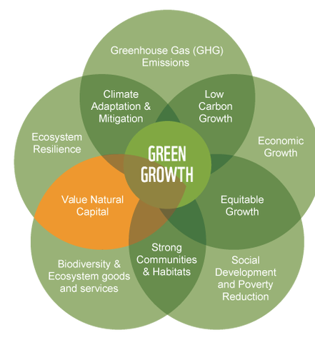
IGE and Green Growth
Green Growth
“
Economic progress that fosters environmentally sustainable, low-carbon and socially inclusive development
“
UN-ESCAP et al., 2010
“
Green growth means fostering economic growth and development, while ensuring that natural assets continue to provide the resources and environmental services on which our well-being relies
“
OECD, 2011
Source: GGGI
Module 1, Section 1: Rationale for Advancing IGE
Notes:
There are many definitions similar to the IGE. This and the next slides provide a few examples. The underlying concept is very similar to the one of the IGE (see text in quotes), but different terms are used by different organizations. This is to create ownership and to stress specific aspects of the IGE, those aspects that are key to the mission of each organization that works on sustainable development, such as environment, economic growth, industrial development and jobs.
“Economic progress that fosters environmentally sustainable, low-carbon and socially inclusive development” (UN-ESCAP et al., 2010).
“Green growth means fostering economic growth and development, while ensuring that natural assets continue to provide the resources and environmental services on which our well-being relies” (OECD, 2011).

Slide 12
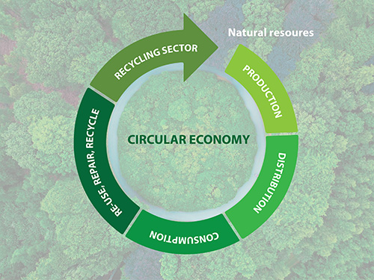
IGE AND CIRCULAR ECONOMY
Circular Economy
An economy that:
reduces the consumption of resources and the generation of waste, and reuses and recycles waste throughout the production, distribution and consumption processes.
Source: UN Environment, 2018
Module 1, Section 1: Rationale for Advancing IGE
Notes:
The CE is also very similar to the IGE. The CE is an economy that reduces the consumption of resources and the generation of waste, and reuses and recycles waste throughout the production, distribution and consumption processes. As a result, it could be said that the CE is a strategy that is a subset of the broader concept of IGE that is consistent but narrower in scope.
Source: UN Environment, 2018: https://www.unenvironment.org/events/workshop/strengthening-leadership-circular-economy

Slide 13
POLICY QUESTIONS THAT MODELLING SHOULD HELP TO ANSWER
How can the impact of investments and policies be assessed?
Are the impacts likely to be long or short-term?
What benefits might investments and policies generate across sectors in terms of economic opportunities, inclusiveness and environmental sustainability?
Which labour interventions deliver more and better green jobs? Which approaches create better access for the unemployed and underemployed?
JOBS
Module 1, Section 3: Simulation Models and How They Support Decision Making

Slide 14
WHAT ASSESSMENTS CAN BE CREATED WITH SIMULATION MODELS?
  Economic assessment
  Social assessment
  Environmental assessment
  Governance assessment
  Integrated assessment
Five main types of assessments can be found to inform policy formulation and assessment.
Each of these assessments makes use of tools.
Module 1, Section 3: Simulation Models and How They Support Decision Making
Notes:
Simulation models can be used to create various types of assessments. This slides provides a brief overview. More details and examples are to follow.
It is important to note that these assessments may or may not use simulation models, but the use of models supports (with quantified estimates) the conclusions of the assessments.

Slide 15
SIMULATION MODELS AND HOW THEY SUPPORT DECISION MAKING
Issues and related policy goals can be of a general nature, or they can be social, economic and environmental (with the latter being more relevant for UNEP).
Issue identification and agenda setting
Polity formulation analysis focuses on issues and opportunities and on the broader advantages and disavantages and disavantages of policy implementation.
Policy formulation - Assessment
Policy evaluation makes use of the indicators identified in the first two steps, to evaluate the effectiveness of the intervention and the emergence of unexpected impacts and trends.
Policy monitoring and evaluation
Decision-making is based on the results of the policy formulation stage, and should account for the forecasted impacts of policy implementation on the environment, the economy and overall well-being of the population.
Decision-making
Policy implementation
Source: UNEP, 2014
Module 1, Section 3: Simulation Models and How They Support Decision Making
Notes:
Agenda setting, policy formulation, decision-making and policy evaluation are all steps of the policymaking process that can be supported by simulation models. Each step has a different goal and provides a different input to the decision-making process. As a result, different models are needed to support different steps.
Issue identification and agenda setting, supported by the use of scenario creation tools.
Policy formulation and assessment: supported by simulation models, sectoral and integrated.
All models can be useful for monitoring and evaluation.
This figure provides the example of UNEP, how have they used simulation models in the early years of the Green Economy Advisory Services.
Source: UNEP, 2014: Using models for Green Economy policymaking.

Slide 16
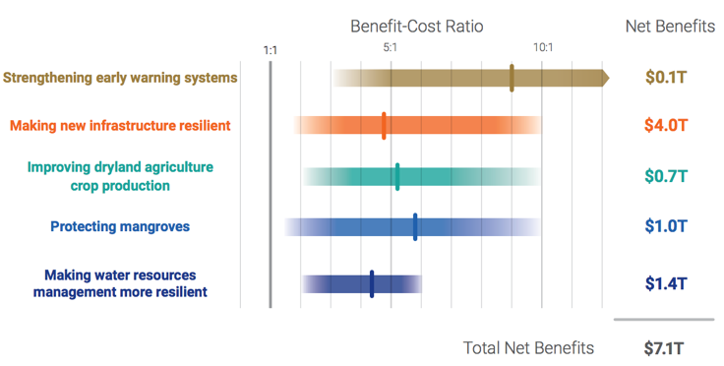
ECONOMIC ASSESSMENTS
Benefits and Costs of Illustrative Investments in Adaptation
Designed to support the analysis
of policies, projects and
investments.
Focuses on expected
economic outcomes.
Example: project feasibility studies
Source: GCA, 2019
Module 1, Section 3: Simulation Models and How They Support Decision Making
Notes:
Economic assessments provide information on whether a policy or investment is economically viable/attractive.
Source: GCA, 2019: Adapt now: A global call for leadership on climate resilience. Global Center on Adaptation & World Resources Institute.

Slide 17
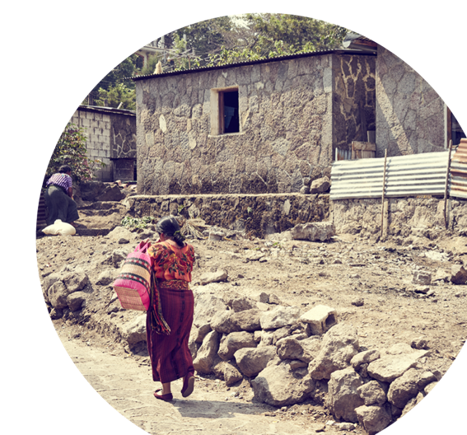
SOCIAL ASSESSMENTS
Provide guidance on policy impacts for different social groups (i.e., inclusiveness).
Support the review and monitoring of key governance indicators.
Example: Poverty and Social Impact Analysis (PSIA), which facilitates the assessment of policy inclusiveness and pro-poor orientation.
@shutterstock
Module 1, Section 3: Simulation Models and How They Support Decision Making
Notes:
Social assessments provide guidance on policy impacts for different social groups, supporting inclusiveness assessments. Social assessments are completed for a variety of topics/sectors, such as fossil fuel subsidies and deforestation.

Slide 18

ENVIRONMENTAL ASSESSMENTS
Provide the evaluation of the environmental impacts of development strategies, policies, projects and investments.
Examples: Strategic Environmental Assessment (SEA) and Environmental Impact Assessments (EIA)
@shutterstock
Module 1, Section 3: Simulation Models and How They Support Decision Making
Notes:
Environmental assessments include methodological frameworks that combine tools for the evaluation of the environmental impacts of development strategies, policies, projects and investments. They include: (1) Strategic Environmental Assessment (SEA), for policies; and (2) Environmental Impact Assessments (EIA), for projects.

Slide 19

GOVERNANCE ASSESSMENTS
Support the analysis of the efficiency and transparency of institutional frameworks and processes at both the national and local levels.
Example: UNDP’s governance assessment.
Source: UNDP
Module 1, Section 3: Simulation Models and How They Support Decision Making
Notes:
The formulation, implementation, monitoring and evaluation of integrated IGE policies requires efficient and transparent institutional frameworks and processes at both the national and local levels. In order to conduct governance assessments, decision makers can adopt specific methodological frameworks, such as UNDP’s governance assessment.

Slide 20

INTEGRATED ASSESSMENTS
Integrate multiple data and tools in a unique assessment framework.
Estimate policy and investment outcomes across sectors, economic actors, dimensions of development and over time.
Example: Decision Support Systems (DSS).
@shutterstock
Module 1, Section 3: Simulation Models and How They Support Decision Making
Notes:
Approaches exist to conduct a more comprehensive (or integrated) IGE assessment. As an example, by integrating multiple data and tools in a unique assessment framework, Decision Support Systems (DSS) provide valuable guidance to decision makers for the integrated evaluation of IGE policies.

Slide 21
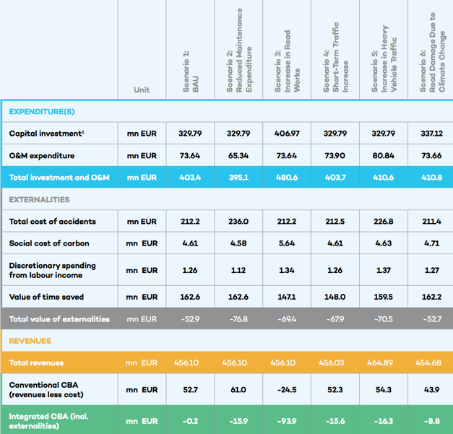
EXAMPLE: SUSTAINABLE ASSET VALUATION (SAVi) OF THE CONTOURNEMENT DE RABAT, MOROCCO
SAVi’s Integrated Cost Benefit Analysis (in EUR millions)
Source: IISD, 2019
Module 1, Section 3: Simulation Models and How They Support Decision Making
Notes:
An assessment of the economic, social and environmental outcomes of various road management strategies.
The assessment focused on road infrastructcure. The analysis covers multiple dimensions (i.e. actors and sectors) over time:
Financial impact of management decisions.
Environmental impacts in terms of material use and emissions.
Social impacts in terms of income generation, travel time and accidents.
Source: IISD, 2019: Sustainable Asset Valuation (SAVi) of the Contournement de Rabat, Morocco: A focus on road infrastructure. Bassi, A.M.; Casier, L.; Perera, O.; Pallaske, G. & Uzsoki, D. Geneva: International Institute for Sustainable Development (IISD).
https://www.iisd.org/sites/default/files/publications/savi-contournement-morocco-en.pdf

Slide 22
SIMULATION MODELS AND HOW THEY SUPPORT DECISION MAKING
Four main groups of tools:
Policy/project assessments tools
Indicators and
measurements frameworks
Scenario forecasting tools (quantitative)
Scenario creation tools (qualitative)
Notes:
There are four main groups of tools, which are complementary to one another. The diagram shows that indicators can be used in all assessments and are an integral part of simulation models. Furthermore, scenario creation tools can support the creation of scenario forecasting tools. For example, a qualitative model and causal-descriptive can be used as a blueprint for the creation of quantitative models. Policy and project assessment tools do not necessarily need forecasts and can make use of indicators.

Slide 23
Модели
QUALITATIVE MODELS:
Delphi Analysis,
Causal Loop Diagram (CLD),
QUANTITATIVE MODELS:
Sectoral Input-Output (I-O) Tables,
Computable General Equilibrium (CGE),
System Dynamicsа

Slide 24
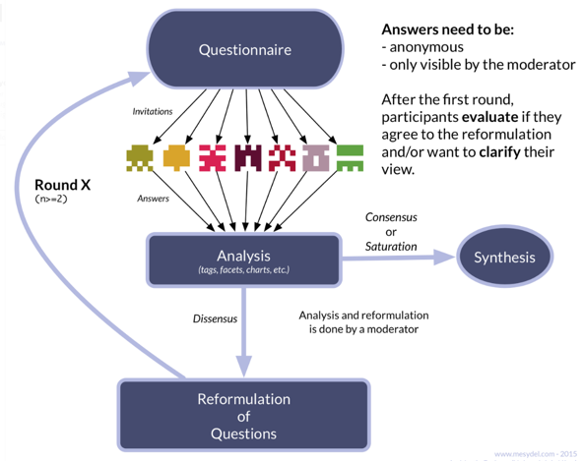
QUALITATIVE MODEL: Delphi Analysis
The Delphi Method
The Delphi method consists of a multi-round survey to converge towards a common solution or view.
At every round following the first one, the participants are given the results of the previous rounds.
Thus, they are asked to reconsider their judgements based on the opinions of others.
This helps them converge towards a common solution or view.
Source: Rivière, 2018
Notes:
Delphi Analysis is a method to elicit knowledge through the use of surveys. Delphi was developed in the early 1960’s by the RAND Corporation (European Commission, 2006). It has since been applied in many foresight activities at the national level, as well as in numerous industrial/commercial strategic assessments. The core of the Delphi method is a multi-round survey. The underlying hypothesis of this method is that experts in a field have expectations for the likely future development (expert knowledge) of their field, and it is possible to identify outliers by involving a large enough group of participants and sharing the result of each survey. Practically, at every round following the first one, the participating experts are given the results of the previous rounds. Thus, the participants are asked to reconsider their judgments based on the opinions of their peers. As a result, Delphi could be considered an anonymous group discussion. While introducing some of the advantages of a discussion into the survey, the anonymity of the process ensures that the opinions of influential individuals do not dominate the findings. Instead the most likely or convincing developments are identified based on rational arguments (European Commission, 2006).
Source: Rivière, M., 2018: What is the Delphi method and what is it used for? Last accessed: Dec 12, 2019 https://blog.mesydel.com/what-is-the-delphi-method-and-what-is-it-used-for-feb2d26f917a

Slide 25
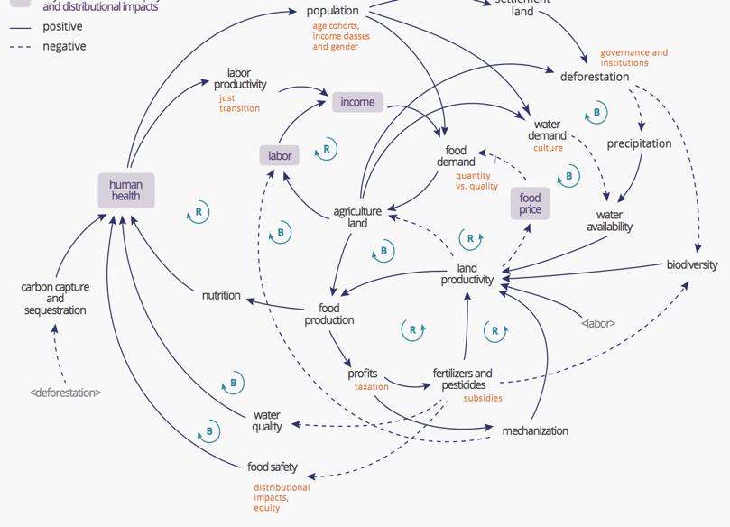
QUALITATIVE MODEL: Causal Loop Diagram (CLD)
A CLD consists of variables connected by arrows denoting the causal influences among the variables. Feedback loops are also identified in the diagram.
CLDs support the identification of policy outcomes using a systemic approach
CLDs have been used extensively to carry out qualitative assessments of policy impacts.
TEEB developed a CLD to explain the dynamics existing in the eco-agri-food system.
Illustrative Causal Loop Diagram of a generic eco-agri-food system (Source: Zhang et al. 2018)
Source: TEEB, 2018
Notes:
UN Environment has also used CLDs to map the complexity of the eco-agri-food system in their latest TEEB report for agriculture and food (Zhang, 2018). The CLD highlights several reinforcing loops, such as demand driving production, production leading to income creation and income stimulating demand, as well as various balancing loops, such as the more agricultural land there is, the more deforestation, the lower biodiversity and land productivity, leading to a greater need for agricultural land. Further, it shows how human health is central to the realization of a sustainable eco-agri-food system.
Source: TEEB, 2018: Measuring what matters in agriculture and food systems. A synthesis of the results and recommendations of TEEB for Agriculture and Food’s Scientific and Economic Foundations Report.

Slide 26
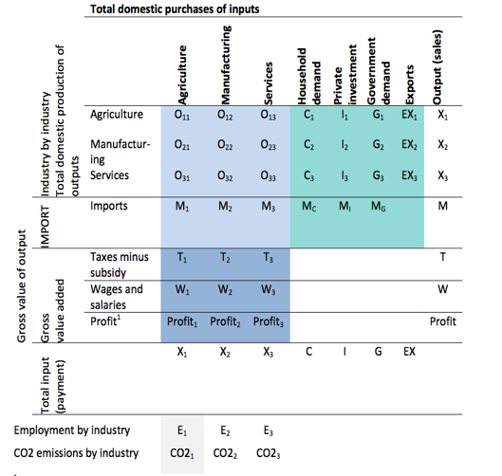
QUANTITATIVE MODEL: Sectoral Input-Output (I-O) Tables
I-O table in symbols
Represent inputs and outputs of several economic activities, physical and/or monetary.
An input-output model replaces the data in an input-output table with equations.
I-O models can be descriptive and prescriptive.
Source: ILO,2017
Notes:
Input-output tables (Leontief, 1951) represent inputs and outputs of several economic activities. These inputs and outputs can be physical and/or monetary. Input-output tables are frequently used to estimate physical and monetary flows across value chains.
An input-output model of production and distribution of goods and services replaces the data in an input-output table with equations. These equations explain the relationship between inputs and outputs of a given process. In other words, the model uses productivity multipliers that serve for the calculation of the output values given a specific set and quantity of inputs, or it estimates the required inputs for a given value of output (Tcheremnykh, 2003).
Descriptive I-O models generate information about the current state of the economy (production, employment, imports/exports and gross value added).
Predictive I-O models look forward to evaluate policy impacts.
Source: ILO, 2017: How to measure and model social and employment outcomes of climate and sustainable development policies. Training guidebook.

Slide 27
QUANTITATIVE MODEL: Computable General Equilibrium (CGE)
Models supply and demand behaviour across all markets in an economy.
Widely used to analyse the aggregate welfare and distributional impacts of policies.
Optimize the benefits for various economic actors.
Source: Banerjee, Onil, 2019.
Notes:
A general equilibrium approach models supply and demand behaviour across all markets in an economy. Analysis is typically conducted using computable general equilibrium (CGE) models (see, for instance, Lofgren & Diaz-Bonilla (2010)). CGE models are a standard tool of empirical analysis, and are widely used to analyse the aggregate welfare and distributional impacts of policies whose effects may be transmitted through multiple markets, or contain menus of different tax, subsidy, quota or transfer instruments (Sue Wing, 2004).
CGE models optimize utility for economic actors. The three conditions of market clearance, zero profit and income balance are employed to simultaneously solve the setting of prices and the allocation of goods and factors that support general equilibrium.
Source: Sue Wing, I., 2004: Computable General Equilibrium Models and Their Use in Economy-Wide Policy Analysis: Everything You Ever Wanted to Know (But Were Afraid to Ask). Joint Program on the Science and Policy of Global Change MIT. Cambridge, MA, USA.
Source: Banerjee, Onil & Cicowiez, Martin & Horridge, Jonathan & Vargas, Renato, 2016: A Conceptual Framework for Integrated Economic–Environmental Modeling. The Journal of Environment & Development.

Slide 28
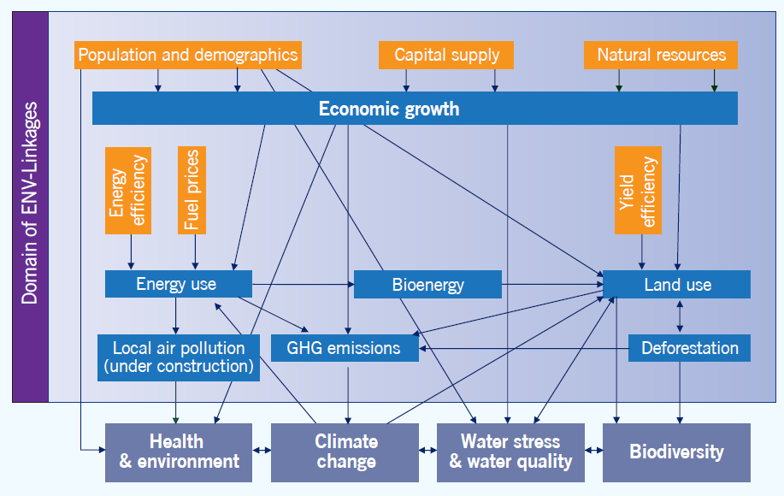
EXAMPLE
The ENV-Linkages model is a multi-sectoral and multi-regional dynamic CGE model, based on microeconomic foundations.
It is used to generate the results for the OECD Environment Outlook to 2050.
It uses the Global Trade Analysis Project (GTAP) as data input.
Source: OECD, 2012.
Notes:
The OECD model is a multi-sectoral and multi-regional dynamic CGE model, based on microeconomic foundations. ENV-Linkages is the successor to the OECD GREEN model, and is used to generate the results for the OECD Environment Outlook to 2050 (OECD, 2012), which examines likely future economic, environmental and social developments up to 2050, given the current state of policy. In the context of response measures, the greater disaggregation is useful for analysing existing policies that are sector-specific. For example, the model can be used to simulate sector-, region- and pollutant-specific taxes. It is also useful for looking at policies of emission permit trading.
Source: OECD, 2012: OECD Environmental Outlook to 2050: The Consequences of Inaction. Paris.

Slide 29
QUANTITATIVE MODEL: System Dynamics
Integrated quantitative approach (causal descriptive) utilized to understand situations for complex issues.
Methodology that allows the integration of social, economic and environmental indicators.
The pillars are feedback, delays and non-linearity.
Models can be top-down or bottom-up.
Source: Bassi, 2015
Notes:
System Dynamics (SD) is an integrated quantitative (modelling) approach (causal descriptive) utilized to understand situations for complex issues. SD is a flexible methodology that allows the integration of social, economic and environmental indicators in a single framework of analysis.
SD models are based on the assumption that structure drives behaviour and use causal relationships to link variables.
The pillars of SD models are feedback, delays and non-linearity. Models can be customized to analyse the socioeconomic implications of actions across sectors (social, economic and environmental) and actors, such as households, the private sector and the government, within and across countries.
SD models can be top-down or bottom-up, general or partial equilibrium.
The image shows the underlying structure of the Green Economy Model (GEM), which captures built, human, social and natural capital.
Source: Bassi, A.M., 2015: Moving towards integrated policy formulation and evaluation: the Green Economy Model (GEM). Environmental and Climate Technologies, Volume 16, Issue 1.

Slide 30
СПАСИБО ЗА ВНИМАНИЕ!
КОНТАКТЫ
+7777 0 333 264
kobzev@dku.kz

